Slide 1
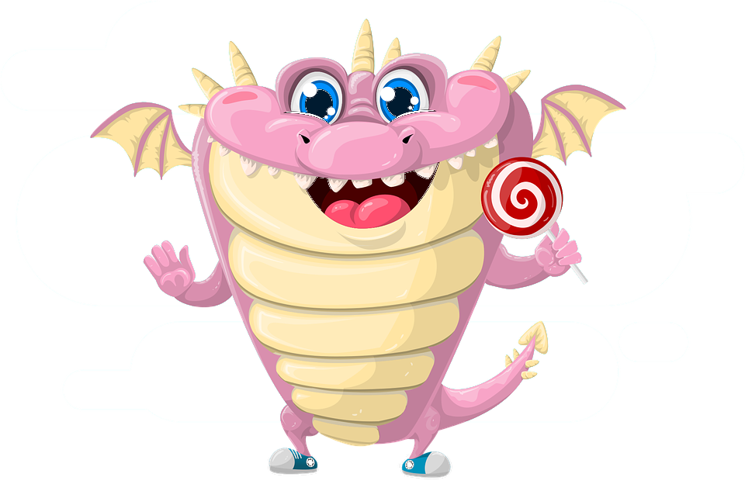
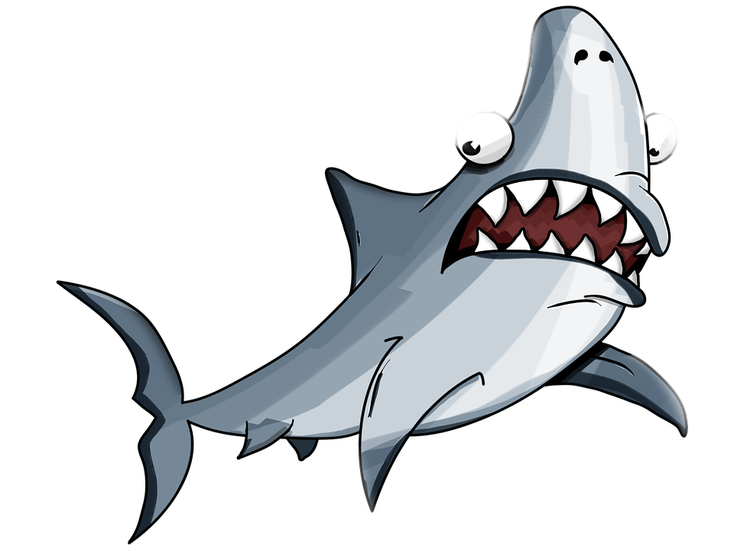
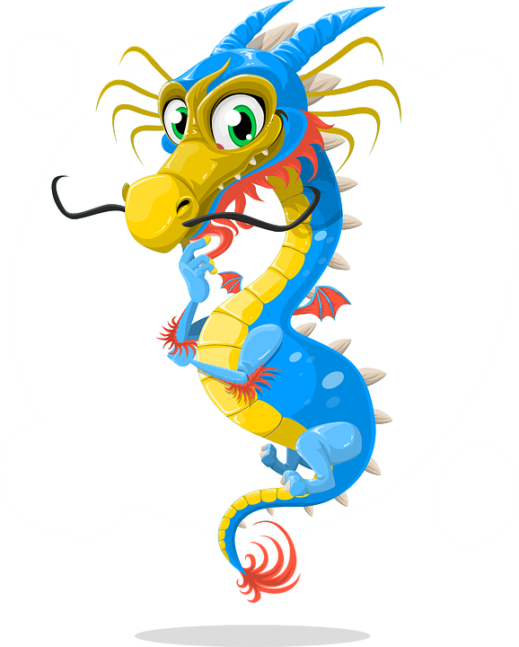
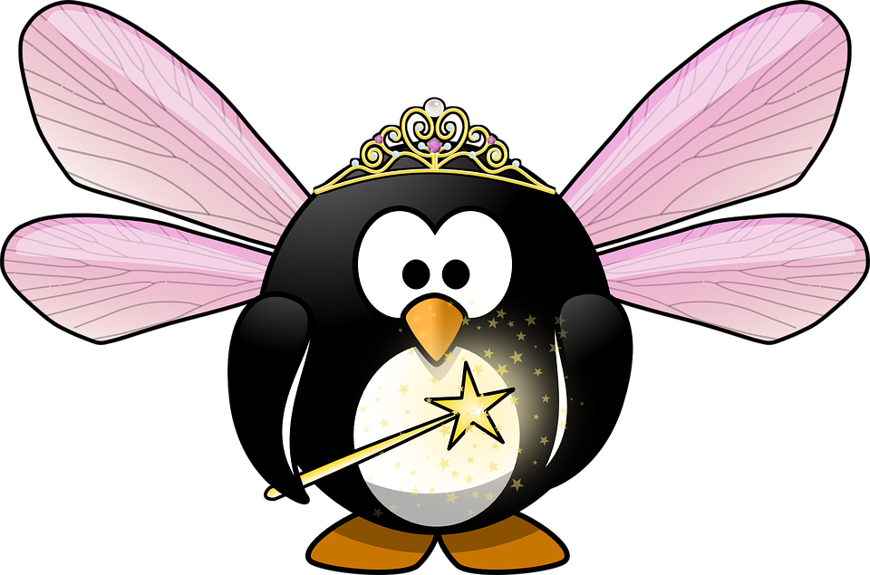
Dragons, Sharks, Unicorns and Elves
Stories of Crisis Exercises

Slide 2
Dragons, Sharks, Unicorns and Elves; Stories of Crisis Exercises

Slide 3
What are we talking about?
A cyber incident is an IT incident that disrupts the expected availability of services and/or provokes the unauthorised disclosure, acquisition and/or modification of information.
A cyber crisis is an abnormal and unstable situation in which strategic goals, reputation and reliability are threatened by a disturbance, intentional or unintentional, at the core of the targeted organisation.

Slide 4
Why exercise?
Validating policies, plans, procedures, training, equipment and/or inter-organizational agreements
Testing ICT disaster recovery systems
Clarifying and training personnel in roles and responsibilities
Improving inter-organizational coordination and communications or individual performance
Identifying opportunities for improvement and gaps in resources
Providing a controlled opportunity to practice improvisation

Slide 5
Goals?
Orientation/demonstration
Learning
Cooperation
Experimenting
Testing
Notes:
simulating experience of an expected situation to increase awareness of vulnerabilities and the importance of effective action in response to the simulated conditions;
enhancing knowledge, skills, or abilities by individuals or groups with the goal of mastering specific competencies;
providing an opportunity for people to work together to achieve a common end result;
trying new methods and/or procedures with the intent of refinement; and,
evaluating a method and/or procedure to assess which components are sufficiently developed.

Slide 6
Options?
Exercise forms
Notes:
Desk Check – A desk check is a method used to validate plans and procedures and any changes to them. This is usually conducted in conversation with the author of the plans and procedures.
Tabletop exercise – a tabletop exercise covers all aspects of crisis management. All participants receive the same information in advance about the simulated crisis situation and their role.
Distributed tabletop exercise – A distributed tabletop is a role-play exercise where participants play their usual role in the plans and procedures of a scenario. This exercise is similar in structure to a tabletop exercise, but there is no possibility for discussion.
Command Post Exercise (CPX) 100 – In a CPX (sandbox exercise), a crisis is simulated without the use of emergency services, external environmental factors or players. The crisis teams deal with questions and orders in a realistic and evolving scenario.
Red Team/Blue Team - In a Red Team/Blue Team exercise, the red team attacks the network or another important business service and the blue team tries to foil the attempt.

Slide 7
CLAW2018
Crisis for NREns
Charlie van Genuchten (SURFnet)
Notes:
Talk a bit about OZON/NOZON/CLAW

Slide 8
Welcome to Guilder
A beautiful, fictional country in Europe
Imagine that you are part of the crisis management team for the NREN of Guilder (GuilREN)
With this crisis management team, you are responsible for coordinating a crisis, if one occurs

Slide 9
Countrywide test
It’s an important day in Guilder with the same standardized test on English language skills taking place all over the country.
In total, 200.000 students are supposed to take this test today between 11.00 and 13.00.
This is the first time that this standardized test will be taken countrywide by all students.
It has been a controversial issue to have this test, so there is a lot of publicity already surrounding this test.
Notes:
This is the first time that this standardised test will be taken countrywide by all students.
It has been a controversial issue to have this test, but the Minister of Education pushed it through to make sure all students in Guilder are up to standard on their English language skills. There is a lot of publicity already surrounding this test, with news crews posting outside the biggest universities to get quotes from students if they think this test is necessary. A failing grade for the test will impact the possibility to be admitted into the more prestigious Master programs.

Slide 10
There’s a problem
About half of the students have started taking the test, however the other half has not been able to start because of a connectivity issue
The tests are being made on ipads/portable devices/desktops and they can’t load the tests at some locations.
We are coming up to the one hour mark (almost 12) and students will want to leave the exam room.

Slide 11
It’s becoming a crisis
However, as there are students that have not yet started the test and still have their phones etc. the people that have taken the test cannot leave the exam rooms, as there is the possibility of the exam questions and answers leaking.
So there are 100.000 students countrywide that can’t leave the exam rooms until it is clear that everyone has started the test and another 100.000 students waiting to take the exam getting more and more irritable about having to wait.

Slide 12
What would you do?

Slide 13
Observations exercise
Some great team work
Stress!
Focusing on the technical issue
Overruling communication
No triage of incoming information
A lot of creativity

Slide 14
CLAW 2018
Exercise
Training on stress management in teams
Lightning talks
Train the trainer: how to organize your own exercise?
Training on the basics of crisis management

Slide 15
2019
CLAW 2019: November 6 and 7 in Poznan at PSNC: https://eventr.geant.org/events/3087
Do It Yourself Exercise Pallooza

