Slide 1
UNICANE Cyberexercise: searching for the Unicorn
Jordi Guijarro & Maria Isabel Gandía
CSUC/CATNIX (@CSUC_info)
TNC19
Tallinn, 19-6-2019

Slide 2
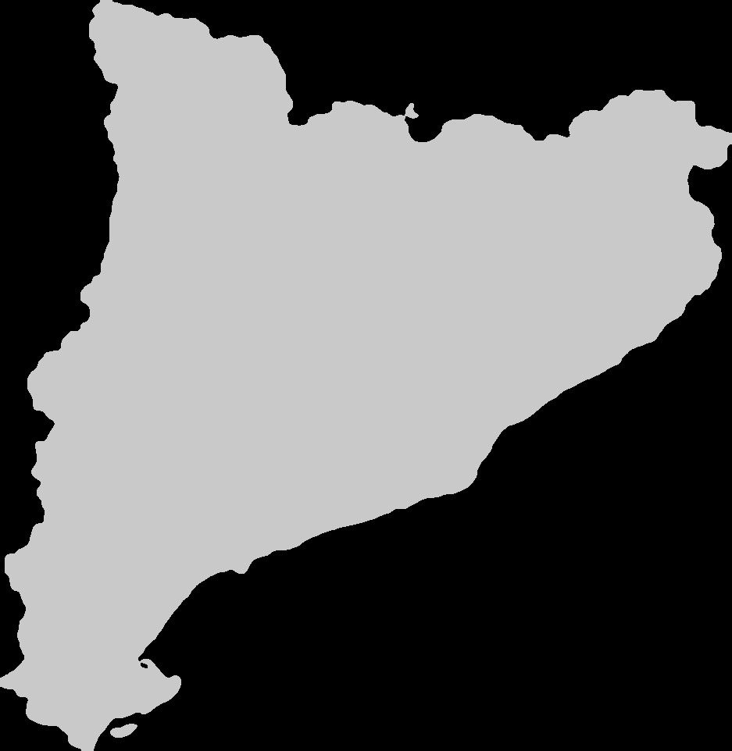
What Is CSUC?
CSUC is a Consortium of 10 Universities and the Catalan Government.
“Collaborating and Sharing to Improve the University System“

Slide 3
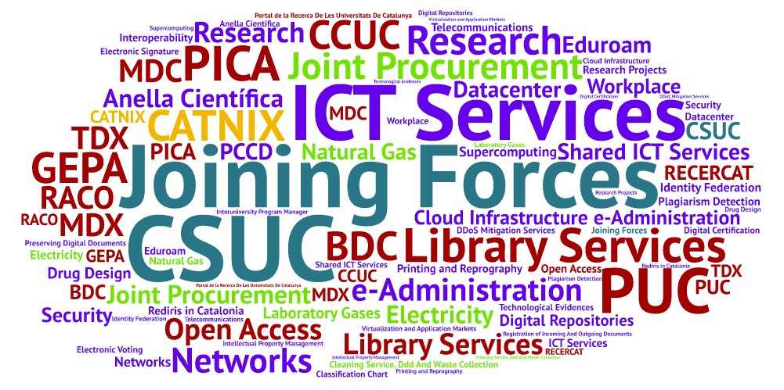
CSUC: What Do We Do?

Slide 5
Anella Científica: Regional Networks in Spain & Year of Creation
2005
1993
RREN in Catalonia
2006
1993
2003
1996
2008
1989
2004
Notes:
Manca any de creació RedCAnaria

Slide 6
Anella Científica: Regional Networks in Spain & Year of Creation
2005
1993
RREN in Catalonia
2006
1993
2003
1996
2008
1989
2004
Notes:
Manca any de creació RedCAnaria

Slide 7
Any Crisis Can Begin Like This
You are quietly working on a GDPR document while your colleagues are having lunch.
Suddenly, when you didn’t even have time to log in into the network equipment…
The race against the clock starts!!

Slide 8
Experiencing a (Short) “Mini-Crisis”
It all began at 13:00 on the 13th December.
It affected Anella Científica.
The network was sloooooooooow.
In 45 minutes we received:
58 phone calls.
300 alerts about packet loss or down circuits to Anella Científica institutions.
7 e-mails from users.
1 tweet
We checked around 400 graphs.
It was a DDoS attack. It lasted for 3 hours and was directed to 2 IP addresses (45 min affecting the network).

Slide 9
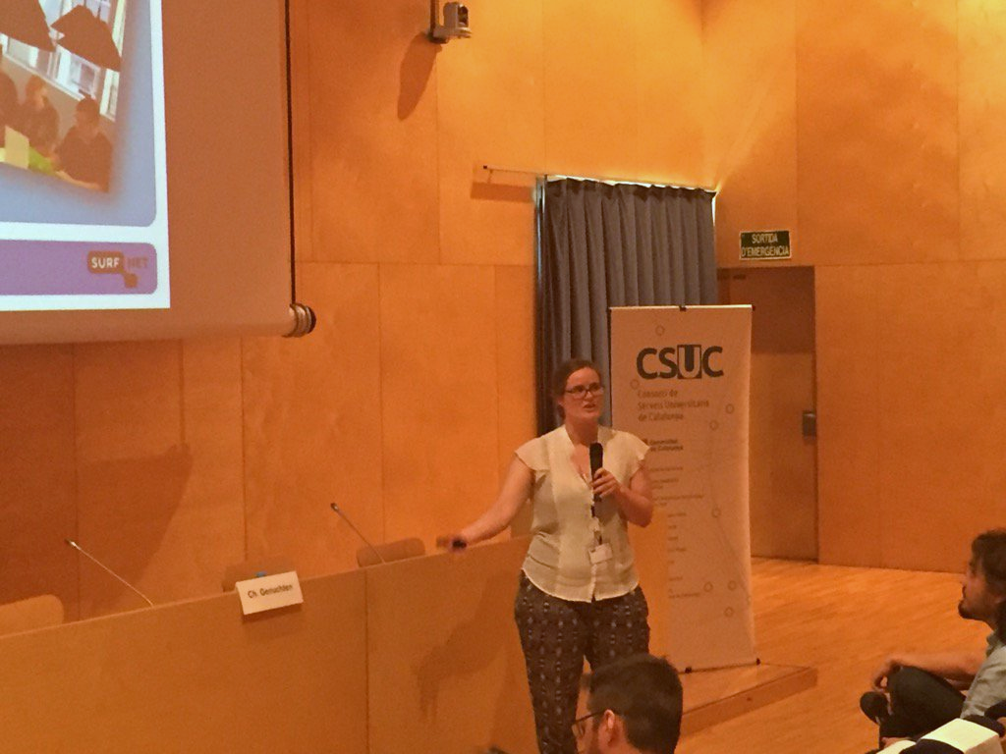
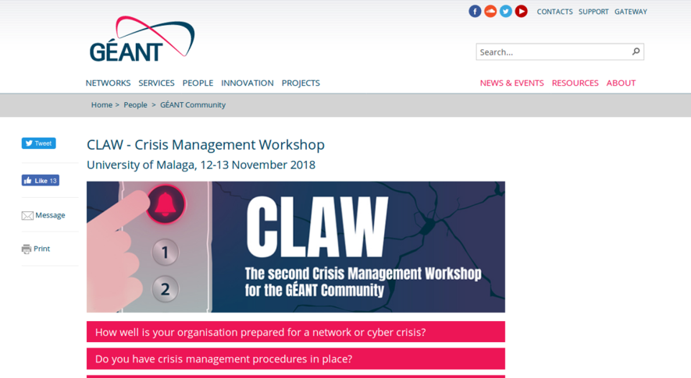
Why Did We Organize a Crisis Day?
SURFnet: OZON
Presentation in 2017 for Anella Científica (TAC).
The Universities asked us to organize one.
Géant: CLAW Crisis Management Exercise.
CSUC participated in the “CLAW” 2017 and 2018.

Slide 10
Organizing a Crisis Management Exercise
Organizing an Exercise like Ozon was expensive for us.
But, hey! We like doing things in a collaborative manner!
The Security Group from the universities worked on it.
We based our case in the CLAW, but for a hypothetical university in Poland: The University of the Pyrenees (yes, we know it’s not there).
Our team recorded audios and videos simulating we were members of the university team, the journalists, the Government…

Slide 11
Crackovia News Journalist
Our Promotion Expert
The Dean
Our Webmaster
The Governement
Our CEO
CSUP-CSIRT
Our Cybersecurity Leader
Polodiario Journalist
Our Promotion Manager
UPIRINEUS NOC
Our NOC Expert Leader
Presidentship Office
Our e-Administration Manager
Presidentship Office
Our Finance Manager
CSUP NOC
Our NOC Manager

Slide 12
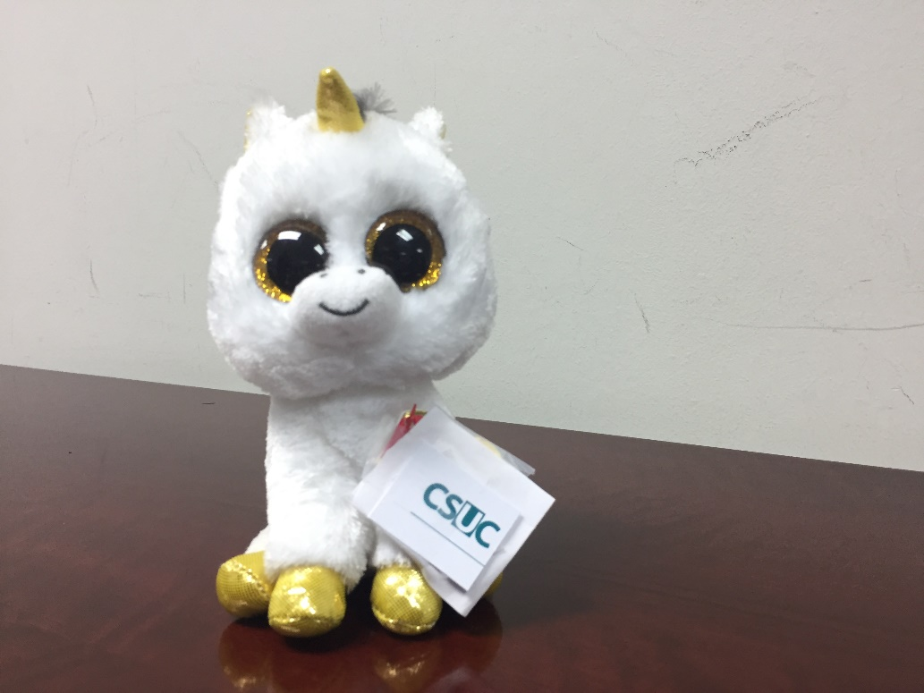
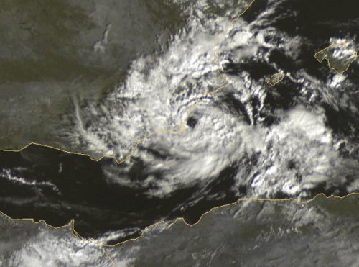
We Called it UNICANE
Unicane, like a University Hurricane…or was it Unicorn Hurricane?
More than 40 participants from the Universities.
Experts from different fields:
Network
IT Management
Communication
IT Security
…and some unicorns!

Slide 13
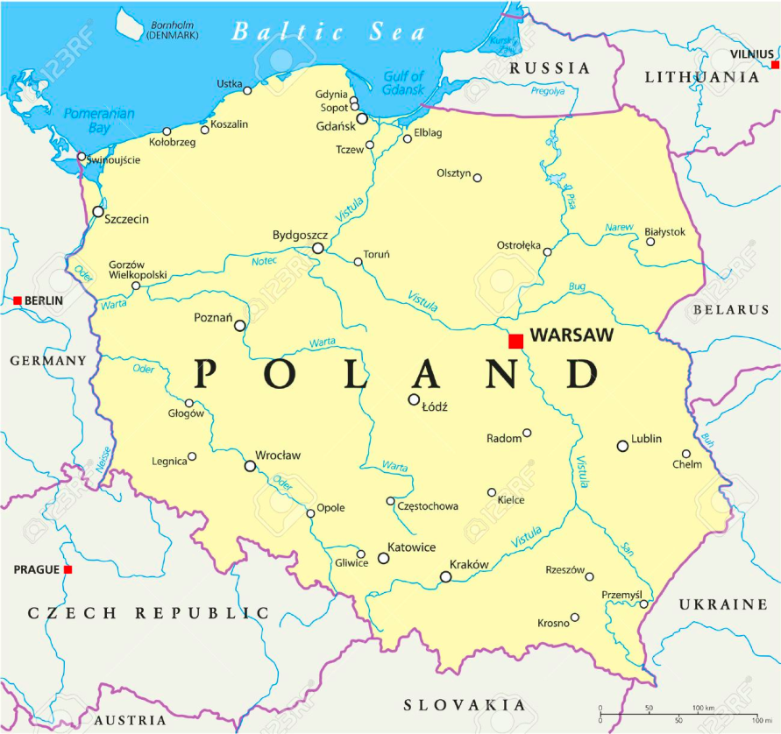
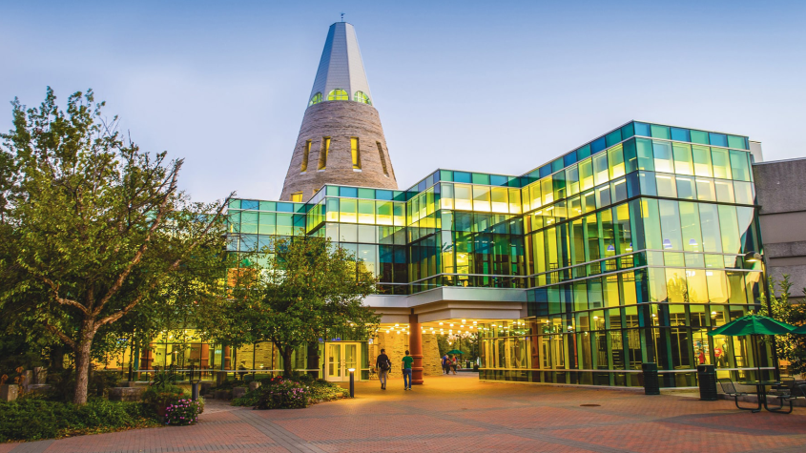
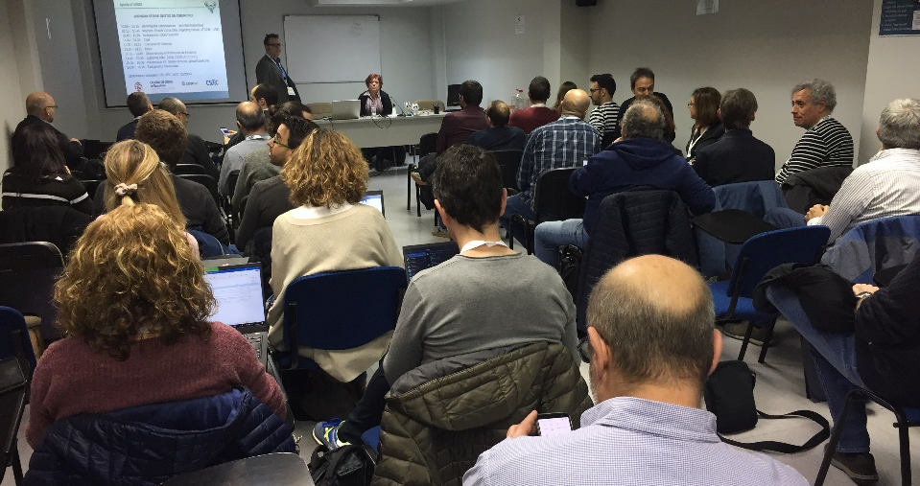
The Case I
The University of the Pyrenees

Slide 14
The Case II

Slide 15
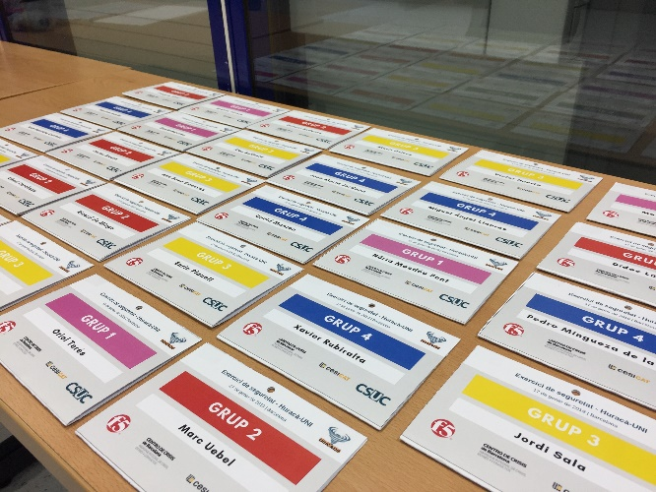
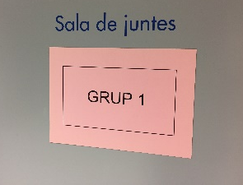
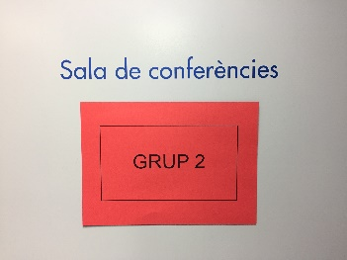
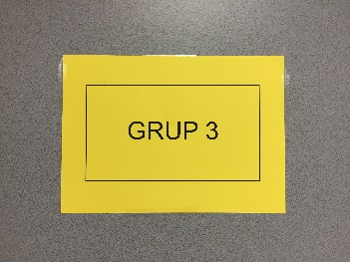
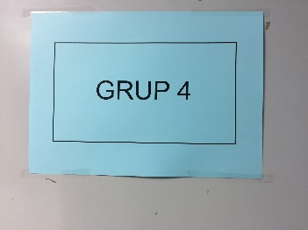
UNICANE
The participants were distributed in 4 groups
Distributed in 4 “War rooms”.
7 roles were distributed:
Crisis Coordinator.
IT Director (CTO)
Security Manager
Communication Expert
Secretary
Network Manager
Public Relations
Other participants from the Universities acted as observers.
Four CSUC members acted as leaders.
And the exercise began…

Slide 16
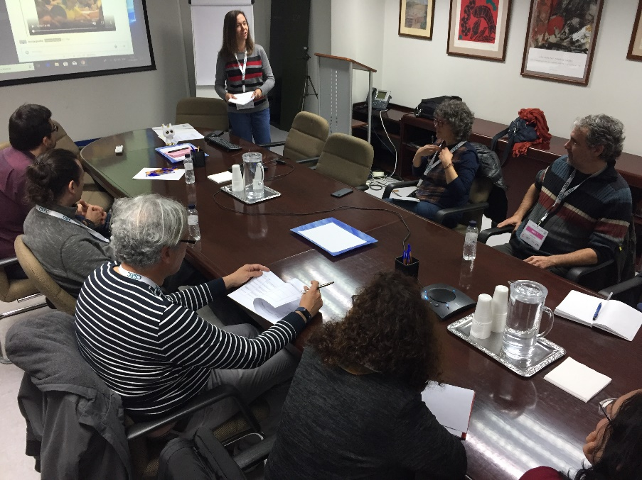
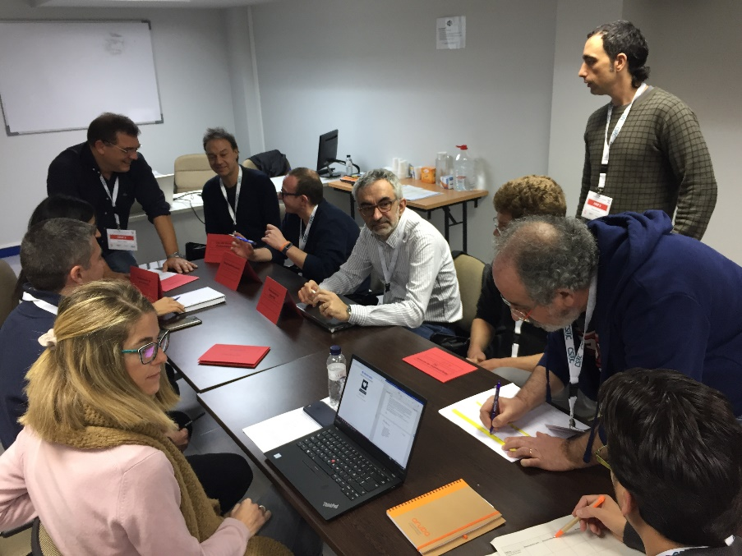
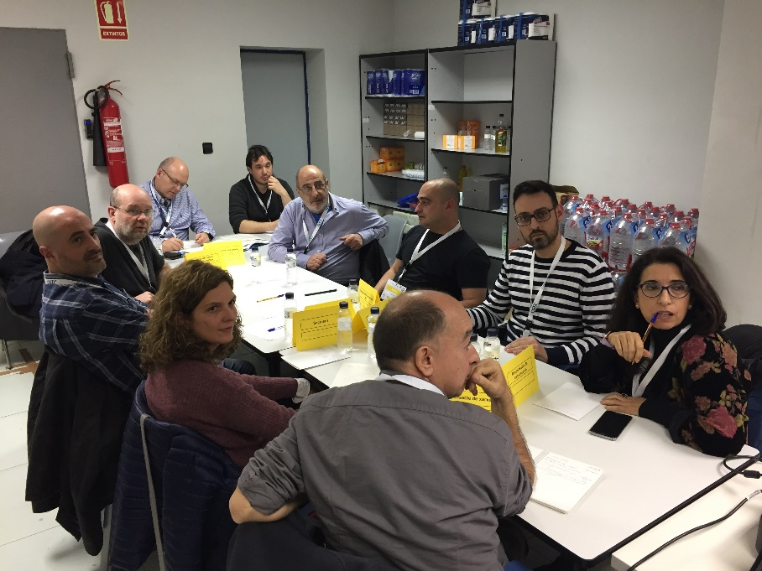
Crisis Management Team from the University of the Pyrenees

Slide 17
Role Assignment

Slide 18
Role Assignment

Slide 19
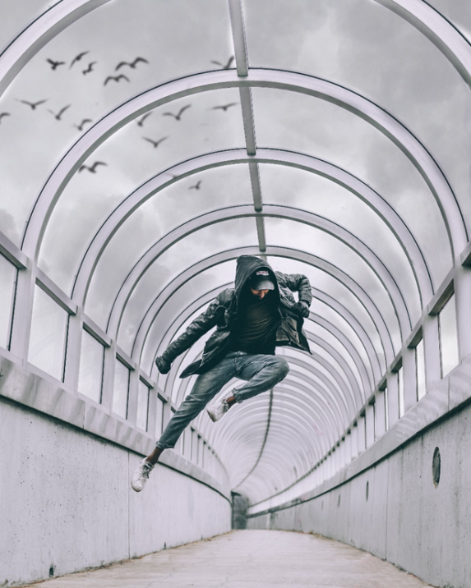
Role Assignment…and Hierarchy

Slide 20
Reading the Case

Slide 21
Searching for Alternatives

Slide 22
Searching for Alternatives

Slide 23
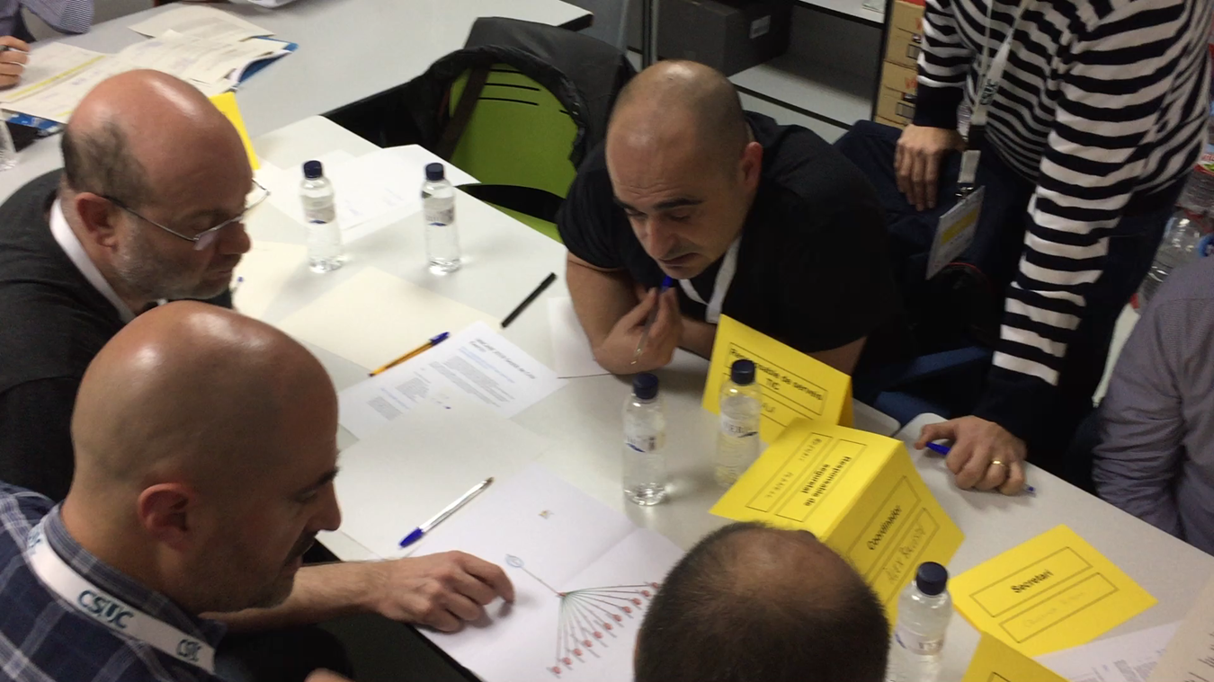
Interpreting Clues

Slide 24
Interpreting Clues

Slide 25
Channels and Timeline
Multimedia content previously uploaded to a Rocket channel.
The leaders had a parallel channel and the same guidelines.
We introduced information “capsules” simultaneously.
The information was slowly flooding:
12:05: CSUP monitoring systems showed an increase on the traffic
12:07: Call from the Dean.
12:10: We access a weathermap from the university and another one from CSUP.

Slide 26
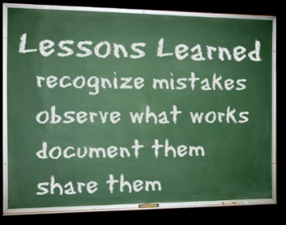
Lessons Learned, from Crisis
Having a Crisis Management Plan is a must! You can improve it later (continuous improvement).
Roles
Communication flows
Processes
Regarding coordination:
Even if the technical teams were exchanging information and working together, we must involve the Marcomms team. The image of the University is important!
The telephone calls must be redirected to someone who can attend them while the technicians try to solve the incident.
On the communication side:
Social networks are every day more relevant.
The Marcomms team can not answer them without double checking with the technical team first.

Slide 27
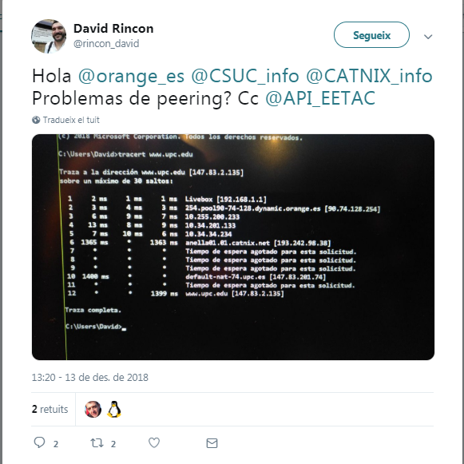
For Instance…
13:20: A user tweets…
Hi @***, @***, @***. Peering problems?

Slide 28
For Instance…
13:45: We answer the tweet: we are taking care of it.
As you see, there is a problem @**. We are working to solve it. We will inform once it’s solved.

Slide 29
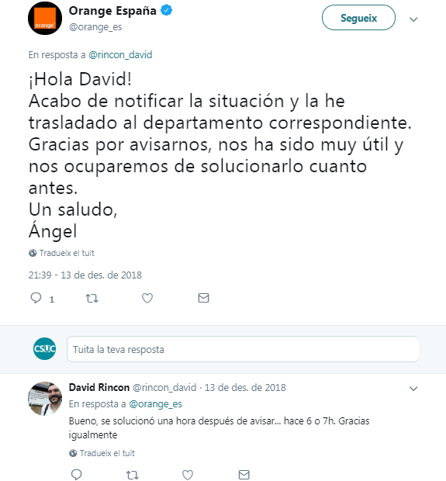
For Instance…
Transit provider’s twitter account
Hi user!
I just notified your situation to the corresponding department. Thanks for contacting us, it was very useful and we will make sure it’s solved as soon as possible.
Regards,
Provider
Well, it was solved an hour after I sent it, like 6 or 7 hours ago. Thanks anyway

Slide 30
Lessons Learned, from the Exercise
All the teams found a creative solution, even if it was not perfect.
The feedback was very positive.
The Communication teams were the happiest!
Interest in future editions.
For the next ones:
Interaction among teams during the exercise.
Share feedback among groups at the end.
Bring more participants from each university.
The Human Network, number one security tool!

Slide 31
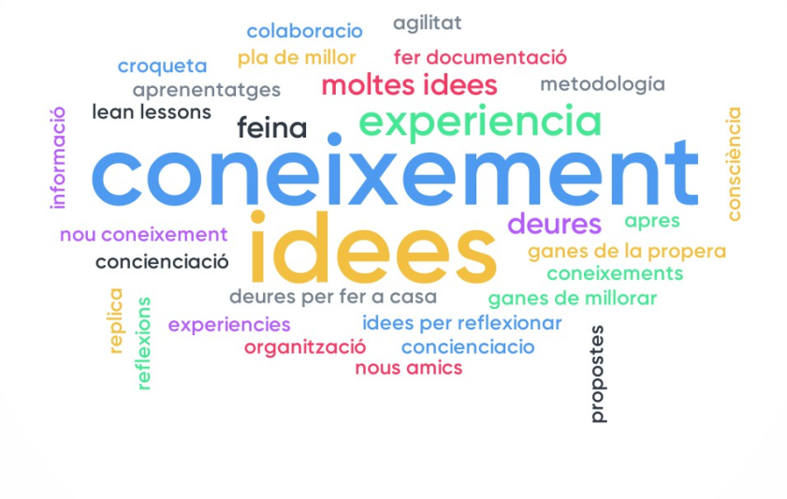
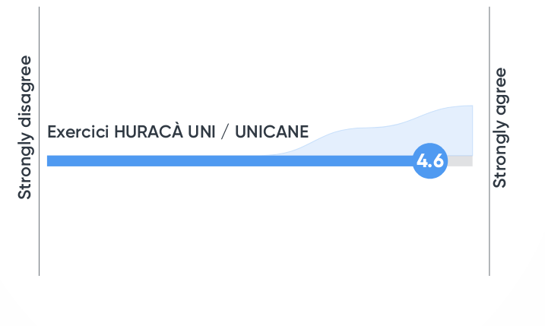
Expectations and Milestones
Before beginning, they wanted to learn
The takeaways were knowledge and ideas
Was the Exercise Useful?

Slide 32
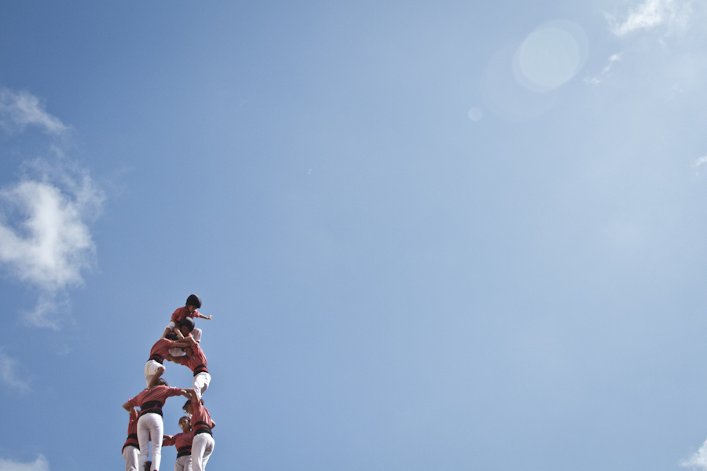
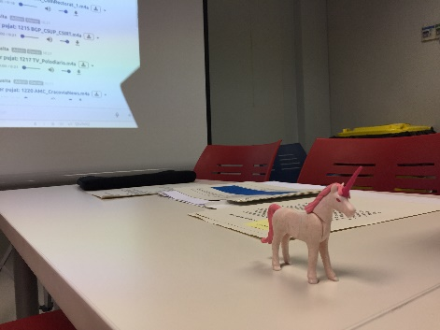
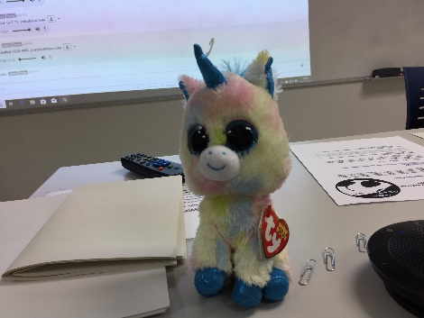
Q&A
Thanks!
@csuc_info
Did you find the unicorns?

