Slide 1
CAE-1: A Next Step in Securing Sustainable Intercontinental R&E Bandwidth in the GREN
TNC19 – Tallinn, Estonia – 19 June 2019
Mary Fleming (AARNet)
Erik-Jan Bos (NORDUnet)

Slide 2
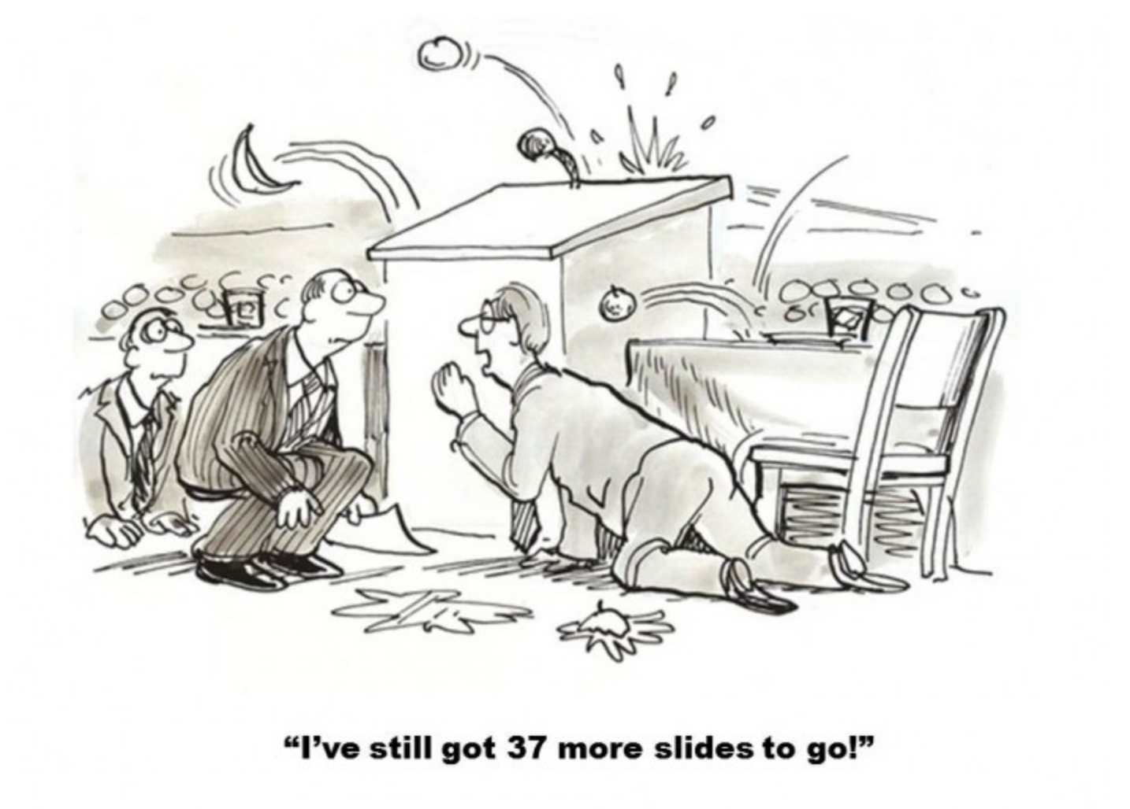
Outline
Introduction
What is CAE-1?
CAE-1 in the GREN
Why CAE-1?
How did we do CAE-1?
Process
Lessons learned
Q & A

Slide 3
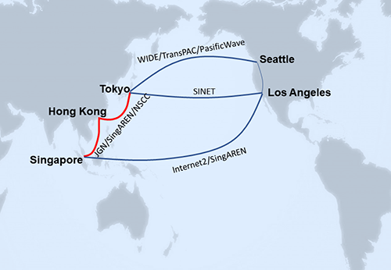
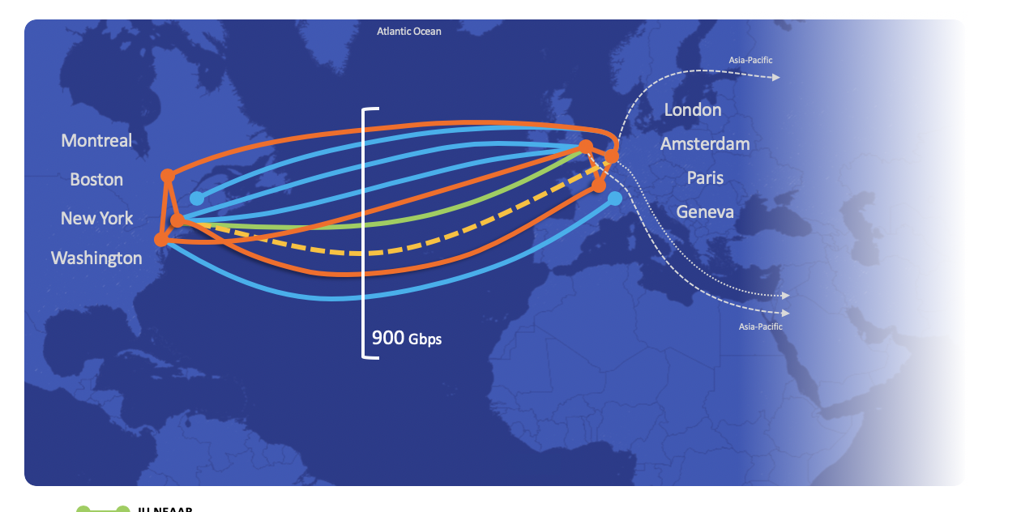
CAE-1? (1/2)
Europe – Asia R&E bandwidth:
A few bilateral links at <=10 Gbit/s
No sustainable system like ANA or APR
Global R&E Network – GREN
Using GNA Design Principles

Slide 4
CAE-1? (2/2)
Dropping bandwidth prices between Europe and Asia
Coherent 100G upgrades finalizing
True start of (some) competition, but just two subsea cable system capable
At APAN45 in Singapore (March 2018):
A few like-minded NRENs from Europe and Asiapacific flocked together
At TNC18 in Trondheim (June 2018):
Six NRENs: Let’s try to do this!
Aim: Jointly buy 100G between Europe and Asia

Slide 5
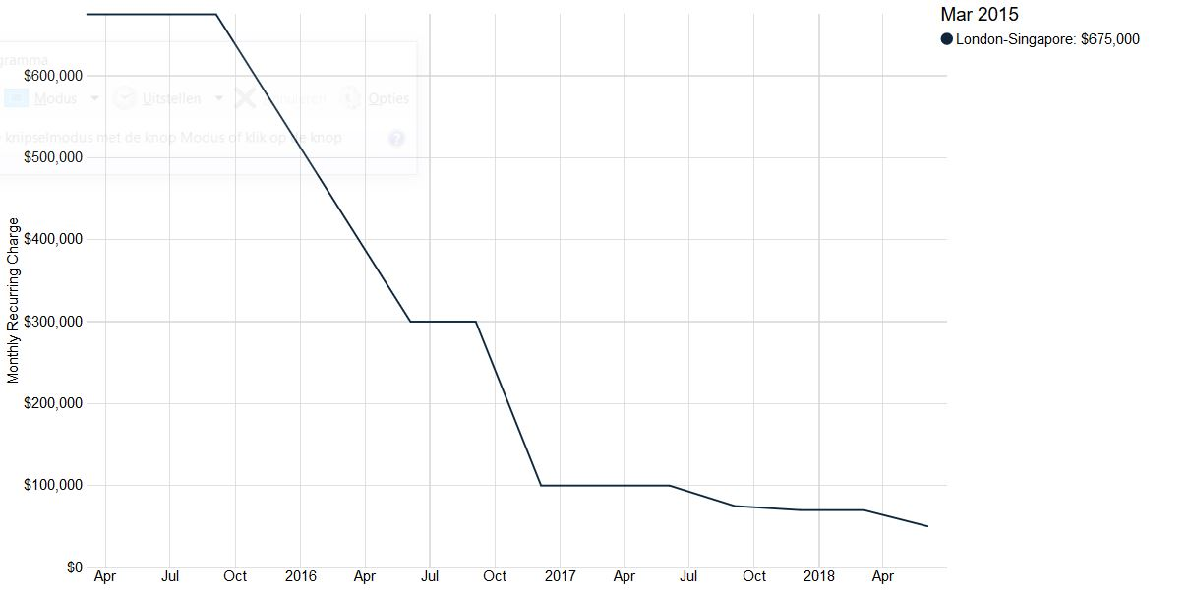
A Word on Cost
Current market indications for a 100G London – Singapore:
Average MRC Q4 2015: 675 kUSD
Average MRC Q4 2016: 160 kUSD
Average MRC Q4 2017: 74 kUSD
Average MRC Q2 2018: 66 kUSD
Source: TeleGeography

Slide 6
Collaboration Asiapacific Europe #1 (CAE-1)
One European Procurement Process:
With six parties jointly desiring to buy
11 time zones
6 jurisdictions
6+ Languages (Korean, Singaporean, Danish, Dutch, English, Australian)
With nine parties on the selling side
Roles:
GÉANT fronting the procurement
AARNet, as a licensed carrier, being the contacting party towards provider
NORDUnet as project coordinator
All participating

Slide 7
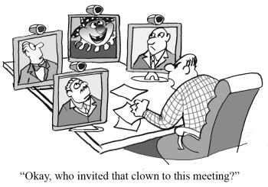
Collaboration Asiapacific Europe #1 (CAE-1)
Consensus on Technical Set-up
Consortium Agreement & Back 2 Back agreement
All done after ±35 VCs

Slide 8
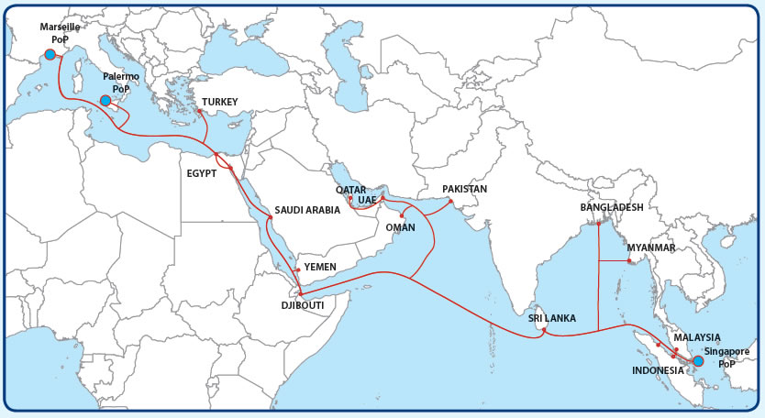

Slide 9
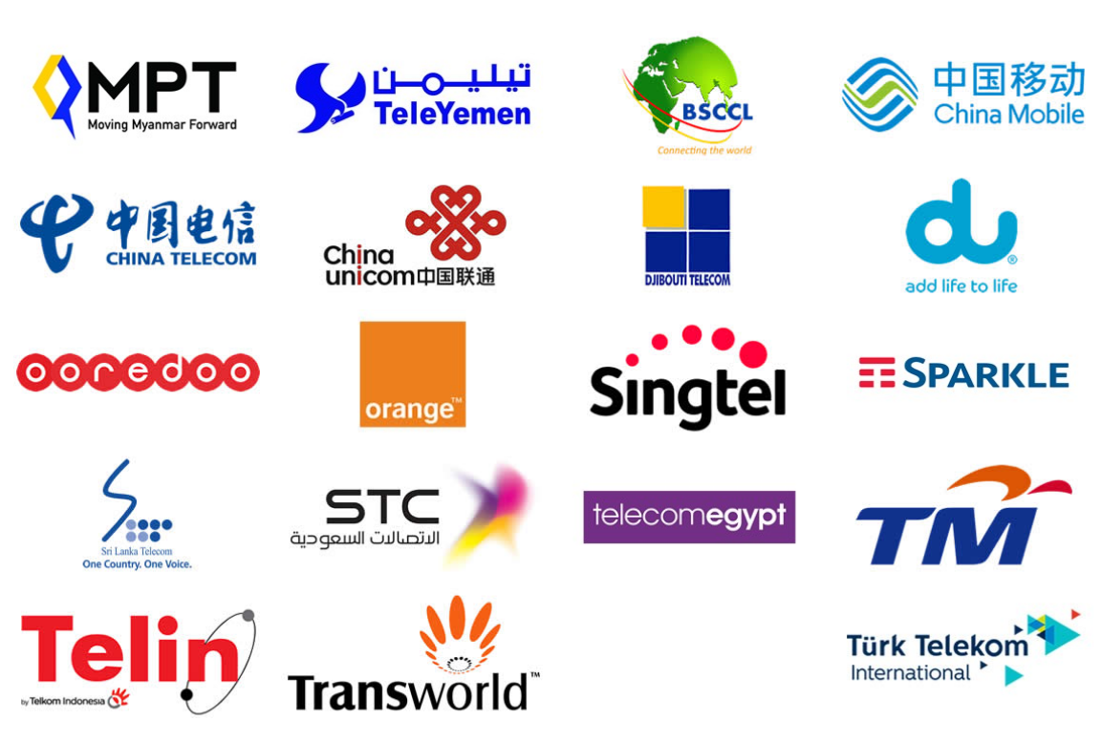
SEA-ME-WE-5 Facts
On RfS Date (13 December 2016):
Length of cable: 20,000 km
Number of fiber pairs: 3
Day 1 Technology: 100 Gbit/s
Day 1 Design capacity: 8 Tbit/s per fiber pair
18 CLSs
19 Consortium Members
Source: www.seamewe5.com

Slide 10
Result: 100G link on SEA-ME-WE-5 (CAE-1)
London
Singapore

Slide 11
Schematic CAE-1 Design
Local or
Remote
HBX
London
Since 7 June 2019:
GXPs can ping each other
RTT between GXPs: 168.8 ms
R
GXPLon
R
R
L2 switching
1x 100G λ
(resilient)
InterXion
Marseille
CLS
Mar
Local or
Remote
Global Switch
Singapore
Glass through
Tuas
Singapore
R
Layer 3
GXP
Sin
CLS
Sin
R
Layer 2
1x 100G λ on SEA-ME-WE-5
subsea cable system
dark fiber
Layer 1
R
v0.9- 19 Mar 2019 - EJB

Slide 12
The Process
Indigo
&
JGA
Sharing ideas and experience
Drivers differ for each NREN
Formed Coalition of the willing and financially able
One party to face Supplier
Ambitious tender for spectrum - long term IRU
Born out of the GNA
Towards a sustainable GREN
Short term leasing V
Long term ownership
economics
Driving down cost requires wholesale pricing under own terms
Procurement rules not always fit for purpose
Notes:
The ability to come together and share is at the heart of the GNA
Born out of the policy and strategy meetings
Interest in what AARNet had done with Indigo and JGA. The market is changing NRENs may be subject to increased regulatory scrutiny
Formed a loose coalition of the willing and financially able
Drivers were different for each party
Driving down input cost necessitates dealing at the wholesale level
Differing views on short v long term value
Tender issued for spectrum or long term IRU
Procurement rules default to the most rigorous but not always fit for purpose
Need one party to front the deal (several v joint and several)
Draft contract issued with tender

Slide 13
Contract formation (1/2)
GNA / GREN
Collaboration
MoU
AER
APR
ANA
Grants long term IRU >15 years
Passes through the obligations from the Supply Agreement
Allocates the capacity but not divides
Provides coverage for the Contracting NREN in event of default
NII
NICT
GXP
Agreements
Consortium Agreement
CAE -1
B to B Agreements
Provider X
Supply Contract
Version 0.3
Notes:
Supply Agreement/IRU between Supplier and Contracting NREN
Back to Back agreement between Contracting NREN and participating NRENs
Grants long term IRU >15 years
Passes through the obligations from the Supply Agreement
Allocates the capacity but not divides
Provides coverage for the Contracting NREN in event of default
Consortium Agreement governs the relationship of the parties
Fair Use
Breach, default, parties leaving and joining
Stepin rights
Upgrades
Governance, decision making, voting…….
GXP space and power
AER MOU provides mutual backup arrangements

Slide 14
Contract formation (2/2)
GNA / GREN
Collaboration
MoU
AER
APR
ANA
Governs the relationship between the parties
Fair Use
Breach, default, parties leaving and joining
Stepin rights
Upgrades
Governance, decision making, voting…….
GXP space and power
NII
NICT
GXP
Agreements
Consortium Agreement
CAE -1
B to B Agreements
Provider X
Supply Contract
Version 0.3
Notes:
Supply Agreement/IRU between Supplier and Contracting NREN
Back to Back agreement between Contracting NREN and participating NRENs
Grants long term IRU >15 years
Passes through the obligations from the Supply Agreement
Allocates the capacity but not divides
Provides coverage for the Contracting NREN in event of default
Consortium Agreement governs the relationship of the parties
Fair Use
Breach, default, parties leaving and joining
Stepin rights
Upgrades
Governance, decision making, voting…….
GXP space and power
AER MOU provides mutual backup arrangements

Slide 15
Lessons for the future
NRENs differ
More that unites us than divides
Come together in a structured manner from the beginning
Agreements are for the long term. Circumstances and people change over time
Use standard legal framework
Trust but verify!
Multimillion dollar agreements don’t rest on a handshake
Notes:
NRENs differ have different structures, funding, experience, timing, governance, legal jurisdiction, regulatory and compliance………..
Standard forms of agreement (IRU, UJV)
Use standard clause constructs, liability
Use standard terminology
Choose common legal jurisdiction, arbitration……

Slide 16
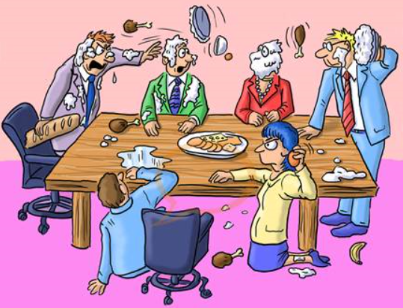
Drivers are the same in the commercial world
Telcos have formed Consortia for decades
What is different here?
Funding
Ability to think and act long term
Experience, commercial, legal
Competing vs. collaborating
Appetite for risk

Slide 17
Summary
The long term ownership economics requires certainty of funding
NRENs - luxury of flexibility
NRENs can enable international projects by VC
Can achieve these outcomes if we join forces and maximise each others strengths and experience
Now for the English lessons……………….
Notes:
Summary
Disproportionate representation among the user community is interesting

Slide 18
Collaboration
Be careful not to over egg the pudding…….
Notes:
English Lessons….
The collaboration: Be careful not to overegg the pudding
The cost: We are not talking sheep stations
The provider: Need to get out the cattle prod
The lawyer: We do not need to teach him to suck eggs
The process: Too much jiggery pokery

Slide 19
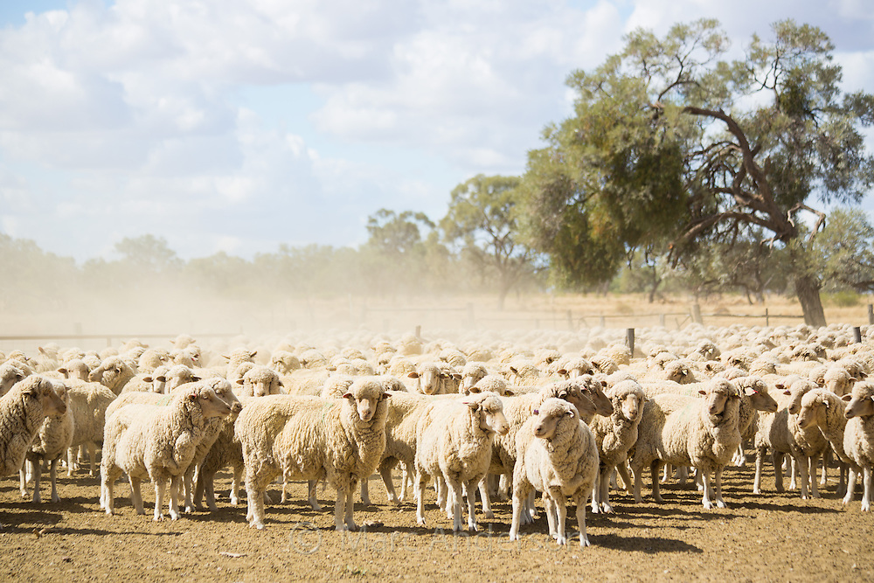
We are not talking sheep stations…..
The Cost

Slide 20
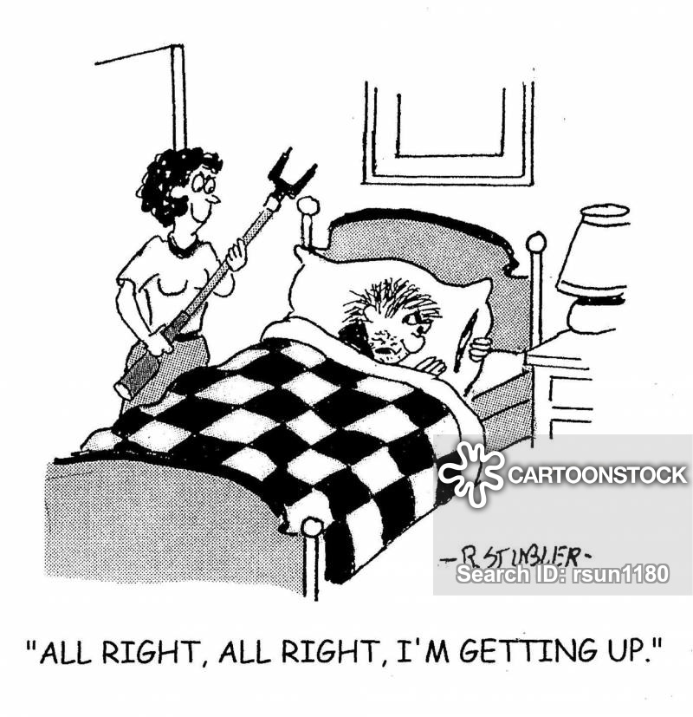
The Provider
Sometimes you need to apply the cattle prod

Slide 21
Don’t teach them to suck eggs…….
Lawyers

Slide 22
The Process
Erik-Jan Bos
Mary Fleming June 2019
Steve MaddocksJune 2019

Slide 23
Thank You! Questions?

