Slide 1
Developments in the South Atlantic
Exploring models for sharing submarine cable capacity
Heidi Morgan - Senior Computer Scientist at Information Science Institute at the University of Southern California (USC USA) Michael Stanton - Network Scientist at Rede Nacional de Ensino e Pesquisa (RNP Brazil) Len Lotz - Executive Officer, Tertiary Education and Research Network (TENET South Africa)
Notes:
[italics in reference to USC]

Slide 2
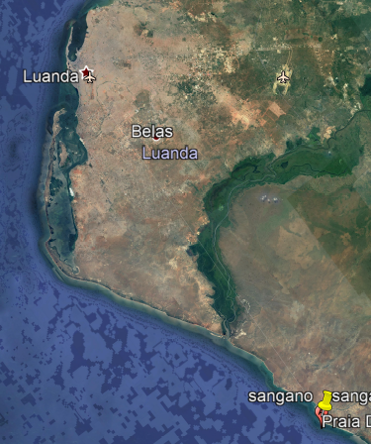
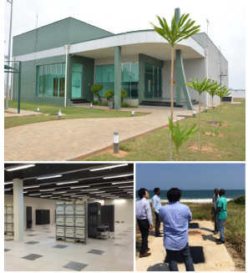
Outline
South Atlantic Cable System (SACS), between Brazil and Angola, is operational and we have acquired capacity for REN network
West African Cable System (WACS), between South Africa and Europe, is operational and connects to SACS in Angola
South America eXchange (SAX), the GXP (GNA eXchange Point) in Fortaleza, Brazil, is ready to connect SACS to AmLight ExP connections
We have the ingredients to create a resilient South Atlantic REN interconnection
60 Miles backhaul
Sangano (Luanda, Angola) is the cable land station built in 2010 to receive the WACS cable
Notes:
Need to define GNA

Slide 3
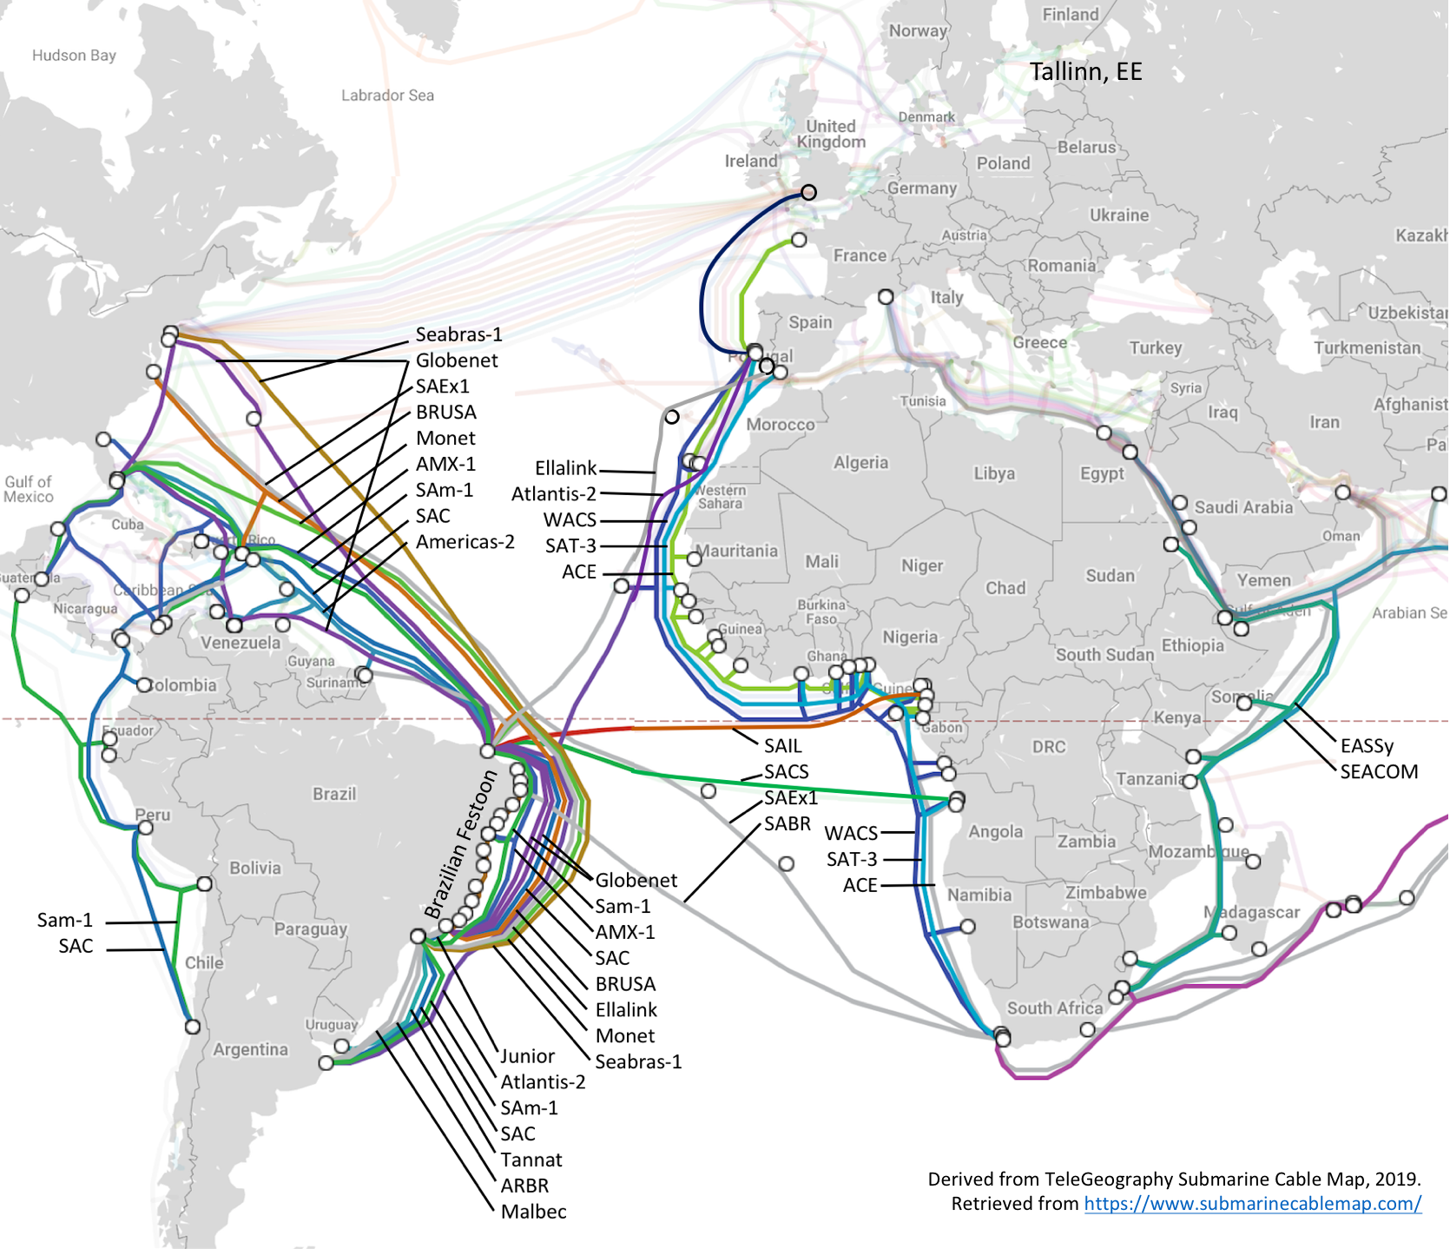
South Atlantic Cables up to 2021
N & S America |  | Africa-Europe
Name | Year | Name | Year
Americas-2 | 2000 | SAT-3/WASC | 2002
SAC | 2000 | SEACOM | 2009
GlobeNet | 2000 | EASSy | 2010
SAm-1 | 2001 | WACS | 2012
AMX-1 | 2014 | ACE | 2012
Monet | 2017
Seabras-1 | 2017
BRUSA | 2018
South America transatlantic
Name | Year
Atlantis-2 | 2000
SACS | 2018
SAIL | 2018
EllaLink | 2020
SABR | 2021
SAEx1 | 2021
South America (internal)
Name | Year | N-S Cable extended
BR Festoon | 1996 | Americas-1/2
Tannat | 2018 | Monet (Google, Antel)
Junior | 2018 | Monet (Google)
Malbec | 2020 | GlobeNet
ARBR | 2021 | Seabras-1
Notes:
3 generations of cables:
Pre-Internet (up to 2000): Americas-2, Atlantis-2
1st generation Internet with 10G DWDM (2000-2012): SAC, Globenet, Sam-1, all African cables. Many later upgraded to 100G
2nd generation Internet (100G): all new cables from 2014
Brazilian Festoon originally built for telephony. Festoon format has permitted easy upgrade to support Internet traffic.

Slide 4
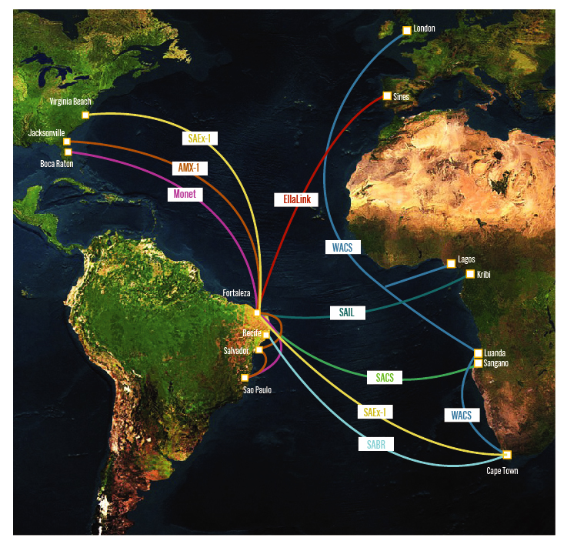
New submarine cables in the South Atlantic
Monet: Boca Raton, FL - Fortaleza, BR. Operational
South Atlantic Cable System (SACS): Fortaleza, BR - Sangano, Angola. Operational
America Movil (AMX-1): Fortaleza, BR - Jacksonville and Hollywood, FL. Operational
SAEx1: Virginia Beach, VA- Cape Town, SA, RFS 2021 Q1
SABR: Cape Town, SA - Recife, BR. RFS 2019
South Atlantic Inter Link (SAIL): Fortaleza, BR - Kribi, Cameroon. RFS 2018
EllaLink: Fortaleza, BR - Sines, Portugal. RFS 2020
Fortaleza is a landing point for all cables, except for SABR
Notes:
The AARCLight Planning project was motivated by new submarine cables in the S. Atlantic
MONET is operational. The AmLight Consortium has multiple GHz waves of spectrum capable of 100G-200Gbps depending on the optical equipment. Capacity can be further increased in the future with new equipment.
SACS has passed the acceptance tests run by NEC and the cable is in production
Fortaleza is geographically located between Sao Paulo and Florida, almost in the middle, and it is a very developed city, with many educational and government initiatives in the field of optical networking.

Slide 5
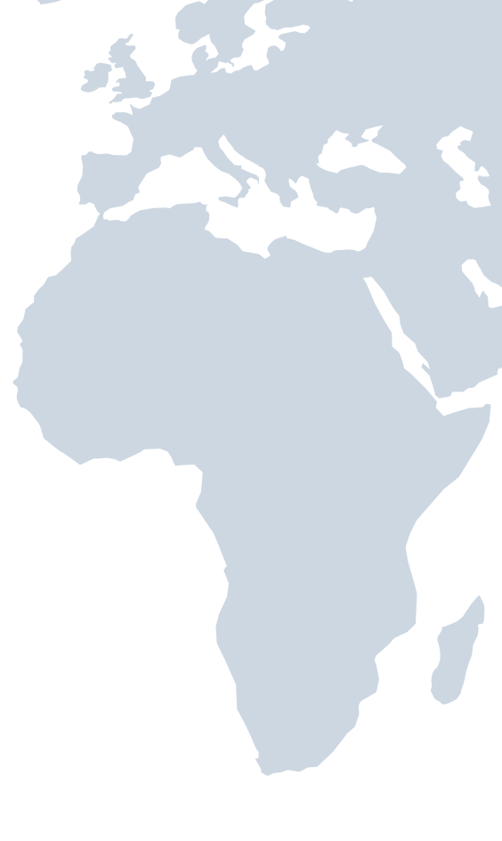
Current REN Infrastructure in the South Atlantic
225GHz of spectrum on Monet committed in AmLight-ExP project
40GHz of spectrum on SACS is available to the R&E community, currently 100G Ethernet. (FIU & Angola Cables MoU in place)
TENET operates capacity on WACS in 100G increments growing to >800G (FIU & TENET MoU in place)
R&E exchange point in Cape Town operated by SANReN and TENET connected to WACS
South America eXchange point (SAX) in Fortaleza, operated by RNP
R&E exchange point in Lagos, operated by WACREN – not on WACS yet

Slide 6
REN Infrastructure in the South Atlantic
SACS and WACS are connected at Sangano Cable Station in Angola, with possibility of being extended to Luanda via AC backhaul
Angola Cables Data Centre (ANGONIX) in Luanda could be significant exchange point to a future Angola REN
SACS creates an opportunity to connect Africa to Brazil and the USA
MONET to Boca Raton
100Gbps
Fortaleza Brazil
WACS
Angola
100Gbps
Angola Cables Back Haul : own duct and cable
Atlantic Ocean
LUANDA Land Station
REN Switch
MONET Land Station
SACS Land Station and Data Center
SACS
100Gbps
SACS
100Gbps
ANGONIX
SANGANO Land Station
MONET to Praia Grande/ São Paulo
100Gbps
WACS
100Gbps
Yzerfonein Cape Town
6

Slide 7
Americas Lightpaths Express and Protect (ExP)
AmLight ExP is a hybrid network that uses Optical spectrum (Express) and Leased capacity (Protect) to build a reliable leading-edge network infrastructure for research and education
Links:
100G ring Miami-Fortaleza, Fortaleza-Sao Paulo, Sao Paulo-Santiago, Santiago-Panama City, Panama City-Miami
10G ring from Miami-Sao Paulo-Miami for protection
10G Miami-Santiago for protection
100G and 10G rings are diverse, operating on multiple submarine cables
Total upstream capacity presently at 230Gbps
(NSF Award# ACI-1451018 2015-2020)
7
Notes:
The AmLight international network topology consists of two rings. The AmLight Express spectrum ring is the primary route to bring large astronomical scientific datasets from Chile to South Florida. Activation is currently in progress. We have accepted the spectrum on Monet from Fortaleza Brazil to Boca Raton Fl. The terrestrial cable has been acquired to connect MI3 where Monet terminates to the AMPATH International Exchange Point at MI1 NAP of the Americas in Miami.
The AmLight protected 100G ring is already in operation and carries multiple types of research and education data. It will be the backup for astronomy data. Recently, a 100G connection between Panama and Miami was completed.

Slide 8
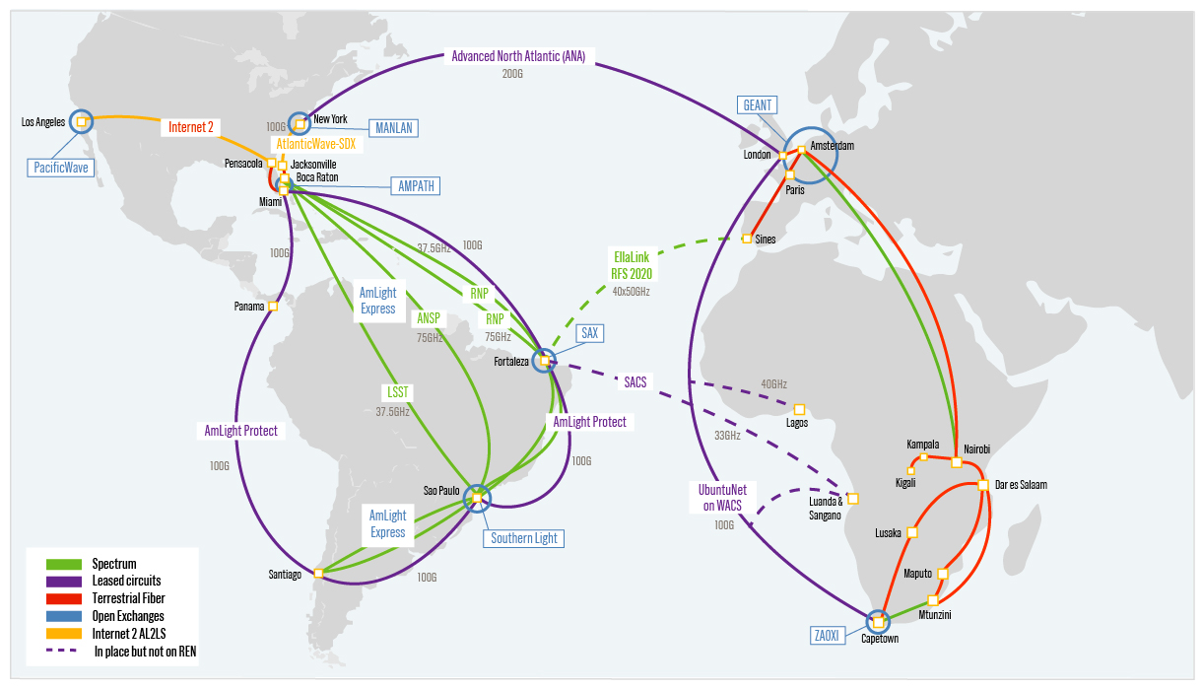
Americas Lightpaths Express and Protect (ExP) (Conceptual)
8
Notes:
This graphic shows the AmLight network and how it interconnects now to Africa through US networks to New York and then on the Advanced North Atlantic or ANA link and GEANT.
The AARCLight Link is shown on the new Angola Cables South Atlantic Cable System connecting Luanda, Angola to Fortaleza, Brazil and AmLight. This link is not yet in service for the research and education network community. Discussion is underway to light the service in early 2019.

Slide 9
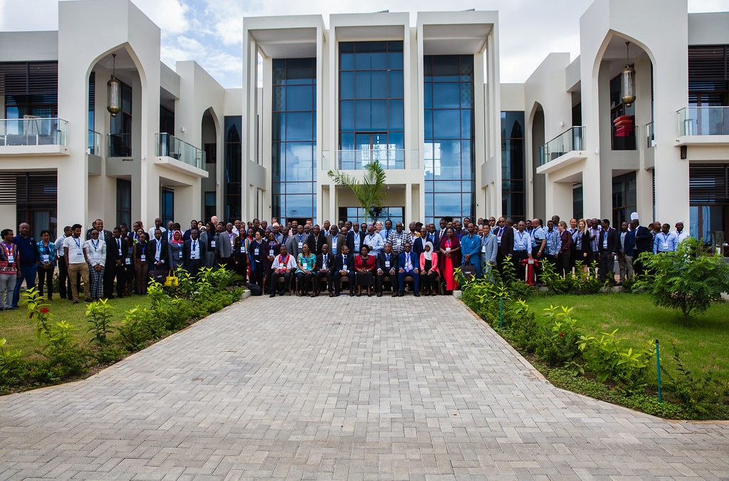
AARCLight planning project
Award #OAC-1638990, at FIU
Purpose - define a strategy for research and education network connectivity between the US, Brazil and Africa
Build a partnership between the stakeholders
Seek long-term spectrum on a trans South Atlantic cable – sufficient for 100G connection
Identify potential users
Define and articulate the interconnection and switching infrastructures at the relevant intermediate exchange points
Develop a plan to integrate science users with the network strategy
UbuntuNet Connect 2018, 22-23 November 2018 in Zanzibar, Tanzania: https://ubuntunet.net/category/events/ubuntunet-connect/
9
Notes:
Activities Completed:
Over the last 2 years the AARCLight team has been working with a number of you to establish collaborative partnerships
The contract with Angola Cables for spectrum is done. We have access to 100 GB to be lit and managed by the collaboration
This is work that is underway especially with Brazil and South Africa
We preformed a science research study last December and have shared those results with many of you in the ARRCLight Annual report.
Established collaborative partners
Established a contract with Angola Cable for Spectrum
Developed a network design in coordination with partners in Brazil, Africa and the US
Developed a plan to integrate the science disciplines with the network strategy
Developed a community engagement plan
Prepared a case study to present to the communities of interest and National Science Foundation (NSF)
NREN operators survey: https://fiu.qualtrics.com/jfe/form/SV_1CcwpFrr72r5ZC5
African REN Challenges: High Internet cost, Competition with Commercial ISP, Economic affordability, Government Support, Start up resources, Geolocation, Recruiting qualified personnel
Benefits to researchers from the USA, Brazil and Africa from the AARCLight project: Faster data exchange, Increased collaboration, More bandwidth, Redundancy to the network data exchange over the Atlantic

Slide 10
The SA NREN = TENET & SANReN
TENET
Created in 2000 as a non-profit company. Membership is primarily universities (all 26) and research institutions, but serves a much wider constituency
Funded through cost recovery from beneficiaries
Operates network deployed by SANReN, but also deploys some network components
Delivers services
SANReN
Created in 2006 as a business unit in the Council for Scientific and Industrial Research
Funded through a State grant (Department of Science and Technology)
Designs, acquires and implements networks and network components, from metro to international level
Develops and incubates services
10

Slide 11
SA NREN
SA NREN (TENET and SANReN) operates an exchange point in Cape Town – ZAOXI.
SA NREN has ownership of 7.4% of the WACS cable allowing it to light capacity between any 2 landing stations between Cape Town and London.
AARCLight and AmLight are forming a collaborative partnership with SA NREN.
UbuntuNet will participate in this project by connecting to ZAOXI.
Once an exchange point is established in Luanda, SA NREN can light capacity between ZAOXI and the new exchange point using WACS
Collaborative partners can utilize capacity as needed on the SACS cable, WACS cable, AARCLight etc. to connect to AmLight in Fortaleza, ZAOXI in Cape Town or any other connected Exchange point
SA NREN’s WACS connectivity may be extended to reach other landing stations to add new collaborative partners to the project.
11
Notes:
SA NREN, formed by TENET and SANReN, operates an exchange point in Cape Town
SA NREN has ownership of 7.4% of the WACS cable allowing it to light capacity between any 2 landing stations.
AARCLight and AmLight are forming a collaborative partnership with SA NREN.
*Ubuntunet can participate in this project through its connection in Cape Town.
*Ubuntunet can participate by helping to establish an Exchange Point in Luanda.
*Collaborative partners can utilize capacity as needed on the AARCLight SACS cable capacity, the WACS cable and AmLight via open exchange points in Fortaleza, Cape Town, or any other connected Exchange point
*SA NREN’s WACS connectivity may be extended to reach other landing stations to add new collaborative partners to the project.

Slide 12
SA NREN Connectivity to Angola & London & Amsterdam
12

Slide 13
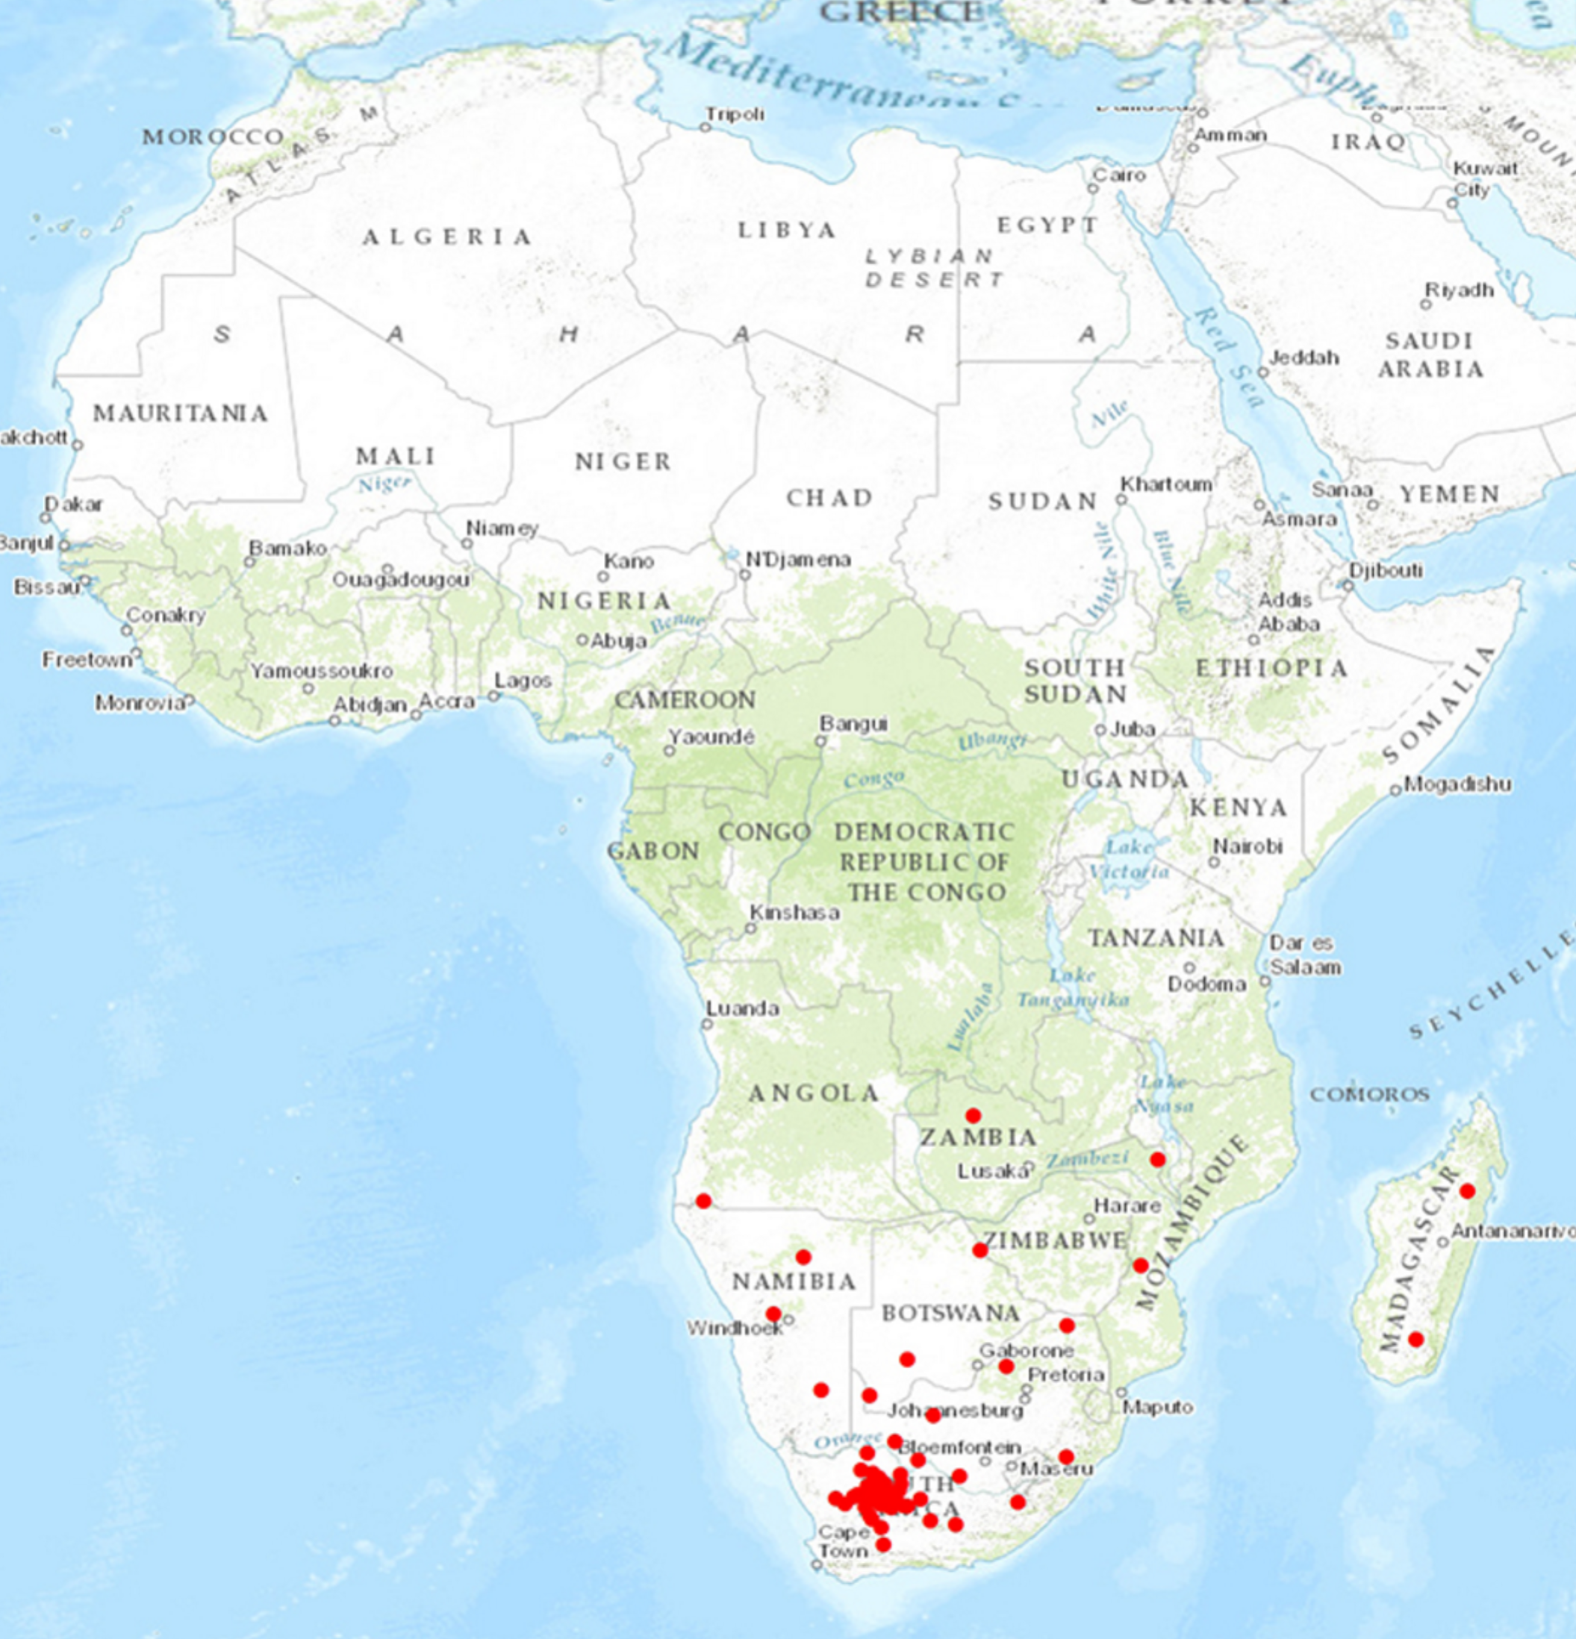
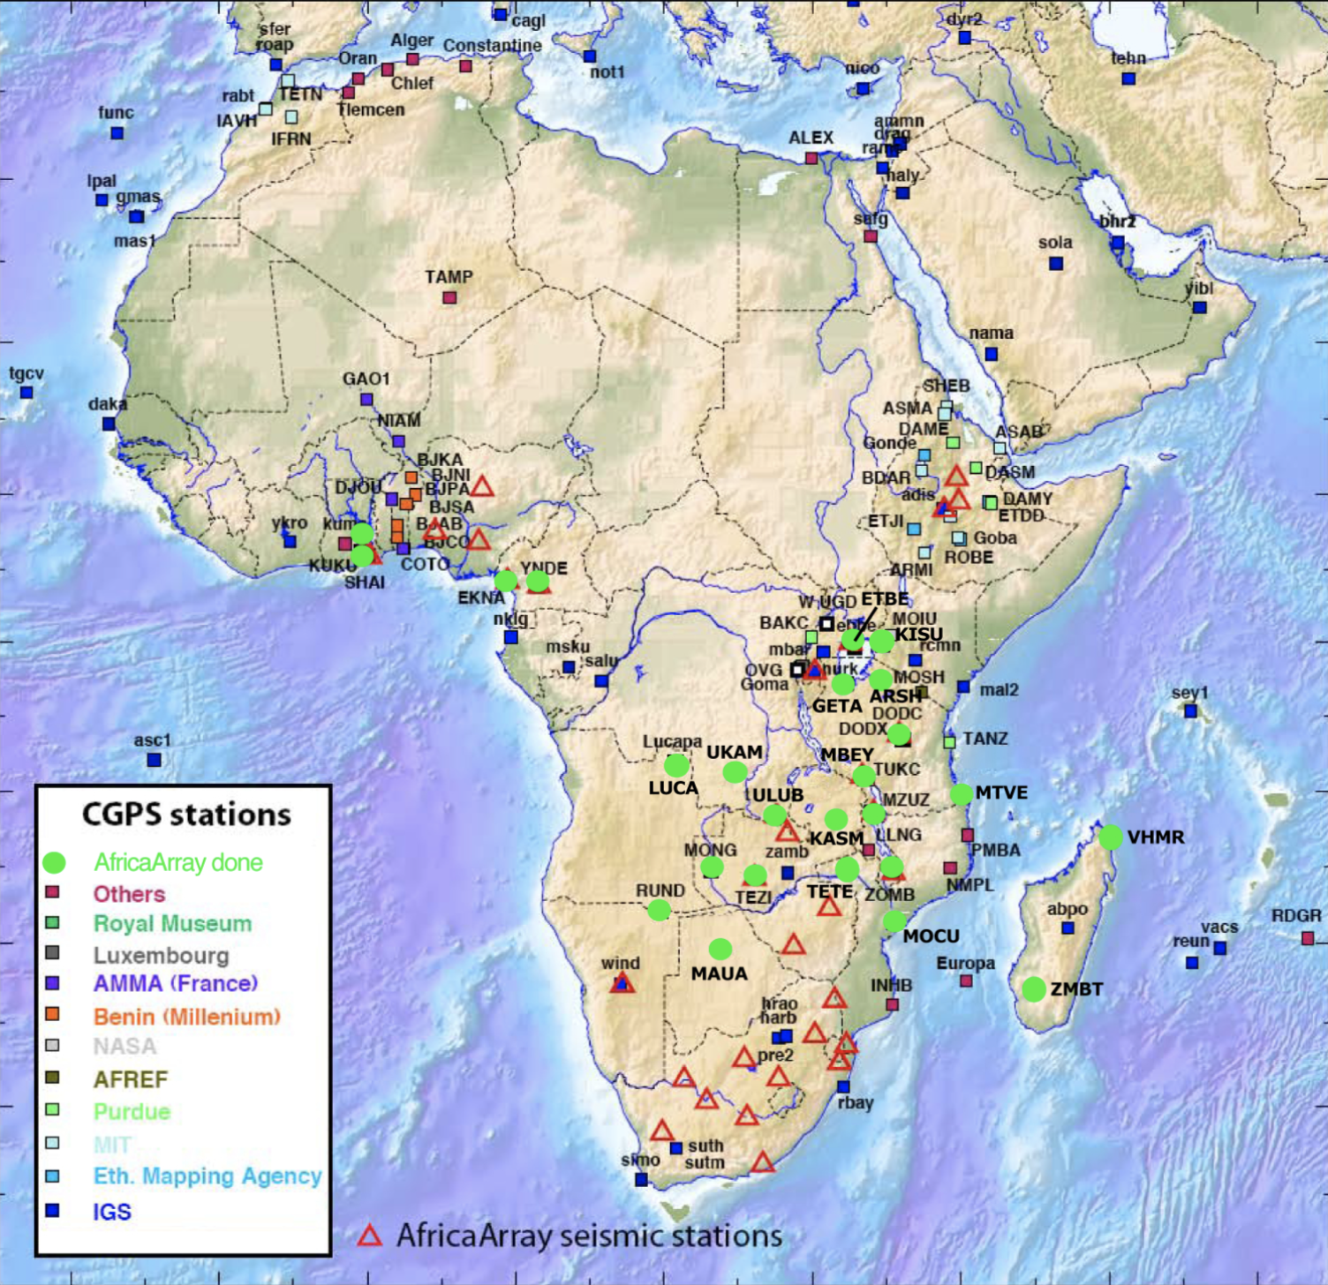
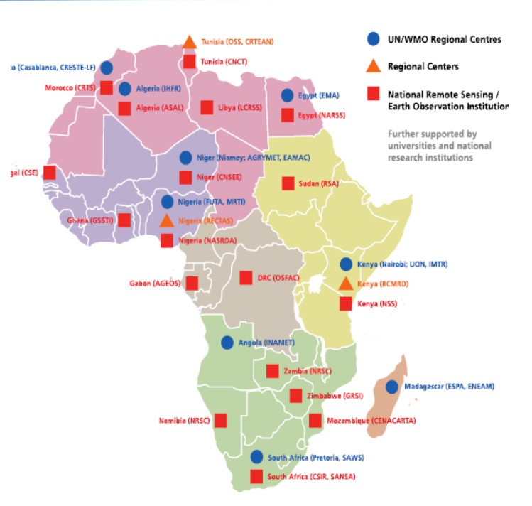
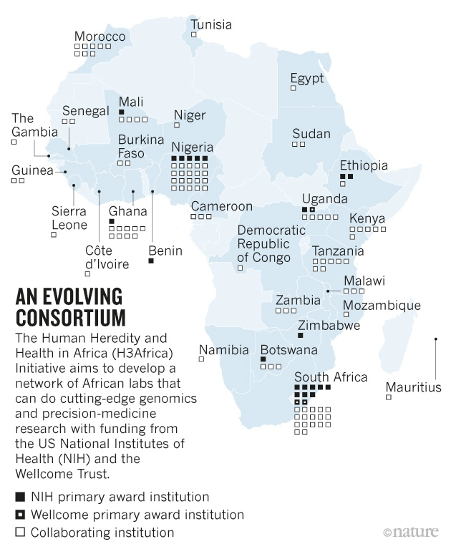
Science Driver collaborations Africa & The Americas
Astronomy
Medical
Other Science Disciplines
Telescope sites across Africa, with its core in the Northern Cape Potgieter, P. (2015). GIS in constructing the SKA. Retrieved from https://www.ee.co.za/article/gis-constructing-ska.html
Global Positioning System (CGPS) in Africa. Source: https://www.unavco.org/community/publications_and_reports/reports/reports.html
Earth Observation Institutions
Torman, Y. (2017). AfREN and AfriGEOSS. Paper presented at the AfriGEOSS Symposium 2017, Sunyani, Ghana.
Human Heredity and Health in Africa (H3Africa) Nordling, L. (2017). How the genomics revolution could finally help Africa. Nature News, 544(7648), 20.
13
Notes:
Heidi Speaking notes:
Astronomy
MeerKAT & SKA related Projects
HERA is an NSF funded experiment currently in operation
Produces ~1.5-2 TB/day but current infrastructure only supports 200 Mbps
Medical
National Institute of Health (NIH) has many collaborative projects in Africa
The United States Army Medical Research Directorate Kenya (USAMRD-K)
Human Health and Heredity - H3 Africa Genomics and bioinformatics project
Genomics
Human Heredity and Health in Africa (H3Africa)
Other Science Disciplines
Biological Sciences: Africa has 116 biological field stations.
Earth Sciences: AfricaArray (AA) Seismic Network has 53 seismic stations deployed in 17 countries. AA participates in UNAVCO, which manages thousands of GPS sites worldwide.
International and Integrative Activities: InCommon/eduGain implementation, Network Startup Resource Center (NSRC) with University of Oregon
* Most of the data is transferred via hard drives because there is no reliable network
-----------------------------------------------------------------------
Astronomy
US PIs of MeerKAT & SKA related Projects:
Aaron Parsons - University of California-Berkeley
Kelly Holley-Bockelmann- Vanderbilt University
Richard Bradley - University of Virginia
Anamparambu Ramaprakash- California Institute of Technology
Matthew Bershady, Eric Wilscots - University of Wisconsin- Madison
HERA is an NSF funded experiment currently in operation
Produces ~1.5-2 TB/day but current infrastructure only supports 200 Mbps
Collaboration relies on shipping tapes
Other Science Disciplines
Biological Sciences: Africa has 116 biological field stations.
USA PI of relate projects: Craig Stewart - Indiana University, and PI of JetStream cloud
Earth Sciences: AfricaArray (AA) Seismic Network has 53 seismic stations deployed in 17 countries. AA participates in UNAVCO, which manages thousands of GPS sites worldwide.
USA PI of relate projects: Charles Meertens, Eric Calais-UNAVCO, Christian Rocken, James Stowell - The University Corporation for Atmospheric Research
International and Integrative Activities: InCommon/eduGain implementation, Network Startup Resource Center (NSRC) with University of Oregon
Medical
National Institute of Health (NIH) has many collaborative projects in Africa
Multidisciplinary Research for Malaria Control and Prevention in West Africa
Malaria Transmission and the Impact of Control Efforts in Southern and Central Africa
Resistance, Immunology, Surveillance & Modeling of Malaria in Uganda (PRISM)
The Intransigence of Malaria in Malawi
Environmental Modifications in Sub-Saharan Africa
NIH HIV/AIDS Clinical Trials Networks
The United States Army Medical Research Directorate Kenya (USAMRD-K)
Malaria Drug Resistance (MDR) , Entomology Program/Vector Biology, Malaria Diagnostics Centre (MDC), Basic Science Lab, Clinical Trials

Slide 14
Network performance to Latin America
Current Academic networks transited were TENET, UbuntuNet, GEANT, Internet2, AmLight, REUNA, RNP and ANSP
Miami - Cape Town
Sao Paulo - Cape Town
Santiago (Pacific) - Cape Town
Santiago (Atlantic) - Cape Town
La Serena - Cape Town
* Data column 2 provided by Len Lotz June 2018, except NY. All else from Angola Cables.
14
Notes:
We have run some Network Performance Tests from Cape Town to Latin America and the US. The current latency data provided by TENET over the UbuntuNet, GEANT and Internet2 links. The next column shows improved performance using data collected from the Angola Cables IP network which will be the same path that SACS and AmLight will use. The last column shows possible improvement percentages ranging from 20% to 71% reduced latency.
Other Notes:
Packet trajectory is from south to north, then to west, then to south.
Simulated latency is going from south to south, then north.

Slide 15
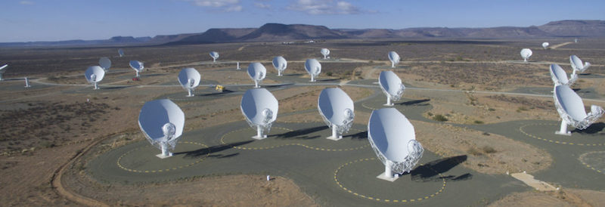
Science Drivers: South African’s radio telescopes MeerKAT & Square Kilometre Array (SKA)
The MeerKAT 64-antenna array radio telescope in the Karoo region
Collaborators: USA, Canada, India, Japan, China, Australia, France, UK, Italy, Finland, Germany
MeerKAT is a precursor to the SKA
Will be merged into the SKA1 (2020)
SKA will be the largest array telescope in the southern hemisphere (2024)
Currently data at a rate of 3.5 Gbps
SKA will generate
160Gbits per second from each radio dish to a central processor
High frequency dishes will produce ten times the current global internet traffic!
Phase two will include telescopes from New Zealand, Botswana, Ghana, Kenya, Mauritius, Madagascar, Mozambique, Namibia and Zambia.
The SKA will generate 960,000 Tb/day
https://www.ska.ac.za/science-engineering/meerkat/about-meerkat/
https://www.skatelescope.org
15
Notes:
The SKA array will produce upwards of a hundred gigabits per second of compressed data.
SKA anticipates generating close to an Exabyte of raw data per day when fully operational.
Many African countries will be part of SKA in phase-2 further provoking the need for higher performance R&E Network capacity.
Other Notes:
http://theconversation.com/ghana-is-boosting-africas-ascent-to-astronomical-heights-82849
HERA network connection for example use “mailing disks” and 200Mbps to NRAO (page 3): https://www.dropbox.com/s/tjune963k0cfk45/Technical%20Design%20%E2%80%93%20reionizationHERA.pdf?dl=0

Slide 16
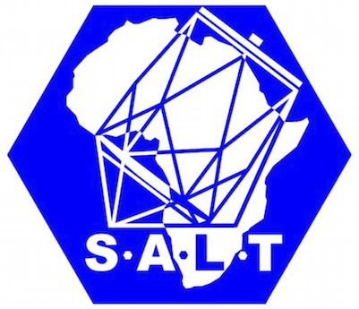
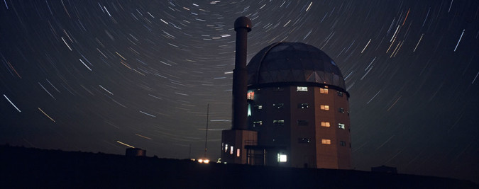
Science Drivers: South African Astronomical Observatory (SAAO)
SAAO is a facility of the National Research Foundation
Operates under the Department of Science and Technology
The Southern African Large Telescope (SALT) is the largest single optical telescope in the southern hemisphere and among the largest in the world.
SALT is funded by a consortium of international partners from South Africa, the USA, Germany, Poland, India, the UK, and New Zealand
SAAO Hosted Research Telescopes: BiSON, KELT-South, LCOGT, MONET, Solaris, SuperWASP-South
SALT generates 5-50 GB/night, with future instrumentation ~250 GB/night
16
Notes:
S. Africa hosts a number of internationally important astronomy projects.
SALT is the largest single optical telescope in the southern hemisphere
The MeerKAT Radio telescope array will merge into the Square Kilometer Array first phase SKA1
Network Connection to the SAAO site in Cape Town now and in the future are critical to the astronomical observatories and will be supported by SANREN.
Next Slide
Other notes:
Right now ALMA in Chile is the largest and most sensitive radio instrument in the world at millimeter and submillimeter wavelengths
SAAO site in Cape Town via a 1 Gbit/s fibre connection over the SA NREN network.
SAAO has a 1 Gbit/s connection to the SA NREN network with 30 Mbit/s of that link being the international portion. https://en.wikipedia.org/wiki/Southern_African_Large_Telescope#Internet_connectivity
SANREN will support the networks for SALT, KAT, eVLBI and SKA . Base capacity is 10Gbps. Exclusively via a country-wide fiber optic network: http://slideplayer.com/slide/10382174/ TENET will provide internationally
Questions:
How much data do combined telescopes generate per night? How much need to be accessible to US?
Is SALT the primary producer of data? If not, which telescope is?
When will future instrumentation be implemented?
Large optical telescopes list here:https://en.wikipedia.org/wiki/List_of_largest_optical_reflecting_telescopes
Large radio telescopes list here:
LSST - single optical

Slide 17
Science Drivers: Genomic, Proteomic and HIV Research
A number of South African Universities and Research Institutions including University of Cape Town, University of Witwatersrand, University of the Western Cape, Centre for Proteomic & Genomic Research, The Medical Research Council and the Agricultural Research Council are interacting with Research Entities globally in these fields.
Participation of UbuntuNet and WACREN:
Access to a wealth of Research undertakings by their Member NRENs
Letters of Collaboration from the CEO’s
Cape Town is an aggregation point for these networks until more can be opened
NIH Projects in Africa. Source: https://report.nih.gov/award/#tab4

Slide 18
RNP - the Brazilian NREN - www.rnp.br
Brazil (8M km2) occupies about 40% of South America, and has a diameter of about 4000 km.
Population (2017) of 219 million. Largest Portuguese-speaking country. 9th largest economy (GDP) in the World.
Independent since 1822, became a Federal republic (1889) with 26 states and Federal District (DF). Capital: Brasília (1960)
RNP, a private non-profit company, operates the federal government-supported NREN and its international connection since 1992.
Based on a national backbone, with a PoP in each state, RNP provides connectivity to around 1500 sites.
The map shows the expected backbone topology and capacities in 2020, Already some of the links have been upgraded to 100G
International connections are currently to the USA (Amlight ExP with 100G links) and to the rest of Latin America via RedClara (Latin American regional REN), serving about 14 mainland countries south of the USA.

Slide 19
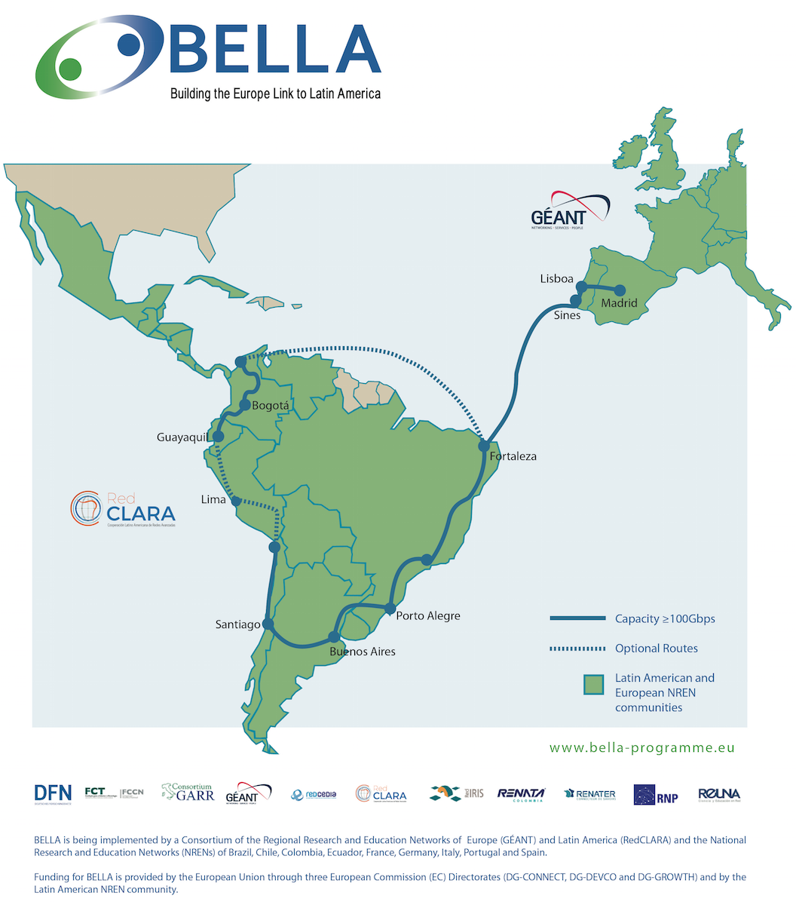
RedClara: Latin American REN (www.redclara.net)
Redclara Backbone (significant funding from the EU from 2003)
18 targeted countries (2002): 12 have a connected ”LA-NREN”
a single PoP in each participating country
external links to the USA, and thence to Europe
BELLA initiative (Building Europe Link to Latin America)
Objective: build 100G RedClara network with a new direct link to Europe
funding from EU (through GÉANT), RedCLARA, South American NRENs
2 components: BELLA-S (submarine), BELLA-T (terrestrial)
BELLA-S: acquire life-time IRU for 3/8 spectrum of a fibre pair on a new, direct cable EU-Brazil; contracted 2018 with EllaLink cable: RFS 2020
BELLA-T: acquire long-term IRUs for mostly terrestrial optical spectrum in South America; ready by 2020
Major drivers: Copernicus; ESO and ALMA observatories in Chile; LHC

Slide 20
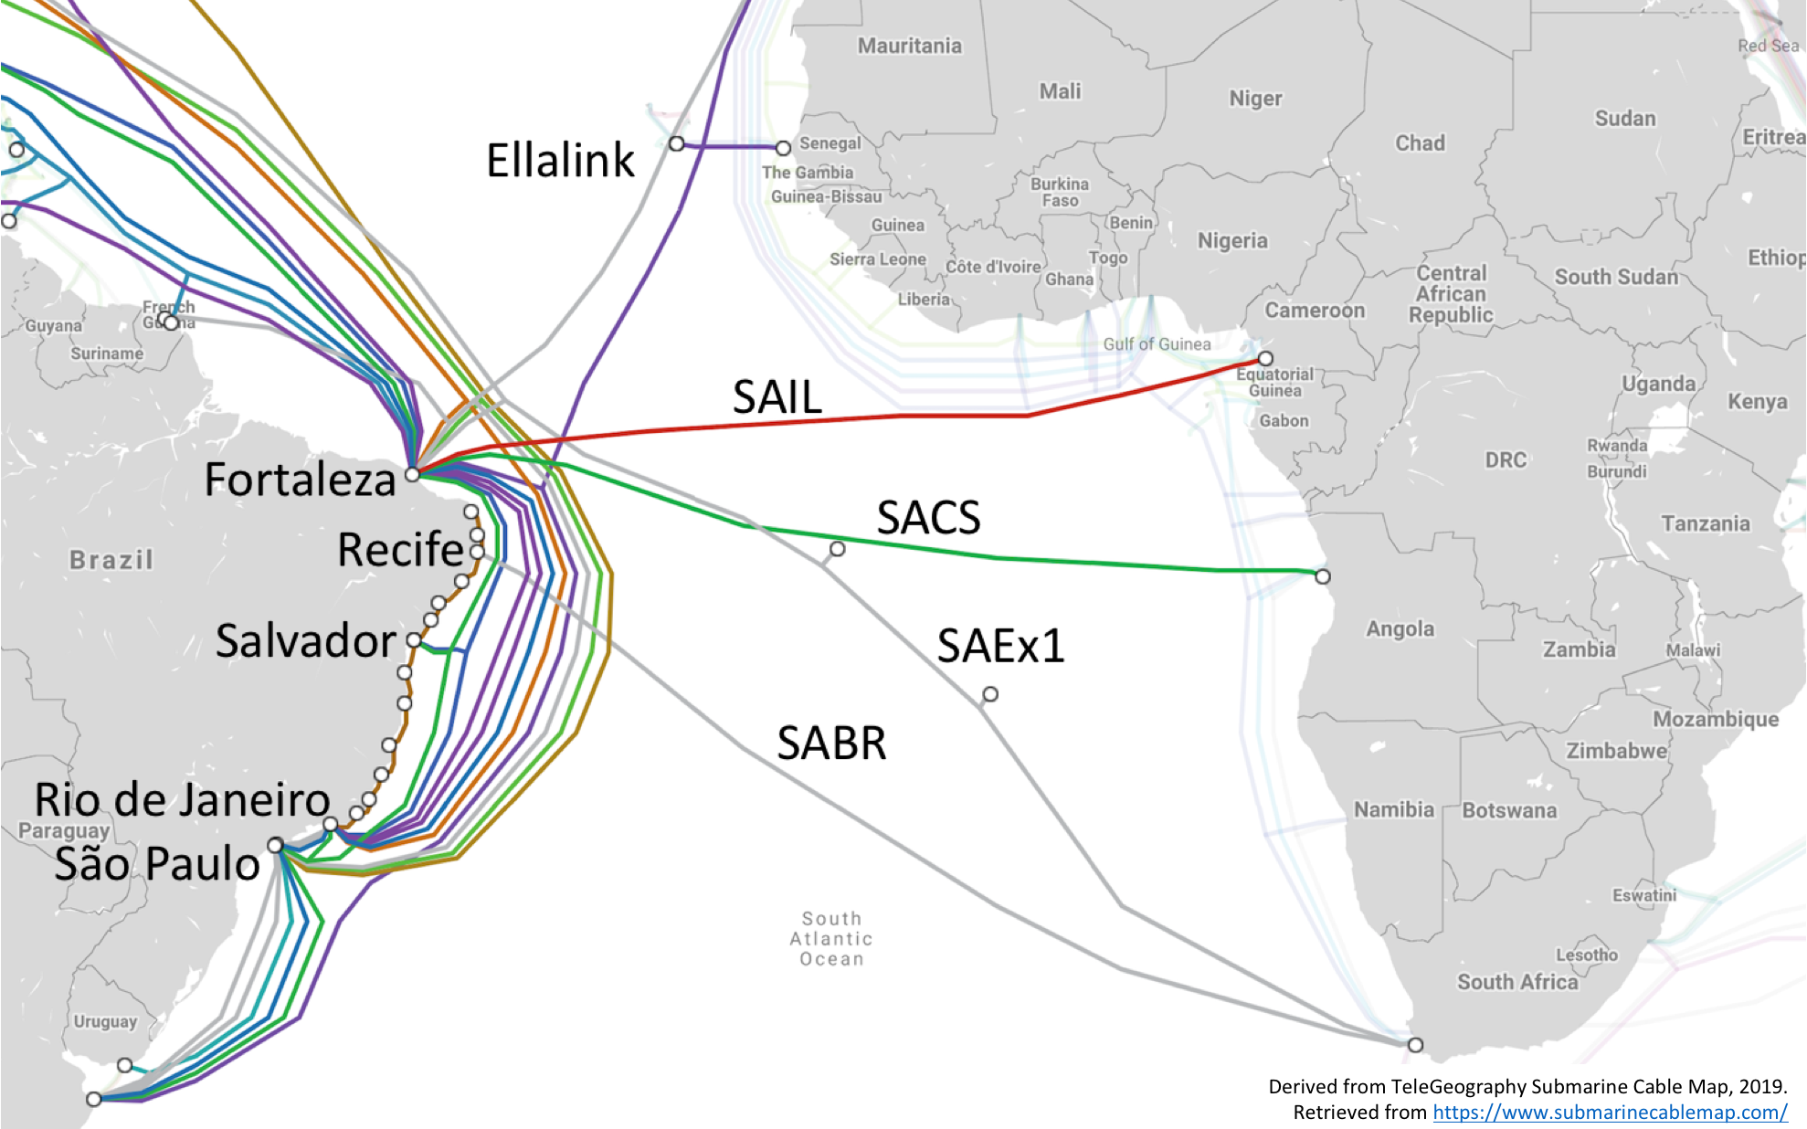
The Evolution of Connectivity in the South Atlantic
Phase | Period | Cables | Connecting to | Bandwidth | Fortaleza?
1 (SA): Only intra-Americas connections | 2000-2001 | SAC, GlobeNet, SAm1 | N & S America (focus on Florida) | 2.5 and 10G | Y
 | 2014 | AMX-1 |  | 100G | Y
 | 2017 | Seabras-1 | N & S America | 100G | N
 | 2017-2018 | Monet, BRUSA |  | 100G | Y
1 (AF): Africa - Europe | 2010 | EASSy | Africa - Europe (just N-S) | 10G | n/a
 | 2012 | WACS, ACE |  | 10G | n/a
2: 100G | 2017-2018 | SAC, GlobeNet, WACS |  | upgrade 100G
3: Also trans-Atlantic connections | 2018 | SACS, SAIL | Angola, Cameroon | 100G | Y
 | 2020 | EllaLink | Portugal | 100G | Y
 | 2021 | SABR | South Africa | 100G | N
 | 2021 | SAEx1 | USA, South Africa | 100G | Y
We can identify 2 parts to the story:
The development of separate cable systems around the continents on both sides of the South Atlantic: South America (SA) and Africa (AF)
The very recent deployment of transatlantic cables in the South Atlantic
It should be noted that 4 of the 5 new and future transatlantic cables land in Fortaleza (and the 5th in Recife), in NE Brazil.
Additionally, all except one of the 7 N. & S. American cables also land in Fortaleza
Thus, with 10 cable landings Fortaleza is an excellent choice for interconnecting these cables

Slide 21
RNP expectations for international links by 2020-21
Brazil already has a GLIF GOLE/GXP in São Paulo, and this interconnects the N-S cables from the US used by R&E networks (Monet, SAC), the Brazilian R&E networks (ANSP, RNP) and the Regional R&E network (RedClara)
To cater for this new international connectivity, RNP has begun to build a new GXP in Fortaleza, called SAX - South America eXchange (also referred to as South Atlantic Crossroads)
SAX will initially interconnect the Monet and SACS cables, and will later be extended to others used by R&E network, especially EllaLink, used by the BELLA project to link S America and Europe from 2021.

Slide 22
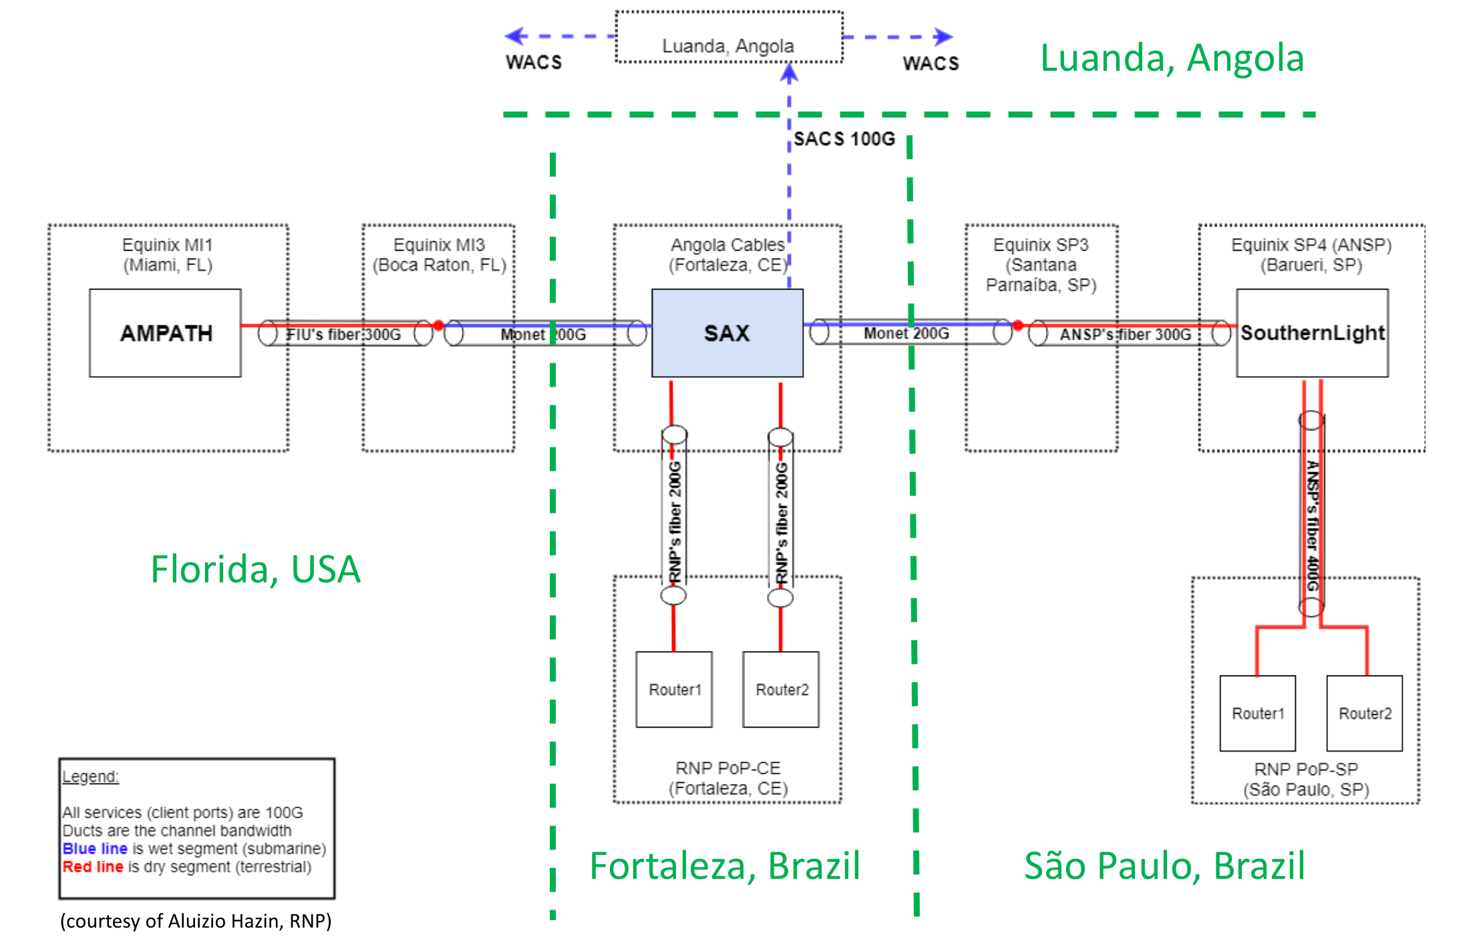
SAX GXP and the links to neighbours
The figure illustrates the connections between the GNA exchange points (GXP) AMPATH (Miami), SAX (Fortaleza) and SouthernLight (São Paulo), as well as the new transatlantic connection between SAX and Angola, using the SACS cable
22

Slide 23
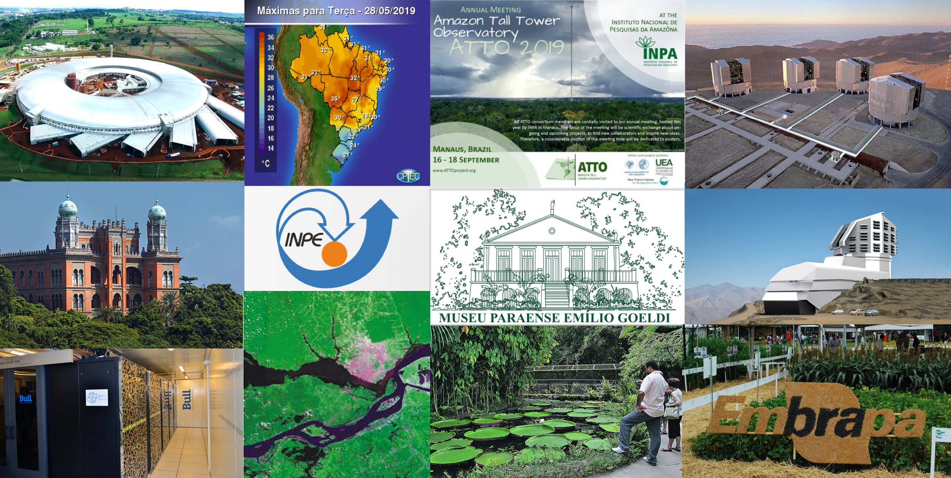
Science Drivers (Brazil):
Some government facilities for research collaborations
1 synchrotron light source
4
weather/climate
10 astronomy Chile (ESO)
7 Amazon region
5 space research
8 Amazon region
11 astronomy Chile (LSST)
2 medical/pharmacology
12 agriculture
3 supercomputing
6
Earth observation
9 Amazon region
Notes:
Images from leading institutions belonging to the Brazilian Federal government, which are carrying out research and development activities.
Withe the exception of Embrapa (Ministry of Agriculture - MA) and Fiocruz (Ministry of Health - MS), all Brazilian institutions mentioned are maintained by the Ministry of Science, Technology, Innovation and Telecommunications (MCTIC).
SIRIUS: 4th Generation synchrotron light souce at Brazilian Center for Research in Energy and Materials (CNPEM), Campinas, SP – www.cnpem.br
HQ of the medical research institute Osvaldo Cruz Foundation (Fiocruz), Rio de Janeiro, RJ – www.fiocruz.br
Santos Dumont supercomputer at National Laboratory for Scientific Computing (LNCC), Petrópolis, RJ – www.lncc.br
Weather forecasting at Weather Forecasting and Climate Studies Centre (CPTEC), National Institute for Space Research (INPE), Cachoeira Paulista, SP - www.cptec.inpe.br
National Institute for Space Research (INPE), São José dos Campos, SP – www.inpe.br
Earth observation (meeting of the rivers Solimões and Negro to form the Amazon at Manaus, AM), INPE, São José dos Campos, SP – www.inpe.br
Poster of the Amazon Tall Tower Observatory (ATTO) by National Institute for Research in the Amazon (INPA), Manaus, AM - www.inpa.br
Logo of the Emílio Goeldi Museum in Pará (MPEG), Belém, PA – www.museu-goeldi.br
Victoria Regia waterlilies at MPEG, Belém, PA – www.museu-goeldi.br
Very Large Telescope (VLT) at Cerro Paranal, Chile, of the European Southern Observatory (ESO), in collaboration with the National Observatory (ON), Rio de Janeiro, RJ - http://www.on.br
Large Scale Synoptic Telescope (LSST) of the USA at Cerro Pachón, Chile, in collaboration with the National Astrophysics Laboratory (LNA), Itajubá, MG – www.lna.br
Research station of the Brazilian Company for Agricultural Research (Embrapa) of the Ministry of Agriculture, whose HQ is in Brasília, DF - www.embrapa.br

Slide 24
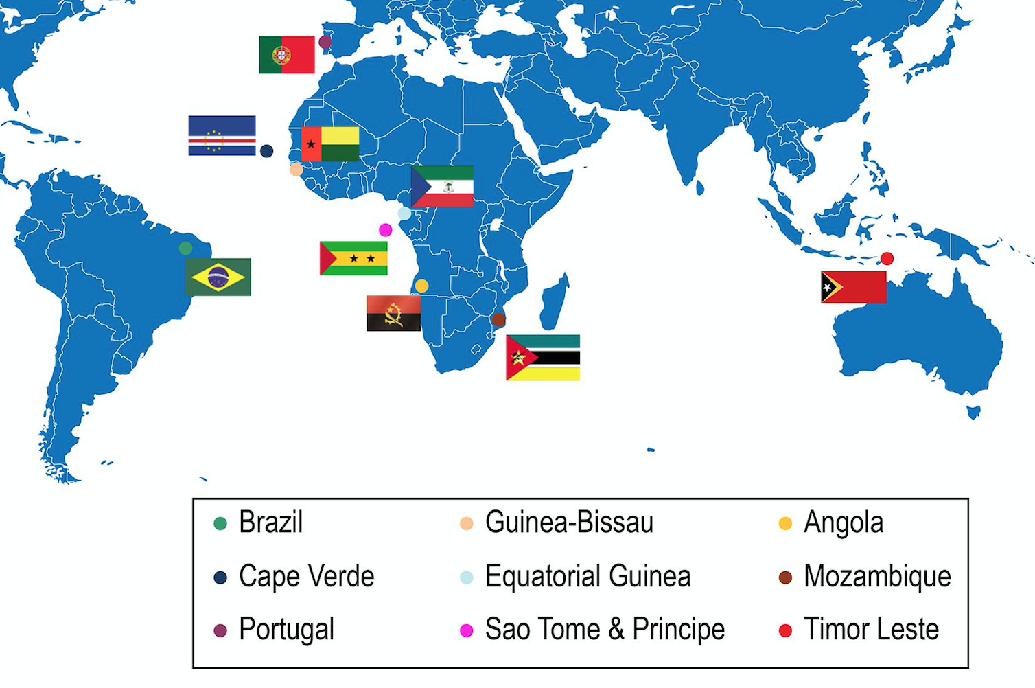
Science Drivers: Brazilian health collaborations within CPLP (Community of Portuguese-Speaking Countries) in Africa
Cooperating institutions in Africa include the National Institutes of Public Health (NIPH) of Angola, Cape Verde, Guiné-Bissau and Mozambique. Soon be extended to São Tomé & Princípe.
Medical research [led by Fundação Osvaldo Crux (Fiocruz), Federal U of Rio de Janeiro (UFRJ)] – collaboration with African members of the CPLP
Research networks for Infectious diseases: Malaria, STI, AIDS, Viral Hepatitis, Tuberculosis {Fiocruz}
AIDS in Angola: genotyping and resistance of HIV-1 to anti-retroviral drugs {UFRJ}
Mozambique: Strategic Planning, post-graduate education (Master’s and Doctoral degrees), and short-duration internships (Academic Management)
(Image adapted from:
http://www.scielo.br/img/revistas/abc/v110n6//0066-782X-abc-110-06-0500-gf01.jpg )
24
Notes:
In the context of SPHC-CPLP, technical cooperation is carried out within the context of the Network of National Institutes of Public Health of the CPLP (NNIPH-CPLP) of which Fiocruz acts as Executive Secretary of the Network. The members of this Network are the National Institutes of Public Health of Angola, Brazil, Cape Verde, Guiné-Bissau and Mozambique. Preparations are being made for setting up National Institutes of Public Health in São Tomé e Príncipe and in East Timor. There is still no information available relating to the situation in Equatorial Guinea relating to the organization of its health system.
The Osvaldo Cruz Institute in the Brazilian Ministry of Health has collaborations with
The National Institute of Infectiology collaborates with Mozambique on Clinical research & clinical tests
Also, the Federal University of Rio de Janeiro performs research on HIV with institutes in Angola

Slide 25
Science Drivers: Additional Brazilian collaborations
Agricultural research [Brazilian Company for Agrarian Research – Embrapa (Ministry. of Agriculture]
pest control - army worm (lagarta do cartucho) which attacks maize and sorghum (Brazil, USA, South Africa + 9 other African countries)
NREN collaboration between MoRENeT (Mozambique) and RNP
Close relationship with RNP for training and exchange of information
Carried out in both countries
Atlantic International Research Centre (AIR-Centre), Azores, Portugal (https://aircentre.org)
(One) Atlantic under change,
One integrated S&T platform to tackle the global challenges and for the creation of local value
AIR Centre is an international distributed scientific network to share science and technology responding to the Global Atlantic scale challenges, enhancing the sharing of scientific & technical resources and creating sustainable local value.
Agreement between EU-BR-ZA
25
Notes:
Brazil’s National Research and Education network supports many science drivers complimentary to collaboration with African research interests.
Embrapa (Brazilian Corporation for Agricultural Research in the Ministry of Agriculture) is working to combat army worms which attack maize and sorghum. The collaboration is between BR, ZA, the US plus 9 other African countries
Morenet has a long standing collaboration with RNP participating annually in the RNP Forum since 2014. Activities include;
» Exchange of good practices in management and governance of research networks
» IT training (including 25 techies in 2017 in Brazil) » Exchange of information on technical and operational management
The Atlantic International Research Centre (AIR-Centre), has agreements between the EU-BR-ZA for collaborative research activities in the South Atlantic and Southern Oceans The ambition of the AIR Centre is to be a long-term platform for North-South, South-North, East-West and West-East collaboration in the Atlantic towards a holistic, integrative and systemic approach to knowledge on space, oceans, climate change impacts, energy and data sciences, while fostering an inclusive perspective to science, technology and economic development.
Next Slide
– http://www.atlanticinteractions.org/air-centre/

Slide 26
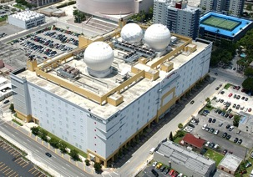
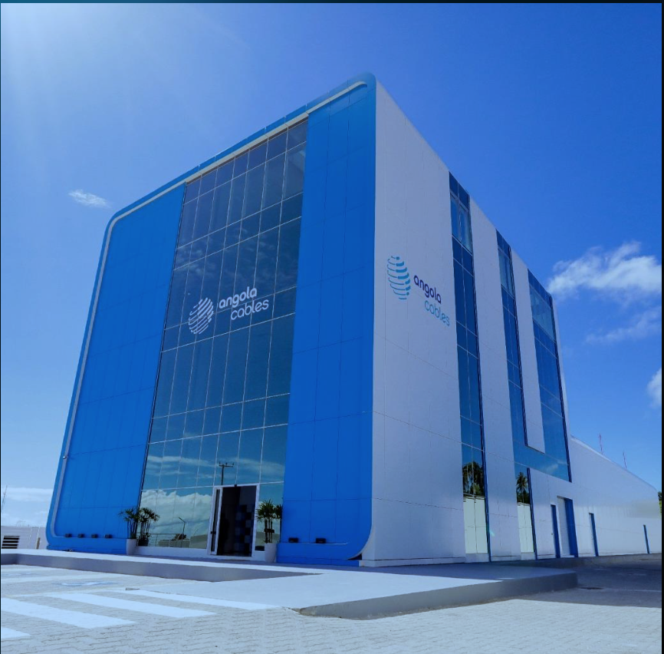
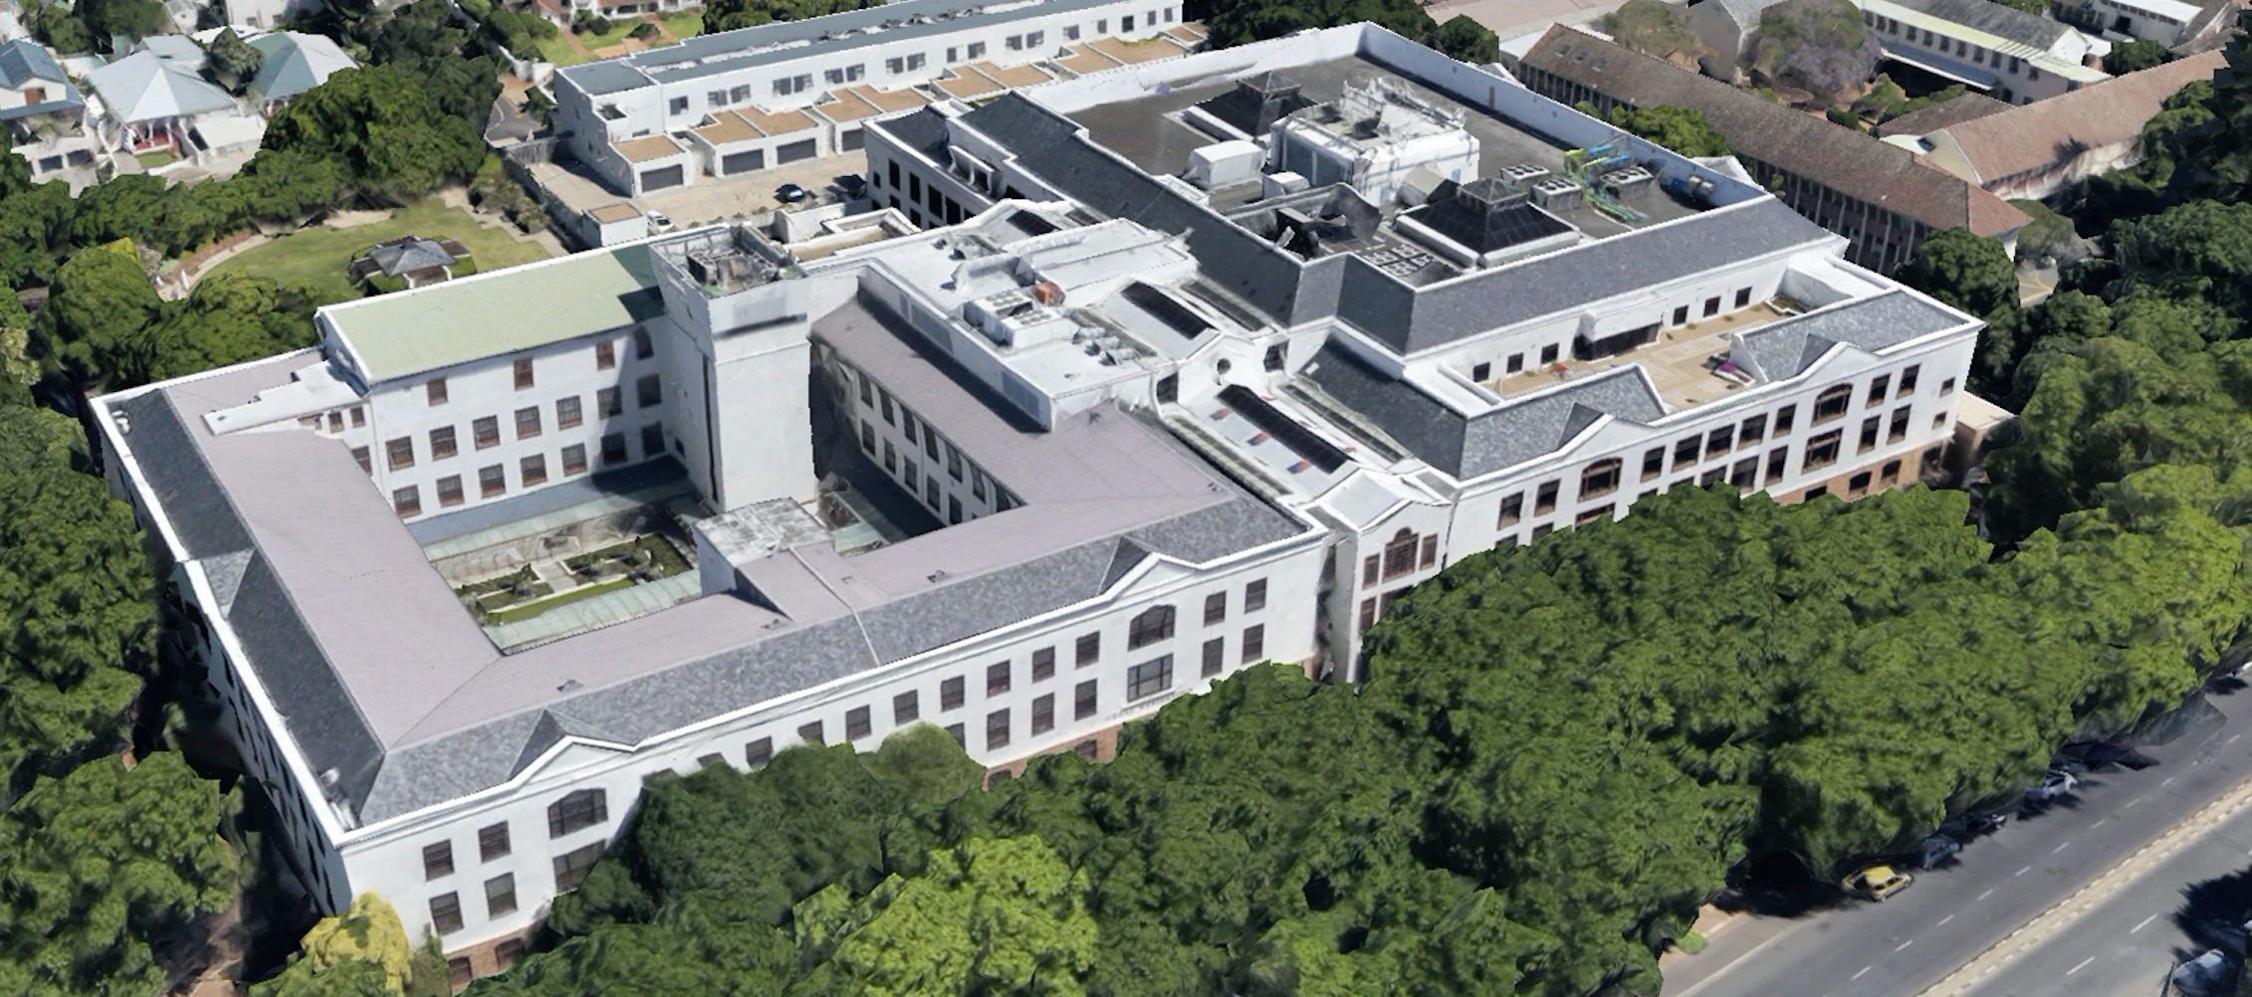
In Conclusion
We have worked together to identify and coordinate new facilities in the South Atlantic, interconnecting the REN exchange points AMPATH (Miami), SAX (Fortaleza) and ZAOXI (Cape Town)
The SACS cable, between Brazil and Angola, is operational and we have acquired capacity for REN network use
The WACS cable, between South Africa and Europe, is operational and connects to SACS in Angola
SACS and the AmLight ExP cables are to be interconnected at the SAX GXP in Fortaleza
We thus have the ingredients to create a resilient South Atlantic REN interconnection, greatly reducing the latency of traffic between the Americas and Africa.
AMPATHMiami
SAX Fortaleza
ZAOXI Cape Town

Slide 27
THANK YOU!
Heidi Morgan- Information Science Institute at the University of Southern California (USC USA) - hlmorgan@isi.edu
Michael Stanton - Network Scientist at Rede Nacional de Ensino e Pesquisa (RNP Brazil) - michael@rnp.br
Len Lotz - Executive Officer, Tertiary Education and Research Network (TENET South Africa) - len@tenet.ac.za
Julio Ibarra - Assistant VP of Technology Augmented Research, Florida International University (FIU)
Jeronimo Bezerra - Assistant Director, Chief Network Engineer, Florida International University (FIU)
Luis Fernandez Lopez - Principal Investigator of the Academic Network at São Paulo (ANSP Brazil)
Vasilka Chergarova - Research Coordinator, Florida International University (FIU)
Donald A. “Chip” Cox III - Research Assistant Professor Department of Physics & Astronomy Vanderbilt University.(USA)
Gabriella E. Alvarez - Researcher at Harvard-Smithsonian Center for Astrophysics, Dept. Astrophysics at Vanderbilt University (USA)
Aluizio Hazin - Engineering and Operation at Rede Nacional de Ensino e Pesquisa (RNP Brazil)
Siju Mammen - Head of Network Engineering at the South African Research Network (SANReN South Africa)
27

Slide 28
Appendix
The following 2 slides document the map on slide 3
The last slide is a key to slide 23 photos

Slide 29
South Atlantic Cables up to 2021
ID | Cable name | Date | Length (km) |  | Landing points - Country (region)
Western Hemiphere cables
W1 | Americas-II | 2000-08 | 8373 |  | BR-CE CW GF MQ TT US-FL US-PR US-VI VE
W2 | South American Crossing (SAC) | 2000-09 | 20000 |  | AR BR-CE BR-RJ BR-SP CL CO PA(2) PE US-VI VE
W3 | GlobeNet | 2000-10 | 23500 |  | BM BR-CE BR-RJ CO-ATL US-FL US-NJ VE
W4 | South America-1 (SAm-1) | 2001-03 | 25000 |  | AR BR-BA BR-RJ BR-SP CL-AP CL-VS CO-ATL DO EC GT-IS GT-IZ PE-LIM PE-PIU US-FL US-PR
W5 | America Movil System-1 (AMX-1) | 2014 | 17800 |  | BR-BA BR-CE BR-RJ CO-ATL CO-BOL DO GT-IZA MX US-FL(2) US-PR
W6 | Monet | 2017-12 | 10556 |  | BR-CE BR-SP US-FL
W7 | Seabras-1 | 2017-08 | 10800 |  | BR-SP US-NJ
W8 | BRUSA | 2018 | 11000 |  | BR-CE BR-RJ US-PR US-VA
Eastern Hemisphere cables
E1 | SAT-3/WASC | 2002-04 | 14350 |  | AO BJ BS CM ES ES-CN GA GH NI PT SN ZA
E2 | SEACOM/Tata TGN Eurasia | 2009-07 | 15000 |  | DJ EG IN KE MZ SA TZ ZA (extension from EG to Europe)
E3 | EASSy | 2010-07 | 10500 |  | DJ KE KM MG MZ SD SO TZ ZA
E4 | WACS | 2012-05 | 14530 |  | AO CD CG CI CM CV ES ES-CN GH NA NG PT TG ZA (link PT to GB)
E5 | ACE | 2012-12 | 17000 |  | BJ CI ES-CN FR GH GM GN LR MR NI PT SL SN ST (planned: AO CD CM GA GQ GW NA ZA)
29

Slide 30
South Atlantic Cables up to 2021
ID | Cable name | Date RFS | Length (km) |  | Landing points - Country (region)
Transatlantic cables
T1 | Atlantis-2 | 2000-02 | 8500 |  | AR BR-CE CV ES-CN PT SN
T2 | SACS | 2018-09 | 6165 |  | AO BR
T3 | SAIL | 2018-09 | 5900 |  | BR CM
T4 | EllaLink | 2020 | 10500 |  | BR-CE BR-SP CV GF PT PT-30
T5 | SABR | 2021 | n/a |  | BR ZA
T6 | SAEx1 | 2021 | 14720 |  | BR SH US-VA ZA
South America cables
SA1 | Brazilian Festoon | 1996 | 2543 |  | BR connects 14 landings on Brazil's East coast
SA2 | Malbec | 2020 | 2500 |  | AR BR-RJ BR-SP
SA3 | ARBR | 2021 | 2700 |  | AR BR-SP
SA4 | Junior | 2018-09 | 390 |  | BR-RJ BR-SP
SA5 | Tannat | 2018-03 | 2000 |  | AR BR-SP UY
30

Slide 31
Images Key from Slide 23
Images from leading institutions belonging to the Brazilian Federal government, which are carrying out research and development activities.
Withe the exception of Embrapa (Ministry of Agriculture - MA) and Fiocruz (Ministry of Health - MS), all Brazilian institutions mentioned are maintained by the Ministry of Science, Technology, Innovation and Telecommunications (MCTIC).
SIRIUS: 4th Generation synchrotron light souce at Brazilian Center for Research in Energy and Materials (CNPEM), Campinas, SP – www.cnpem.br
HQ of the medical research institute Osvaldo Cruz Foundation (Fiocruz), Rio de Janeiro, RJ – www.fiocruz.br
Santos Dumont supercomputer at National Laboratory for Scientific Computing (LNCC), Petrópolis, RJ – www.lncc.br
Weather forecasting at Weather Forecasting and Climate Studies Centre (CPTEC), National Institute for Space Research (INPE), Cachoeira Paulista, SP - www.cptec.inpe.br
National Institute for Space Research (INPE), São José dos Campos, SP – www.inpe.br
Earth observation (meeting of the rivers Solimões and Negro to form the Amazon at Manaus, AM), INPE, São José dos Campos, SP – www.inpe.br
Poster of the Amazon Tall Tower Observatory (ATTO) by National Institute for Research in the Amazon (INPA), Manaus, AM - www.inpa.br
Logo of the Emílio Goeldi Museum in Pará (MPEG), Belém, PA – www.museu-goeldi.br
Victoria Regia waterlilies at MPEG, Belém, PA – www.museu-goeldi.br
Very Large Telescope (VLT) at Cerro Paranal, Chile, of the European Southern Observatory (ESO), in collaboration with the National Observatory (ON), Rio de Janeiro, RJ - http://www.on.br
Large Scale Synoptic Telescope (LSST) of the USA at Cerro Pachón, Chile, in collaboration with the National Astrophysics Laboratory (LNA), Itajubá, MG – www.lna.br
Research station of the Brazilian Company for Agricultural Research (Embrapa) of the Ministry of Agriculture, whose HQ is in Brasília, DF - www.embrapa.br

