Slide 1
Spectrum sharing – lessons from workshop
Kurosh Bozorgebrahimi, Uninett
Tallinn
19/06/2019

Slide 2

What is Spectrum Sharing?
Spectrum sharing is the ability to share available optical spectrum between different organizations
Spectrum customers (cooperators) will have access to inject light directly into the host line system (DWDM).
  Alien Wavelength: Is the simplest form of spectrum services where the spectrum is limited to a single light source over a limited spectrum (<100GHz).
  Spectrum Service: Multiple light sources over a broader portion of optical spectrum
Spectrum customer #1
Spectrum customer #2
Host OLS

Slide 3
What is Spectrum Sharing?
Alien Wavelength
Third party device connected to the ROADM through a filter
Single source transmitter
Limited spectrum <100GHz
WSS/ROADM
e.g. Filter
DCI, integretaed DWDM-line port in Client equipment
Spectrum service
Spectrum customer #1
Third party device connected to a WSS port in the ROADM
Supports multiple light sources
The user stands free to use the dedicated spectrum as they want to
Spectrum size could be several hundreds of GHz but should be limited to a certain value
Spectrum customer #2
WSS/ROADM
e.g. Filter
Notes:
We should define a common sett of rules like power setting, maximum allowed spectrum allowed to drop at a single WSS port, etc.

Slide 4
Motivation
Spectrum sharing fully utilizes the line system capacity and saves cost
  Deployed line system enables enormous amount of capacity: several Tbit/s
  No single NREN needs all this capacity
  Sharing will save unnecessary deployments
  Gives better redundancy since different partners can focus on deployments in different geographical areas
Different part of the optical delivery chain have different lifecycles
  Separation of line system from adaption function(transponders) gives the freedom to choose the best cost efficient solution at any given time
Avoids vendor lock-in

Slide 5
Spectrum Sharing, Considerations/Challenges and requirements (1)
Host Line System should:
  Provide the customer with OSNR/GSNR values between different edge nodes
    (OSNR & GSNR) can be used to predict the performance of source modem used by the customer
    EOL Margin considerations
    These parameters could be used to define the right price for the spectrum service we buy/deliver
The customer must to commit to:
  Coherent light, waveform that has been agreed
  Power levels that are constant
  Spectrum quality: make the QoS data available to the host OLS operator
  Participate in a joint engineering team with OLS operator to discuss planning and operational issues (there will be a closer relationship between the service provider and user)
Lab-testing and verification should be done in partnership with customer before connecting third part equipment to the line system
You need to have a trust with the organization you share spectrum with.
Notes:
Higher GSNR between A and B should be valued more than less GSNR over the same distance.

Slide 6
Spectrum Sharing, Considerations/Challenges and requirements (2)
Need to create a common set of rules. Rules which the spectrum provider and spectrum user could use to configure their network (should be done in WP7-T2).
OLS provider should be able to provide the true OSNR/GSNR values from any node to any node in the network
  Spectrum customer should know in advance the quality of the spectrum they will get
Privacy: Fully separation between spectrum customers.
  Any spectrum-customer should only have access to their own part of spectrum
Security: Protect the spectrum users against each other
  Changes on one part of spectrum shouldn't affect other spectrum users
  Ability to adjust and police any optical ingress port (spectrum) which violates the agreed optical parameter settings

Slide 7
Spectrum sharing in GÉANT network
Guy Roberts, Network Architect
Tallinn
19/06/2019

Slide 8
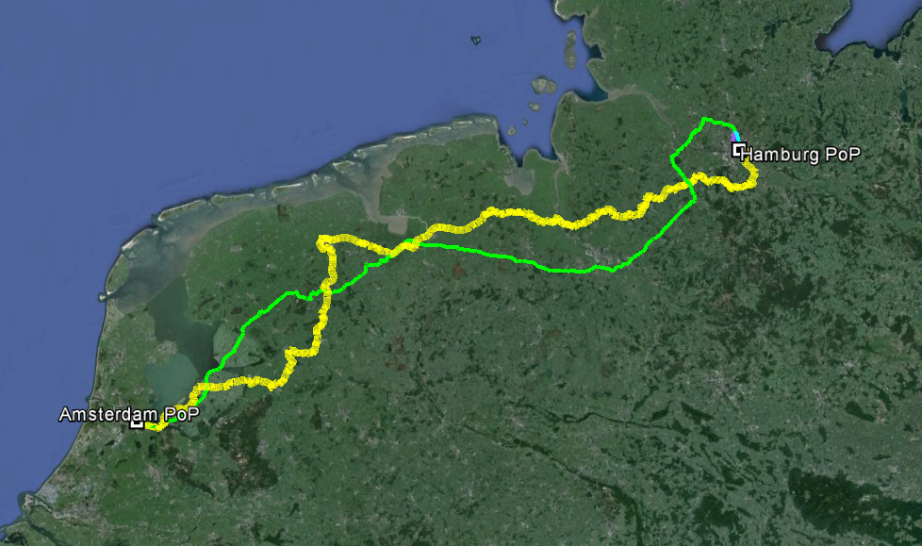
In the beginning: 2015 Ams to Ham
R&E community had two parallel fibre systems between Amsterdam and Hamburg.
Yellow cable is SURFnet.
Green cable is GÉANT.
Duplication of infrastructure diluted utilization.
Objective 1: remove one fibre system and share remaining fibre
Objective 2: retain GMPLS control plane
Solution: alien waves

Slide 9
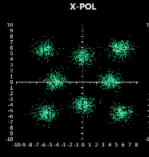
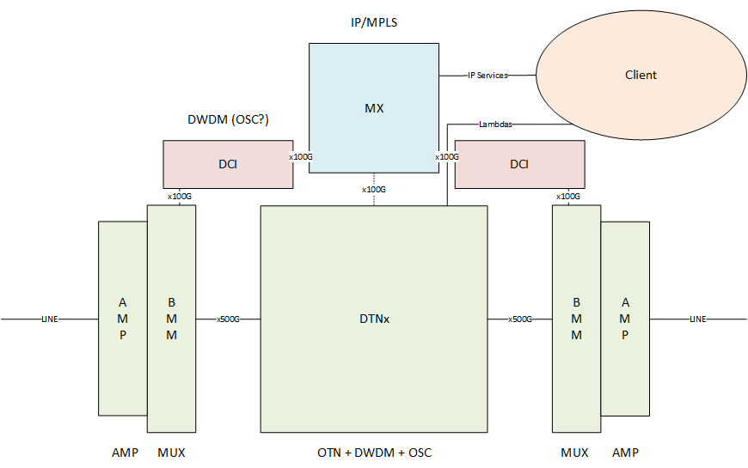
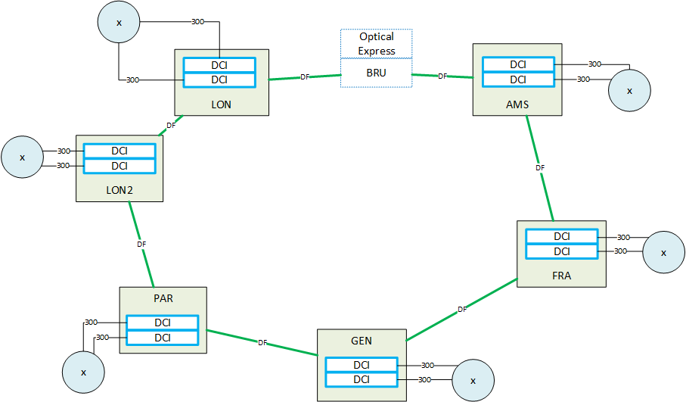
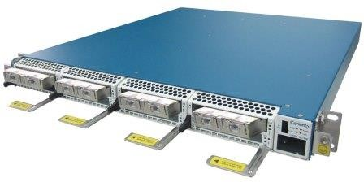
2017/18: IP trunks on AWs
We have integrated DTN-X with DCIs and use DCI for IP/MPLS trunks
Keep DTN-X for link management and lambda provisioning greatly simplifying DCI role and minimising risk
Integration of DCI allows for growth offset and generate spares to be used for Lambda services growth
DCIs can be easily re-used after line system re-procurement in 2020/2021

Slide 10
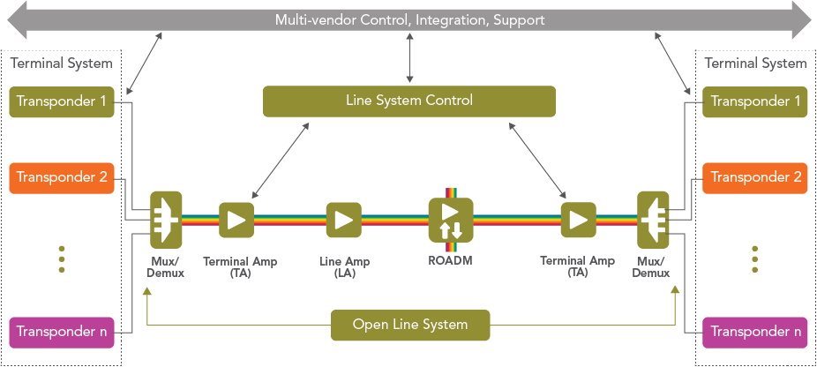
Challenges with spectrum sharing
Commodity DWDM pluggables
Data centre interconnects
Open line systems/ Alien waves maturity
Disaggregation requires APIs
Two-speeds of development cycles:
- WSS/amplifiers 8 years
- Transponders 3 years
TIP reference architecture

Slide 11
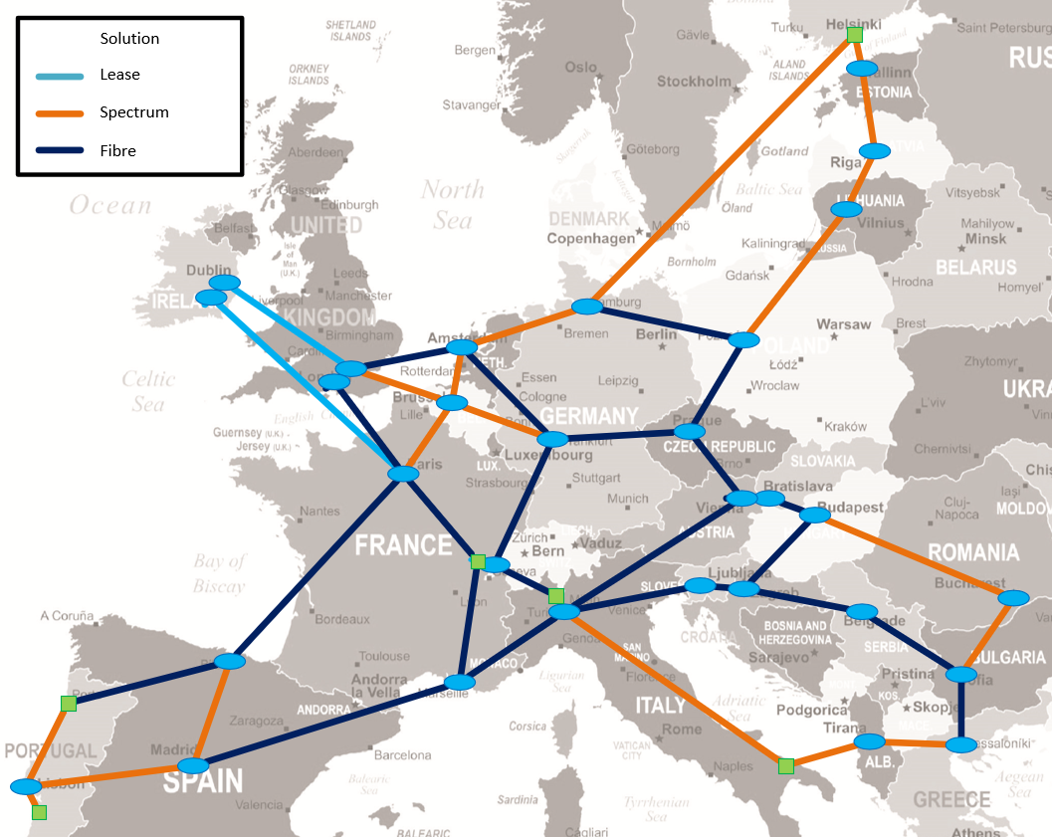
New GÉANT network
Spectrum sharing is key to making the new network economic
We will use spectrum from commercial providers and NRENs
We also plan to offer spectrum as a service to our customers
Coordination with NRENs will be achieved via the Spectrum sharing task in GEANT WP7

Slide 12
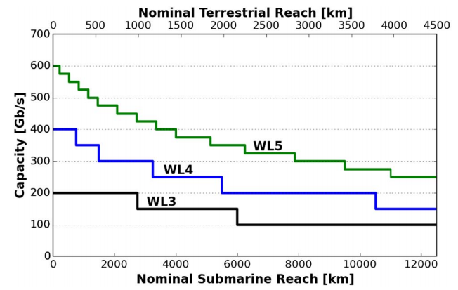
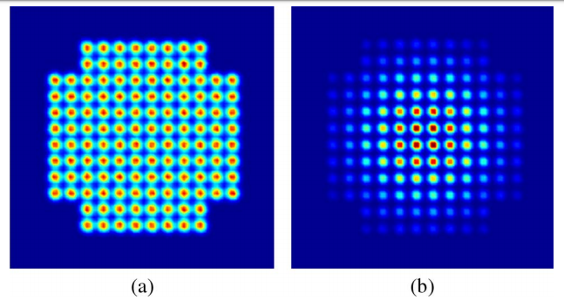
Spectrum: managing 64QAM and beyond
DWDM systems are analogue and impairments accumulate in complex ways
High-density 64QAM modulation methods allow many modulation types
Standardization of FEC will allow DWDM multi-vendor interworking
Dozens of optical settings for new transponders all interact – FEC type, modulation, power levels, gain tilt, EoL margin
With full/partial disaggregation how do we understand these interactions?
* 128QAM Ciena, Roberts et. Al. April 2017

Slide 13
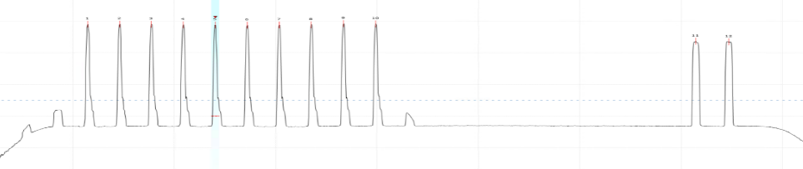
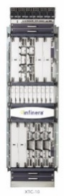

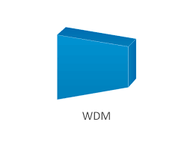
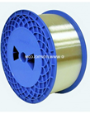
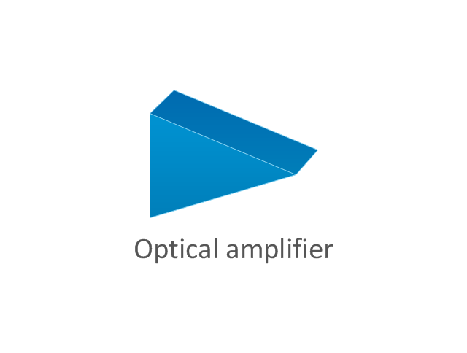
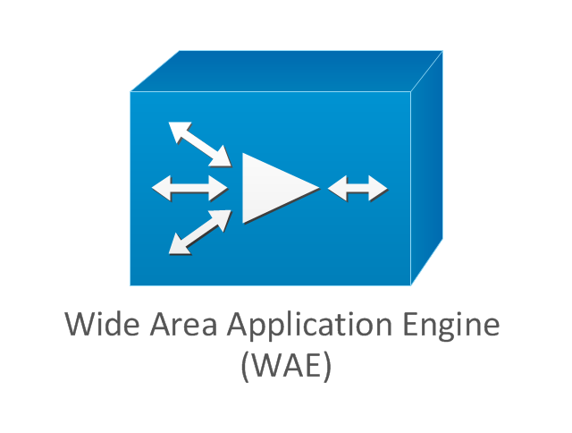
Modelling Spectrum Sharing
Spectrum
Infinera OCG
Groove
Plot Rx sensitivity
Add span noise
Infinera OCG
Band mux
Infinera OCG
Band mux
Vary power/ modulation/FEC
VOA 2
Measure pre-FEC BER
EDFA
EDFA
50km SMF
VOA 1
Groove
splitter
splitter
Groove
GEANT have automated our network model in Cambridge lab
Automated tests can cycle through hundreds of power/gain/modulation/noise/FEC parameters

Slide 14
Modelling spectrum sharing
This is the Groove G30 receive sensitivity when launched over a DTN-X line system with an existing Infinera OCG
Tx power is varied and the Rx pre-FEC BER as a function of Rx power.
The Bathtub curve shows the optimal power for launching the AW.
Nested loop is use to add added and repeat test
Increasing noise
Injected into line

Slide 15
NREN spectrum vs. commercial DF
Link | Commercial DF cost-share 8 years | NREN spectrum cost-share 8 years | Saving
A | 1,008,321 | 107,500 | 900,821*
B | 748,515 | 299,484 | 449,031 √
C | 339,495 | 23,507 | 315,988 √
D | 209,696 | 99,000 | 110,696*
E | 160,492 | 99,000 | 61,492 √
F | 395,156 | 412,500 | -17,344*
G | 192,368 | 272,164 | -79,796
H | 338,977 | 421,960 | -82,983
I | 71,861 | 167,500 | -95,639
J | 291,006 | 400,000 | -108,994*
K | 213,668 | 329,00 | -115,000
L | 868,178 | 2,904,703 | -2,036,000
M | 616,295 | NA
N | NA | 220,380
O | NA | No charge | (?) √
P | NA | No charge | (?) √
Q | NA | 364,000
R | NA | 207,500
S | NA | 40,000
T | NA | 400,000
Analysis carried out in 2018
20 links are candidates for using NREN spectrum
Costs have been compared with commercial DF
For 7 we have both NREN and commercial prices, further 5 with estimated commercial prices
5 NREN offers have confirmed reduction of the cost share (√)

Slide 16
WP7 T2: Building a spectrum service
GÉANT will build our new network using spectrum to reduce costs
This will require close cooperation with NRENs and commercial suppliers
We also aim to offer a spectrum service to our customers
The will require a new way of working
Spectrum Service Task in WP7 has been set up to operationalize this service

Slide 17
Summary
GÉANT is committed to spectrum sharing
We started spectrum sharing in 2015
We integrated DCIs into our network in 2018
The success of these two initiatives is driving the strategy for the new network
64QAM and beyond add to flexibility, but this is an analogue environment
Flexibility of new QAM technology makes life easier rather than more complex

Slide 18
guy.roberts@geant.org

