Slide 1
NORDUnet
Emerging NREN Program
Lars Fischer
TNC19
Tallinn, Estonia, 17 June 2019

Slide 2
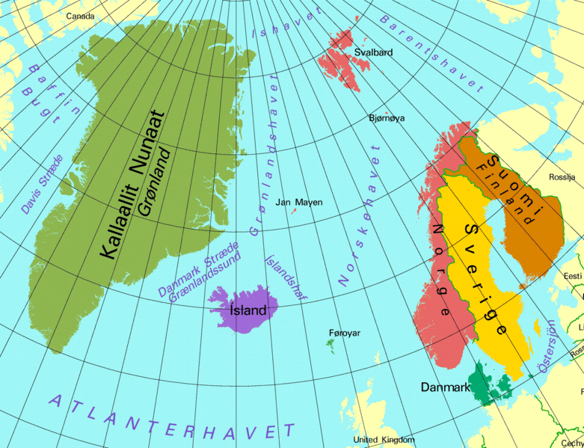
NORDUnet and Nordic NRENs
FUNET
SUNET
UNINETT
RHNET
DeIC
Notes:
An NREN collaboration
Facilitate collaborations among Nordic communutues

Slide 3
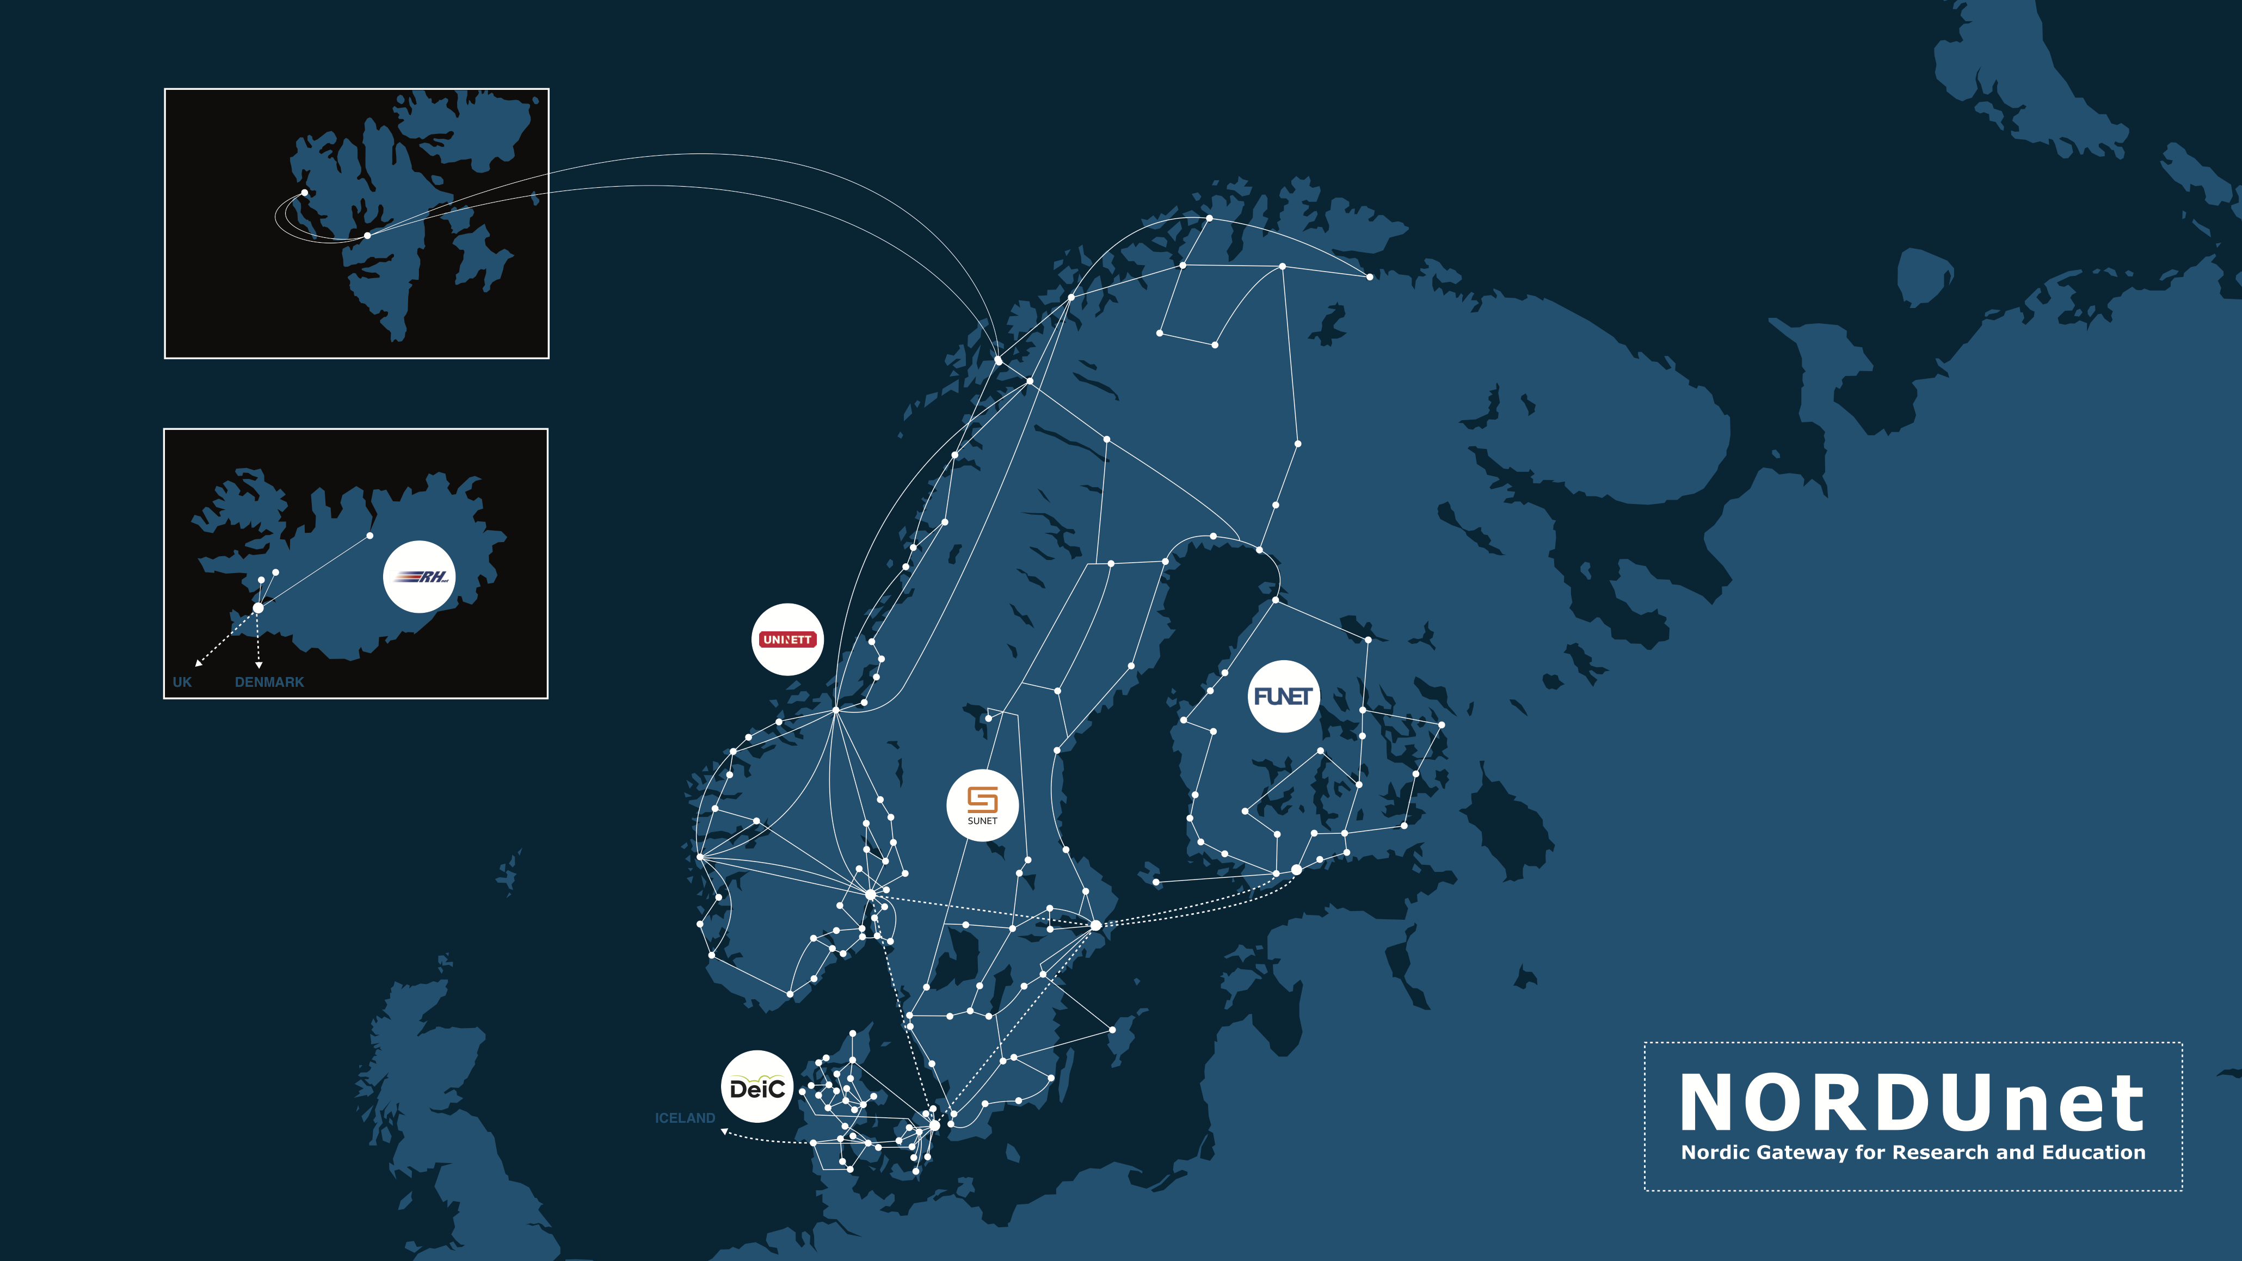
Nordic R&E Networks

Slide 4
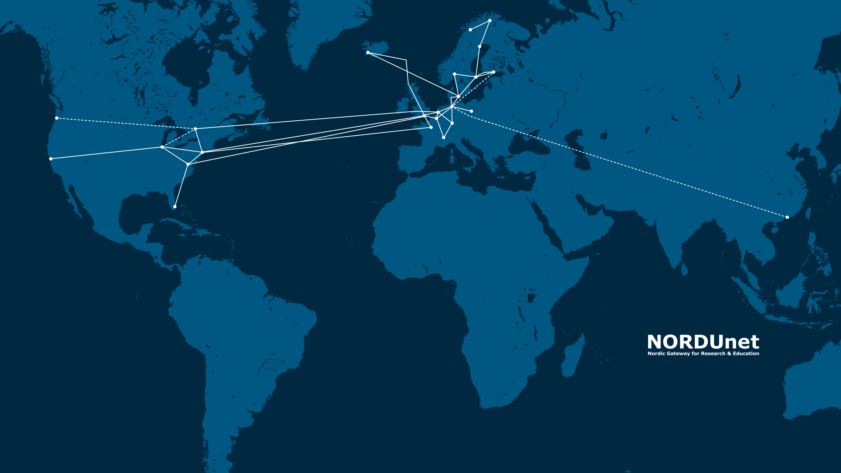
NORDUnet 2017

Slide 5
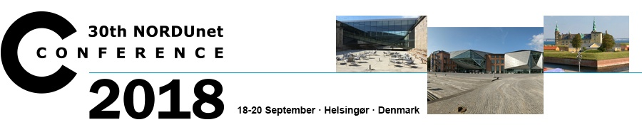
NORDUnet Conferences
The meeting place of the NORDUnet community
The origin of NORDUnet
  Established in 1980
  Where NORDUnet took shape
Vehicles for community building

Slide 6
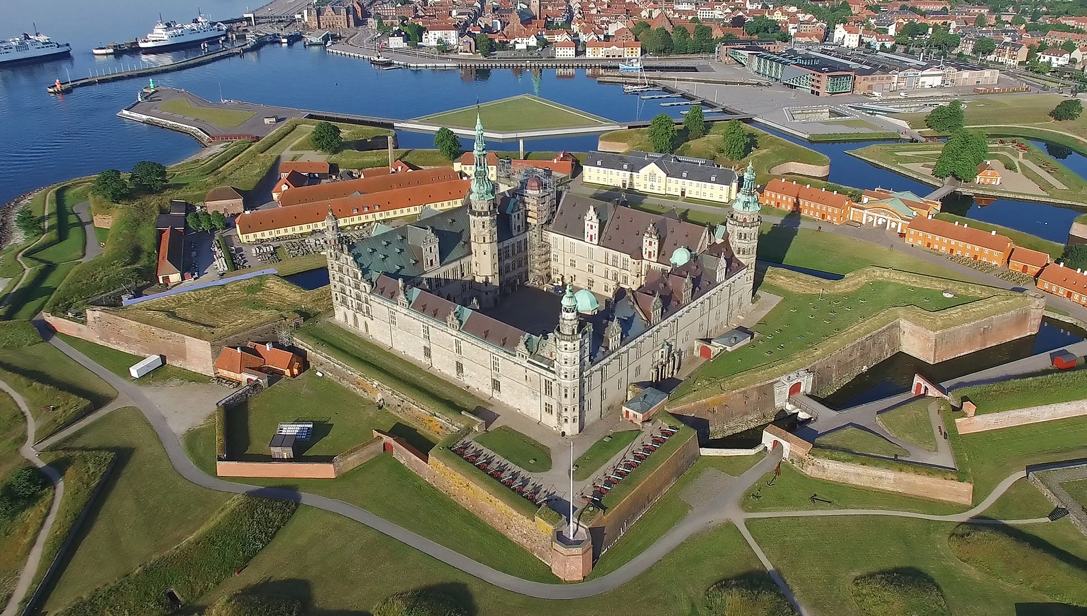
NORDUnet Conference
Rotate among five Nordic countries
Every two years, 10 year cycle
Broad but technical focus

Slide 7
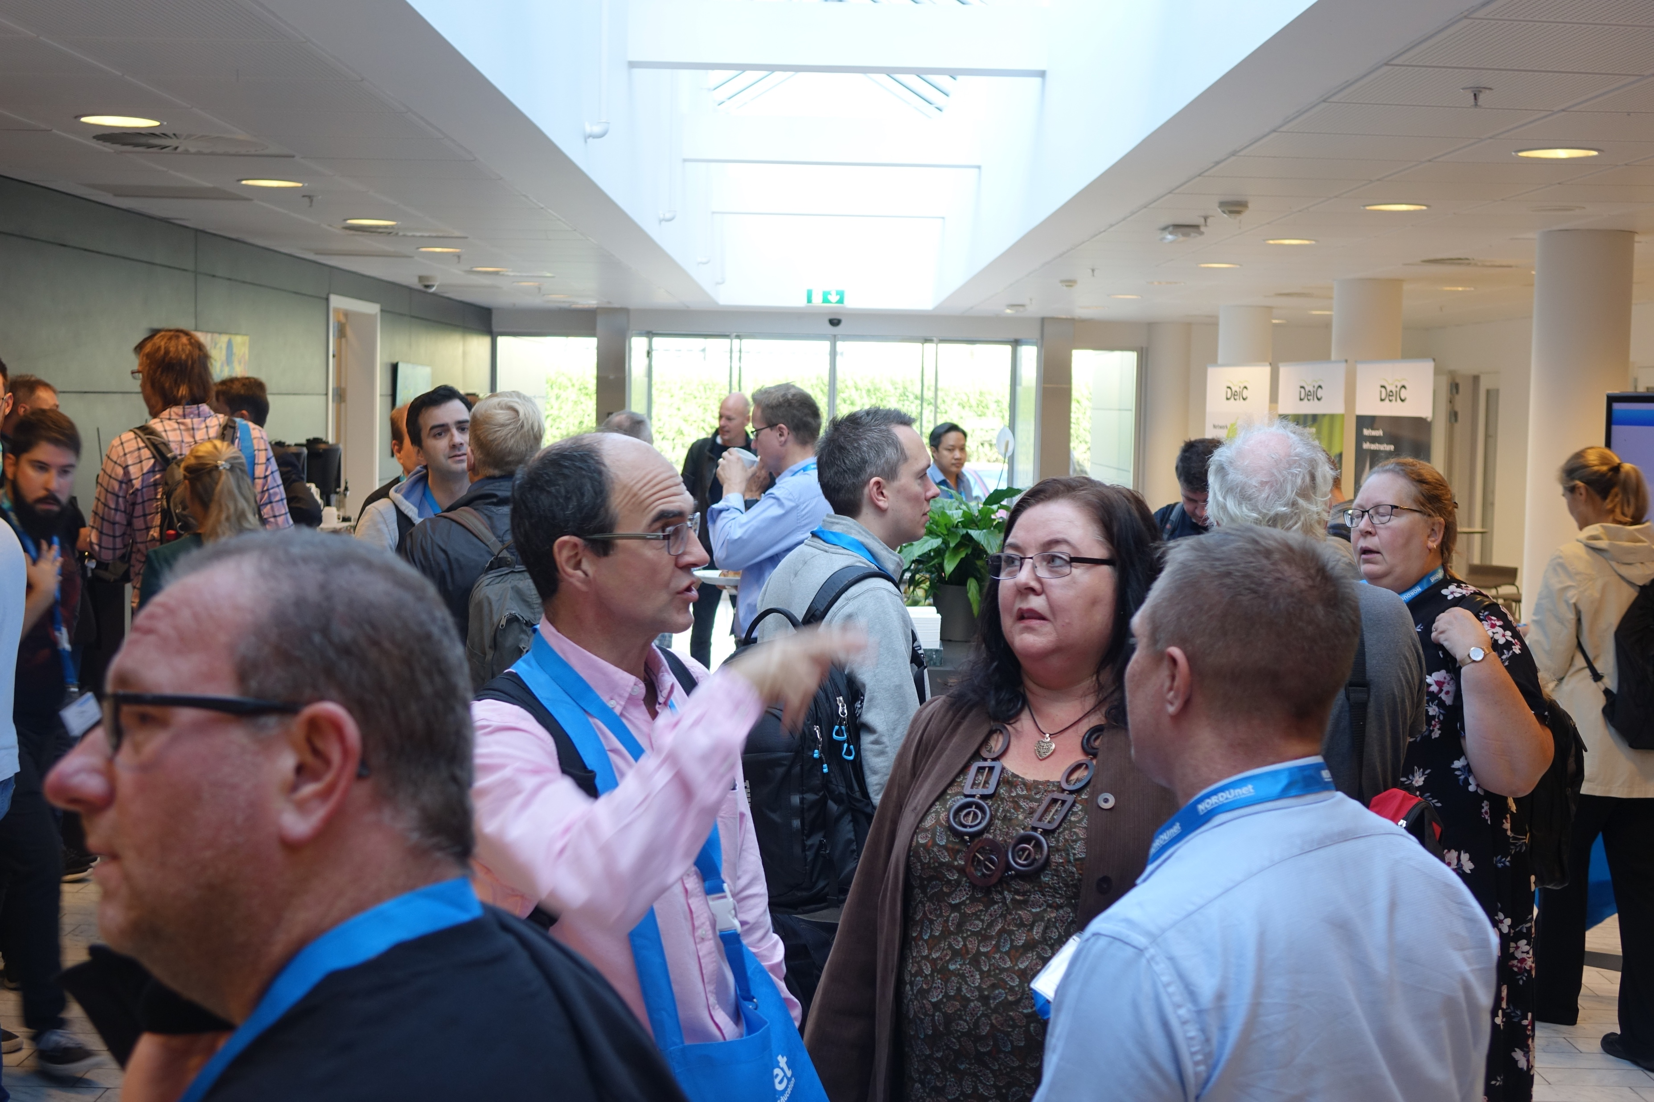
NORDUnet Technical Workshop
In Copenhagen every two years
Community & Working groups
Dynamic & Technical

Slide 8
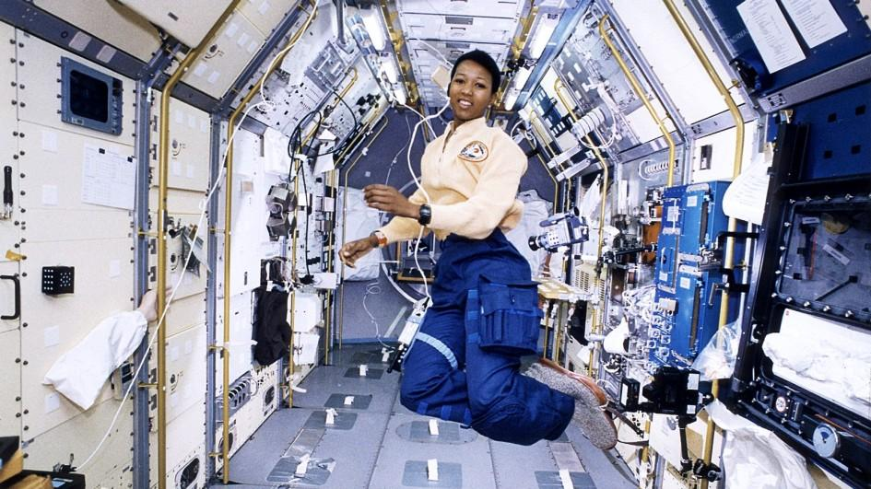


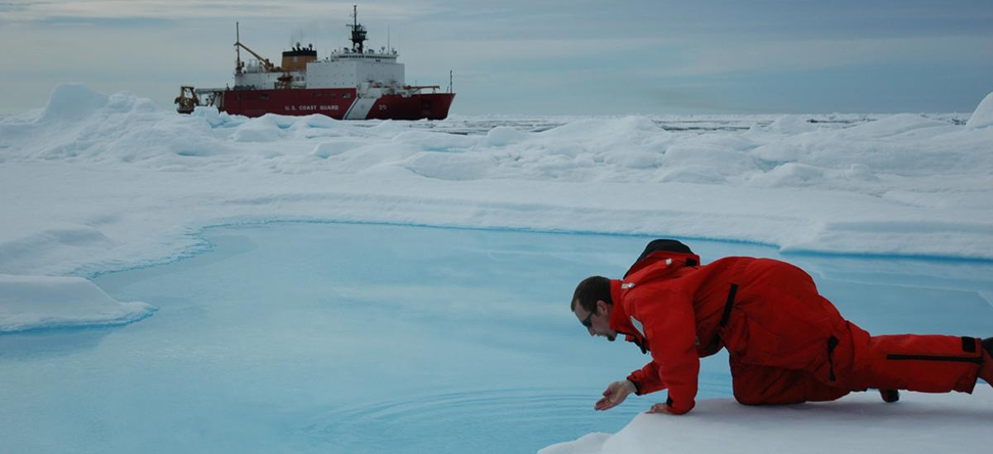
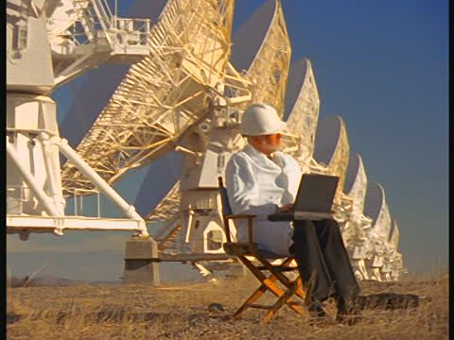
The User Promise
Anyone
Anywhere
Any time

Slide 9

Global Collaboration
GLOBAL COLLABORATION
A Dynamic World
Remote and Shared Instruments
Remote Campuses
Visiting Scientists & Students
Movement and Exchange of Data
Levelling the Playing Field
Global Collaborations & Partnerships

Slide 10
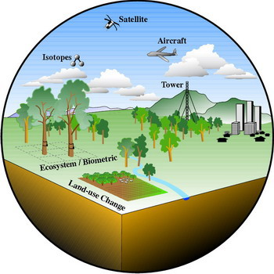
Global Landscape
eScience
Human Collaboration and Interactions
Talent & Knowledge
Observations
Ideas
Computation
Instruments
AAI
Storage & Repositories
The Network Bedrock

Slide 11
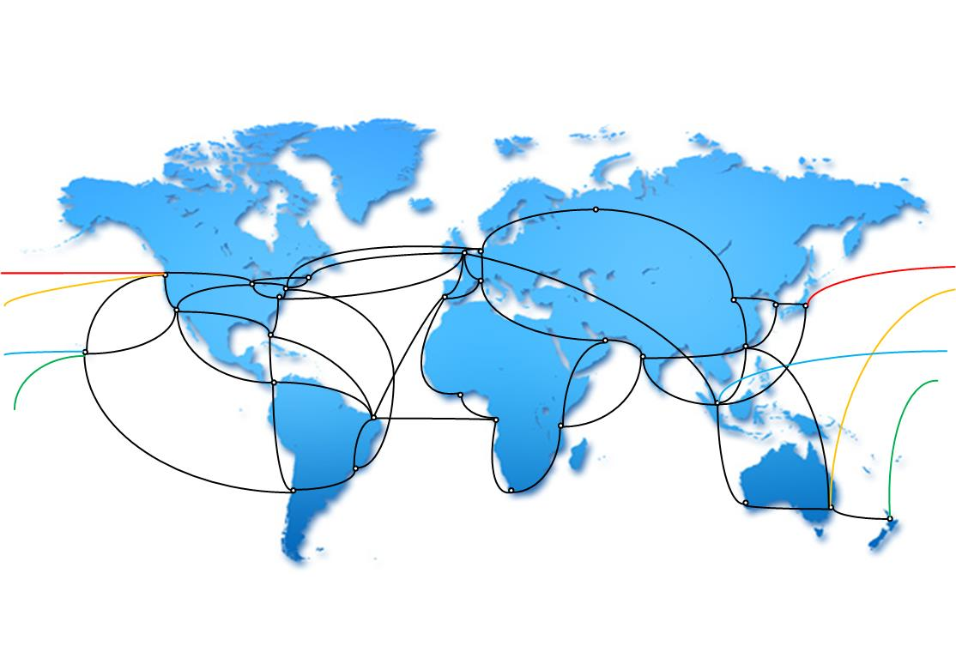
Global Network Architecture
Effort of Global R&E Network Community
Foundation for Global Collaboration

Slide 12
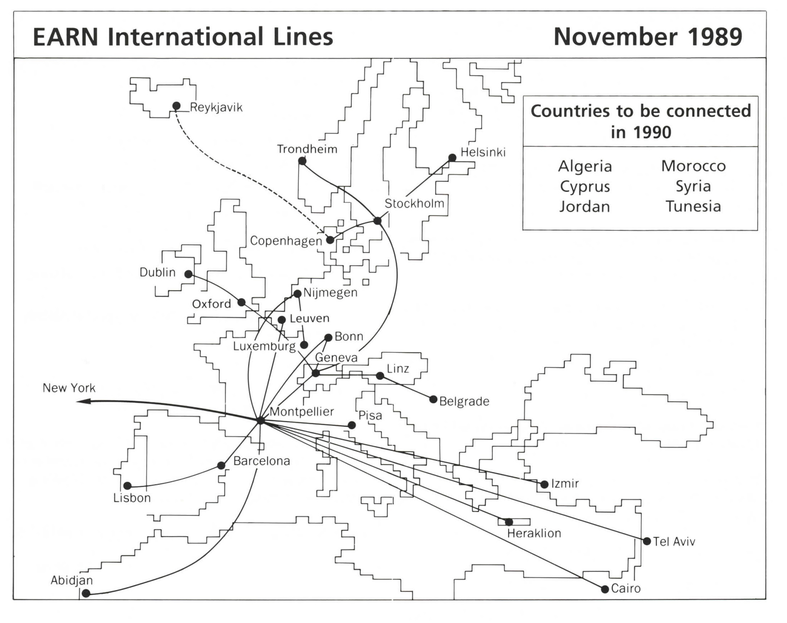
All about the connection …
Notes:
Collaboration was all about building the network
Focus on country, region, continent
High-level global collaboration on connectivity
Support for high-profile clobal science collaborations

Slide 13

All about the services …
Notes:
Support user collavorations
Collaborative reserarch projects
Multi-stakeholder education and training initiatives
Colaboration in providing services

Slide 14

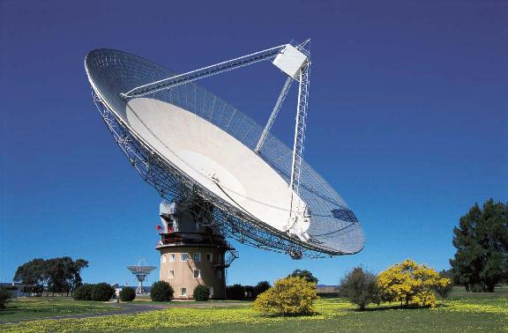

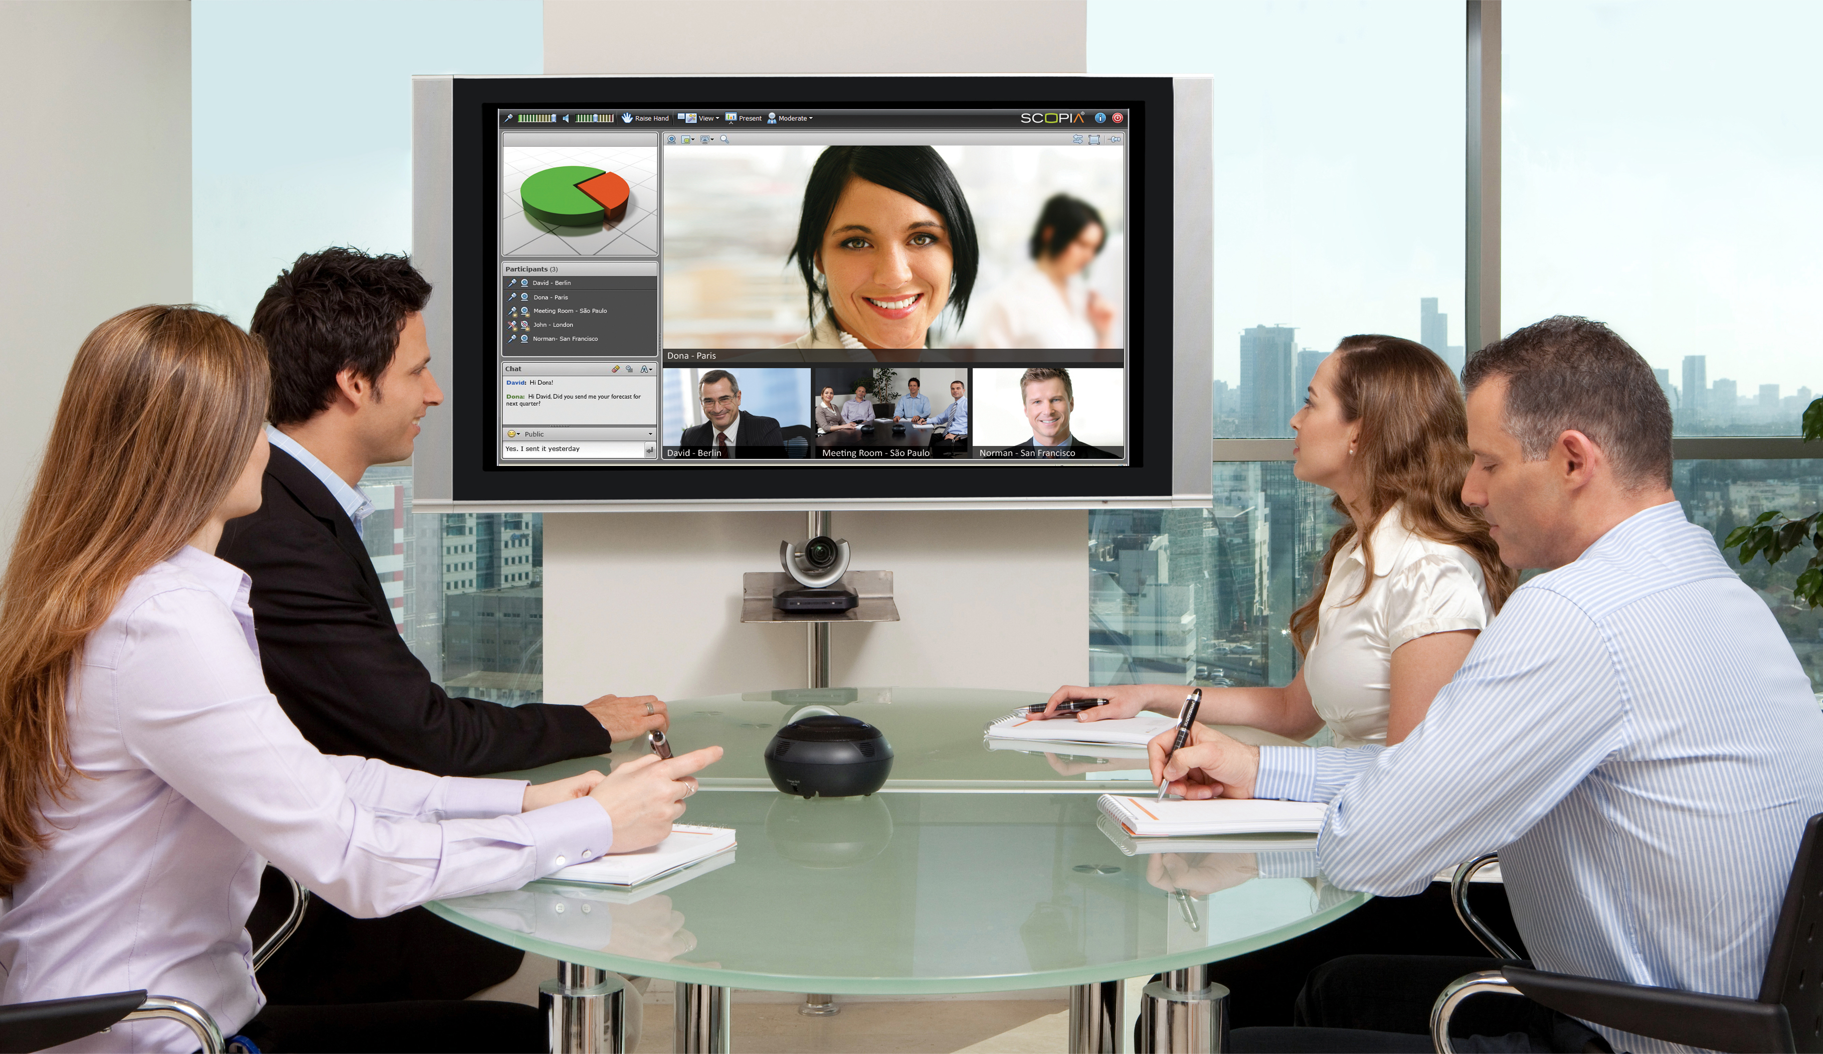
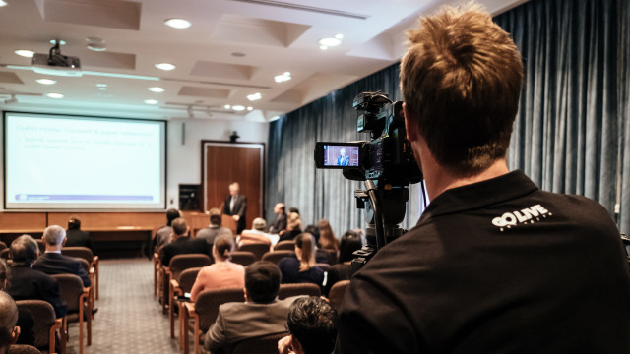

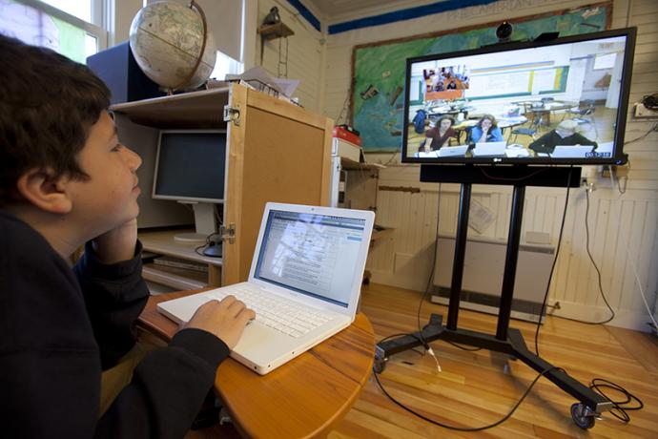
Many faces of Collaboration

Slide 15
NREN: Community Hub
Institution
Media Services
User
HPC Centre
Public Data
Repository
NREN
Commercial
Cloud Provider
Academic
Cloud Resource
Scientific
Instrument
Anyone – Anywhere – Any Time

Slide 16
NORDUnet e-NREN program
Created for the NORDUnet 2016
  e-NREN fellowships with sponsor support
  Travel, accommodation, conference, post-conference programme
Format
  Attend conference + 2-3 days
  Support from stewards
  Community building
  NREN knowledge transfer visits
Joining the global collaboration
Notes:
- It’s all about inviting people into the collaboration

Slide 17
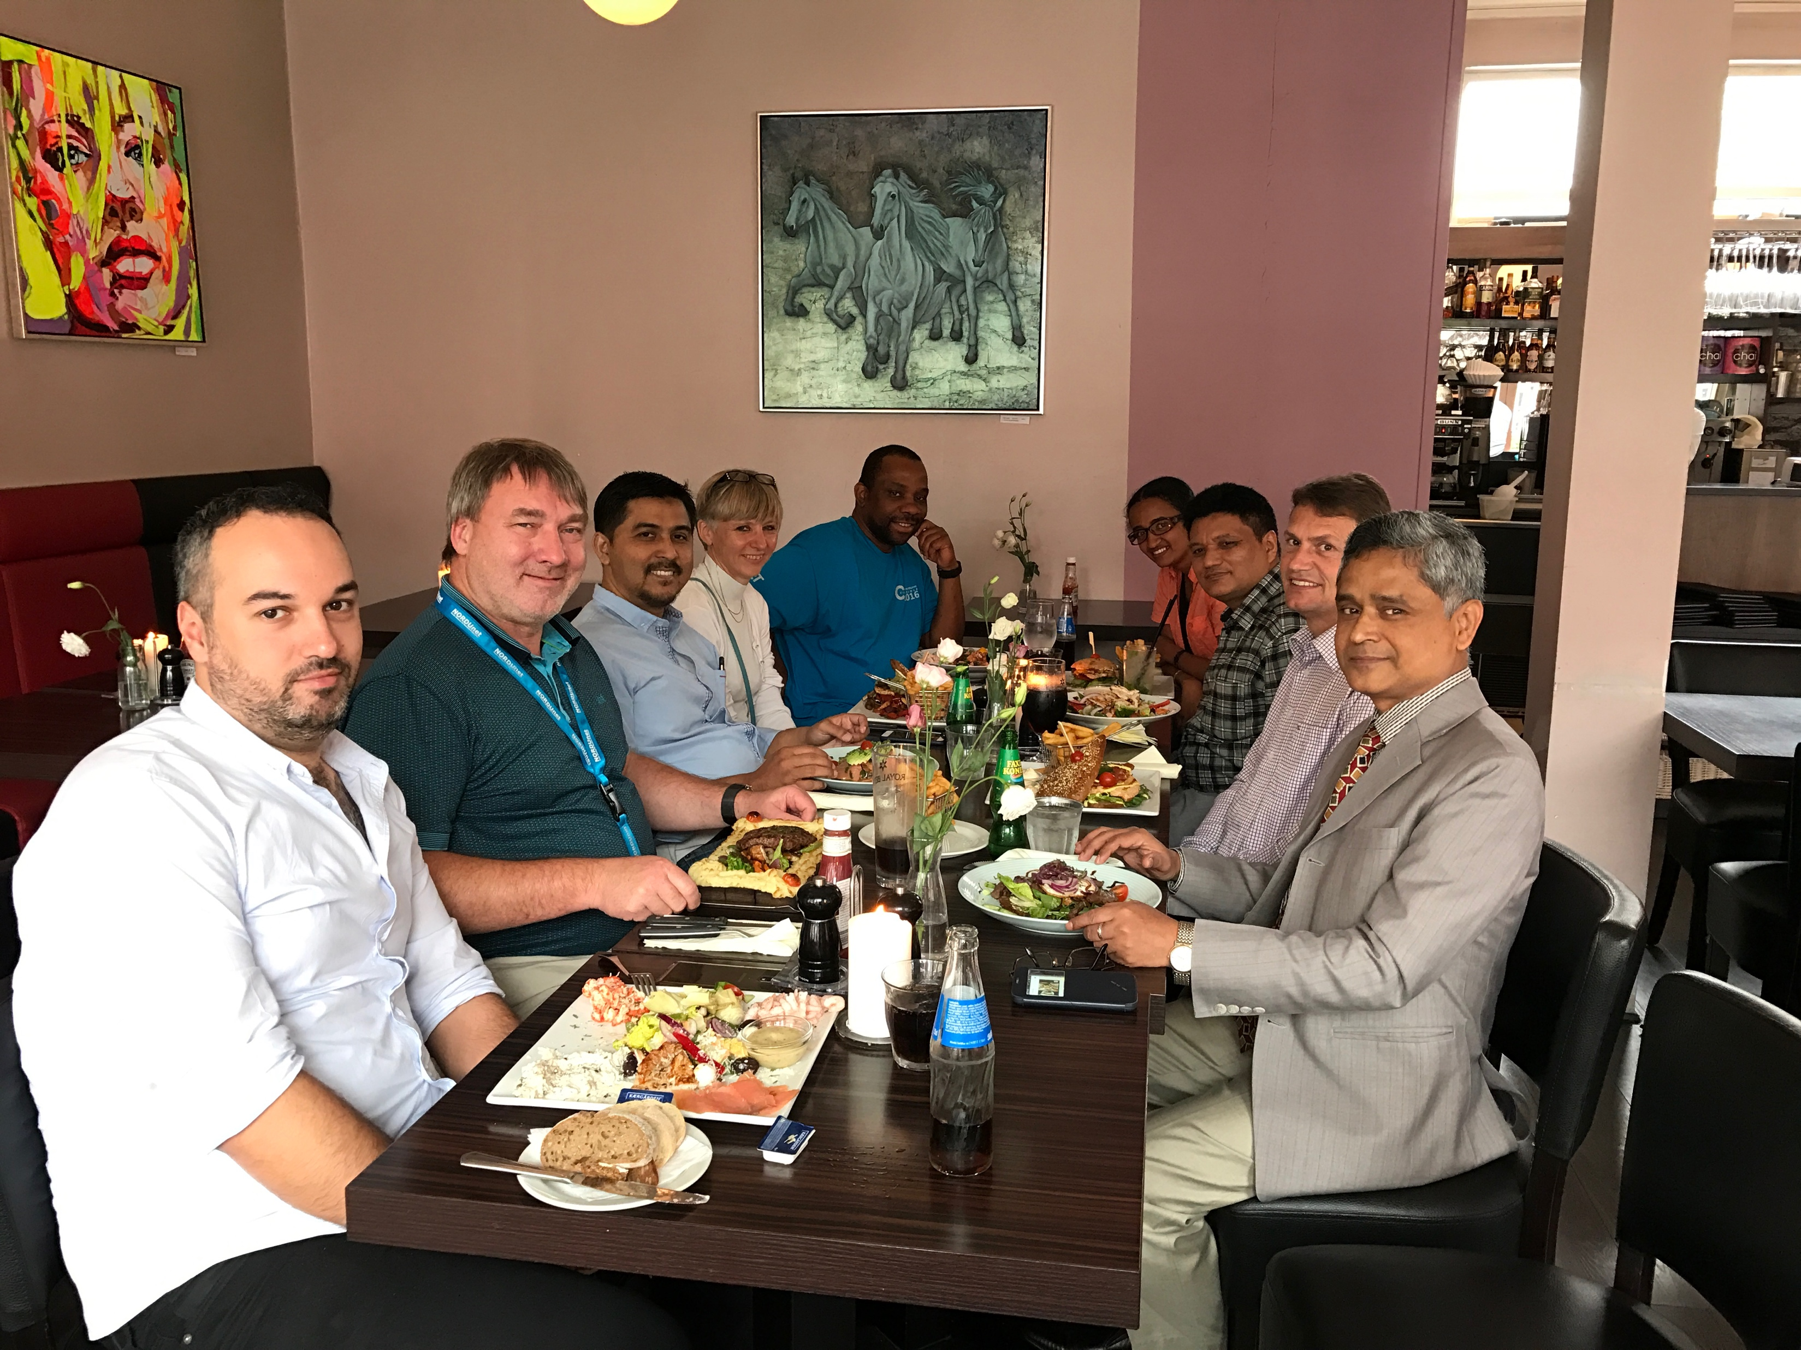
eNREN @ NDN Conference
Management-level fellows
Events focused on
  NREN value proposition and business
  NREN operations & management
  Future partnerships

Slide 18
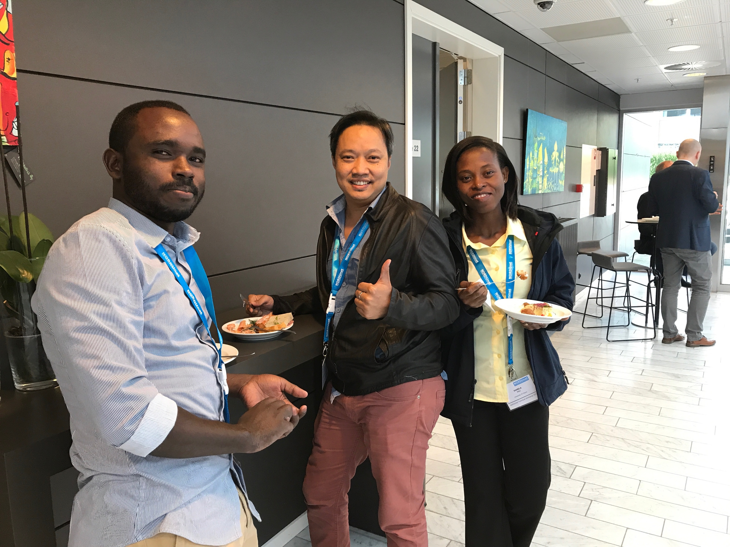
eNREN @ Technical Workshop
Engineering fellows
Events focused on
  NREN core technologies
  NREN services and operations
Technical
community
  Human network
  Mutual support
  Knowledge
  Transfer

Slide 19
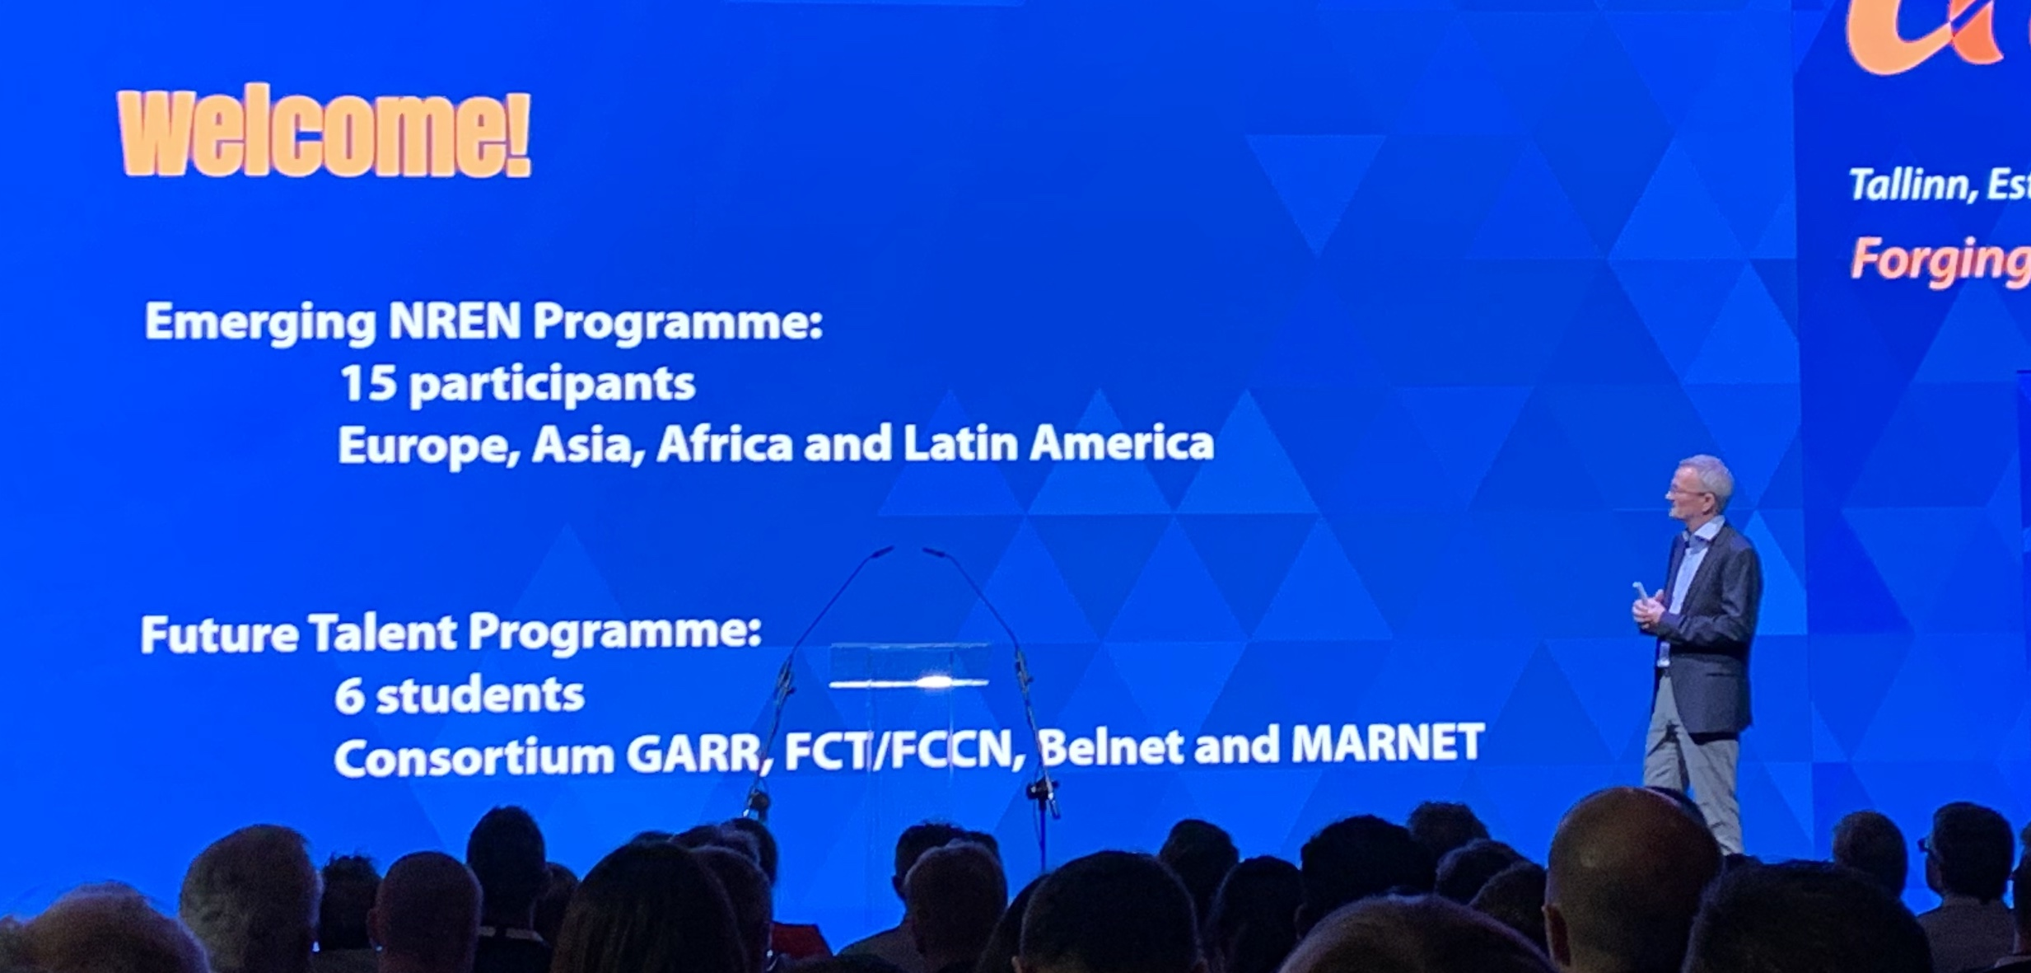
Expanding e-NREN Program
Alumni program
  Invite existing e-NREN partners to participate again (self-financed)
  Fully part of conference e-NREN program
GÉANT emerging NREN program
  Worked with GÉANT to create for TNC18
  Runs Again at TNC19
Go Global?

Slide 20
Partnerships
e-NREN program is just a start
Building partnerships
  For global networking
  For global services
  For future collaborations
Spin-off Activities
  Ad-Hoc support
  Knowledge Exchange visits
  Training visits
  Formal Projects

Slide 21
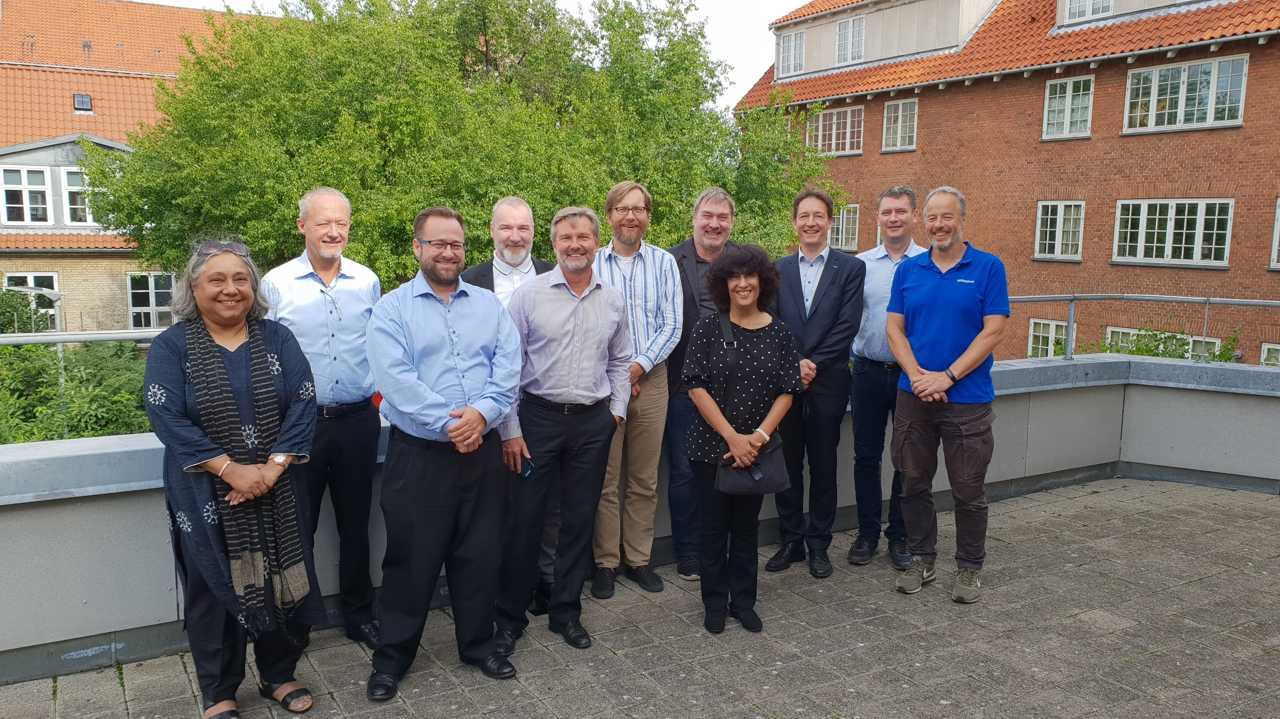
NKN
Notes:
Europe – Asia connectivity
India in next step CAE1

Slide 22
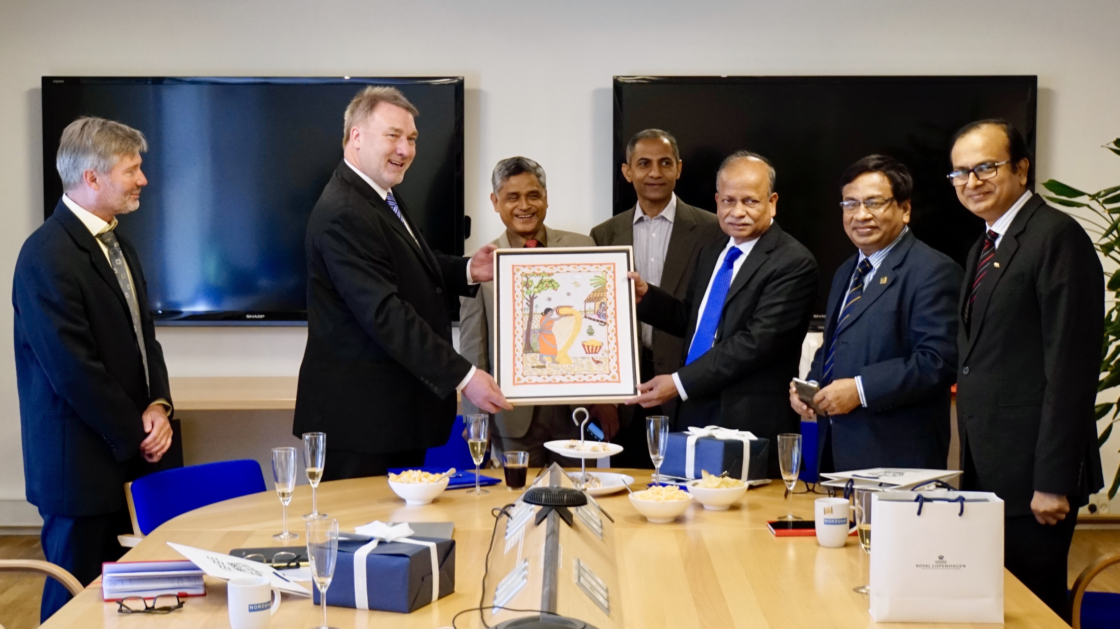
BdREN
Notes:
Direvct supprot for emerging NREN
Visiit from government officials
Mediation of government – government contact
EXPLAIN NREN VALUE PROPOSATION

Slide 23
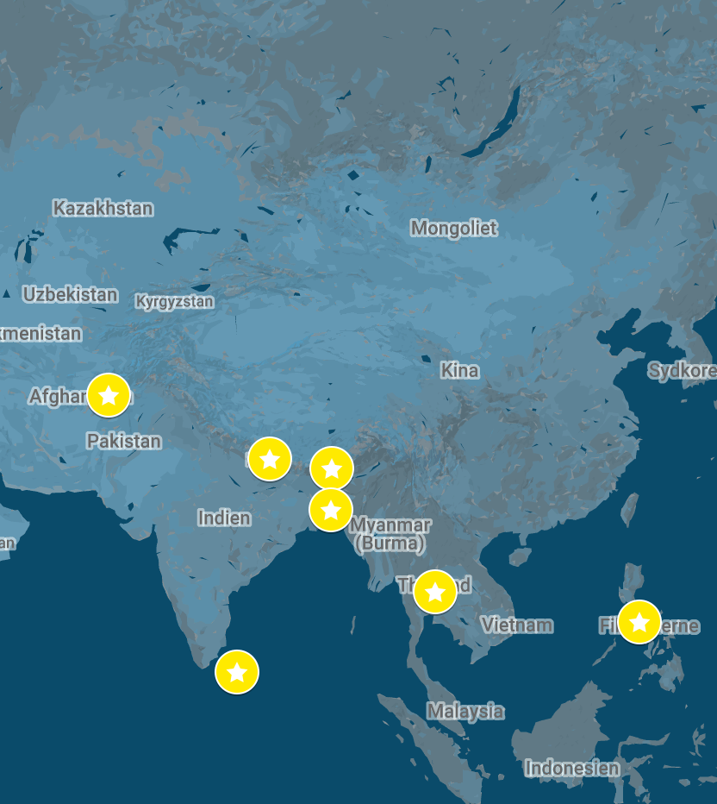
Distance Learning
“Facilitating Distance Learning using Digital Conferencing Facilities”
BdREN (Bangladesh)
ThaiREN (Thailand)
NREN (Nepal)
PREGINET (Philippines)
LEARN (Sri Lanka)
NORDUnet
Supported by European Commission through Asi@Connect Program

Slide 24
Objectives
Deploy
  a Digital Conferencing Platform
Transfer
  of Knowledge
Enhancement
  of Collaboration and Support
Facilitate
  Distance Learning Courses
Train the Trainers

Slide 25

Train the Trainer program
Setting up a training program to share the
NORDUnet experience on Online Education
Part 1
Implementation
Administration
Federation
Part 2
How to use
Pedagogy aspect
Use cases

Slide 26
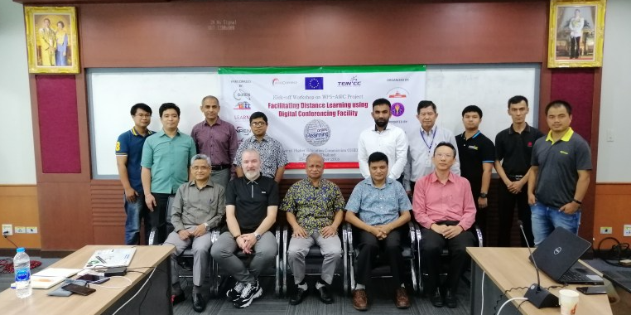
Workshop
Singapore – APAN45 – Aug 2017
Auckland – APAN46 – Feb 2018
Bangkok – Sep 2018
Korea – APAN48 – February 19

Slide 27
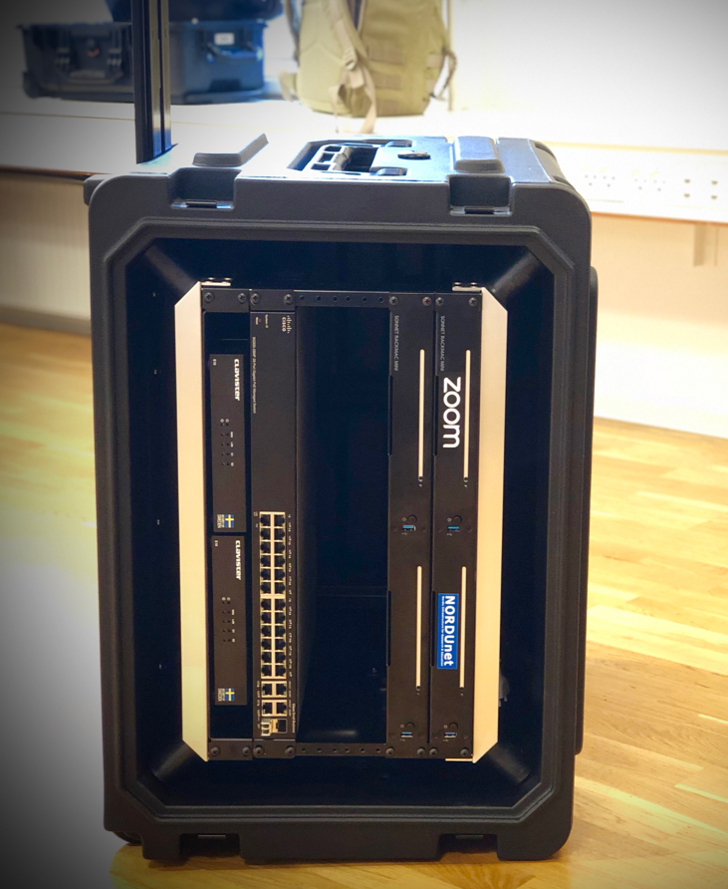
Service Deployment
Service Installation
  Dhaka –
  January 2019
Train the Trainers
  Sri Lanka –
  April 2019
  Bhutan –
  December 2019
Final Workshop
  Dhaka – April 2020

Slide 28
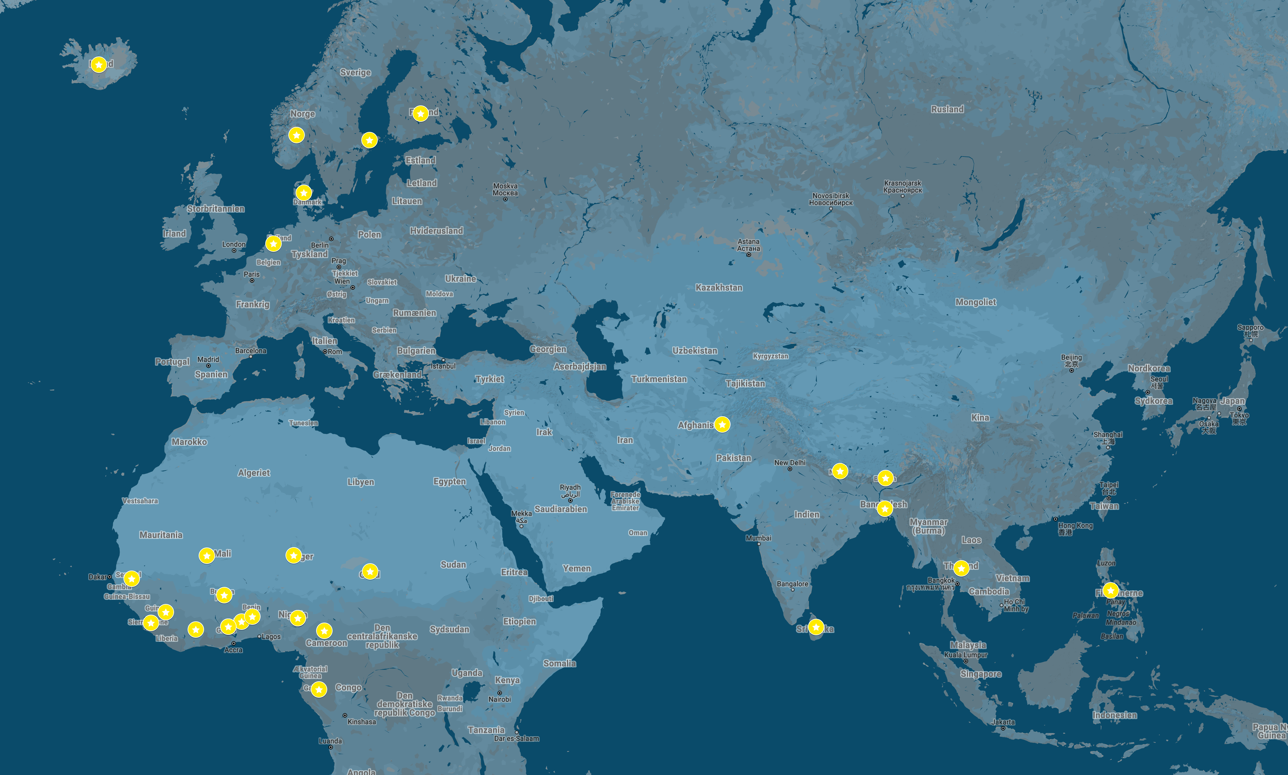
NORDUnet Media Initiatives

Slide 29
Invitation
For emerging NRENs
  Join future e-NREN programs
  Join future alumni programs
  Join the global community
For old NREN
  Host emerging NREN
  Let’s collaborate among the programs
For all
  Focus on Community building
  Create inclusive partnerships
Our strength as NRENs is that we work together as a community

Slide 30
Thank You!
The Nordic Gateway for Research & Education
Lars Fischer
<lars@nordu.net>

