Slide 1
ICDI, EOSC-Pillar and the Italian contribution to EOSC
Federico Ruggieri
TNC19
Tallin, June 2019

Slide 2
Open issues towards Open Science: why we need national initiatives
In order to make Open Science a reality, higher levels of coordination between RIs and e-Infrastructures are needed to:
Efficiently use resources (computing, storage, data, SW…)
Support high-quality research
Avoid duplications of efforts (i.e. reinvent the [same] wheel)
Make more efficient use of Regional, National and EU funds
Harmonise the (currently fragmented) policies to foster and incentivize Open Science at the organisation/national/international level
The participation in EOSC, EDI, EuroHPC (+AI) requires a clear and comprehensive position of the Italian Research Community
The Italian Research Community should play a key role in providing input to the Ministry of University, Research and Education for the preparation of the next FP of the European Commission

Slide 3
National Initiatives & the EOSC: a vision
National initiatives involving RIs and e-Infrastructures can play a key role to involve live user communities and research infrastructures in the very design of EOSC and its sustainable evolution.
Action is required:
At the national level, to bring together all relevant stakeholders
At the international level, to harmonise the National Initiatives and streamline the trans-national roll out of services that can be of interest of different communities distributed across multiple countries.
Having their intrinsic sustainability, the NIs can be a key element to support the development of the EOSC ecosystem, and develop into a cornerstone on which to build its long-term sustainability.

Slide 4
The Italian ICDI initiative: objectives & activities
Sign a MoU among the Research Organisations in Italy to create a core group
Develop an inclusive coordination between RI & eI
Supporting the Italian Scientific Research System by fostering synergies between RIs and e-Is at national level
Harmonizing Italian participation to pan-EU initiatives to optimize available resources and facilitating prioritization and sustainability
Establish a national coordination to increase the Italian capability to address and foster decision-making at EU level
Facilitating the harmonization and synchronization of the Italian priorities and strategies with the European context
Mapping national contributions to pan-European initiatives involving RIs and e-Is
Italian Computing and Data Infrastructure

Slide 5
ICDI: Italian Computing & Data Infrastructure
Born as a Bottom-up initiative, it currently includes major national research organisations and several universities

Slide 6
ICDI: Italian Computing & Data Infrastructure (cont.)
ICDI brings together key RIs in Italy:
National chapters of ERICs
ESFRI Projects
JRUs

Slide 7
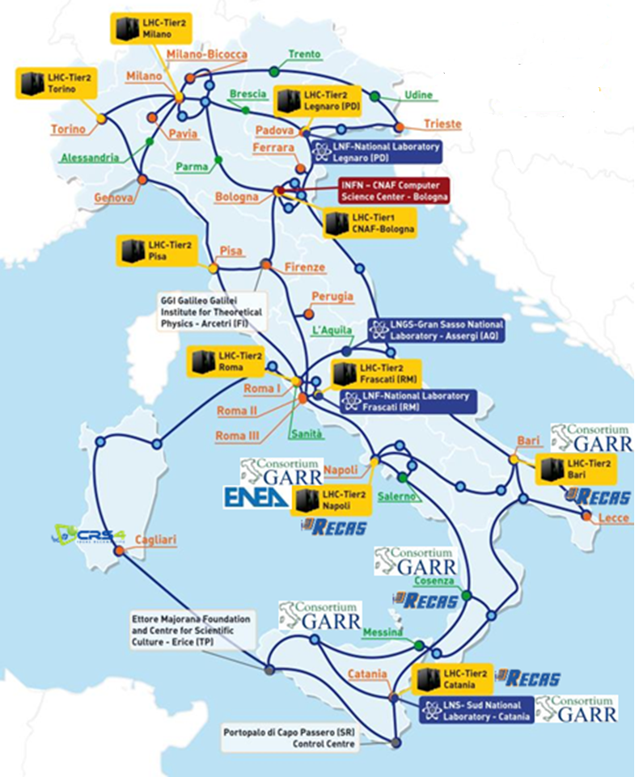
Available Resources and services
High Speed Research and Education Network (GARR)
Computing and Data centres in the major Research Institutes and laboratories (INFN, INAF, ENEA, CNR)
HPC in CINECA
Libraries and Data archives in many scientific domains: Health, BioMedicine, Agriculture, Physics, Earth Observation, Cultural Heritage, Archaeology, Geophysics, etc.
Data infrastructure services (OpenAIRE, D4Science)
International initiatives, e.g. Research Data Alliance
Data Scientist Master and PhD courses (Universities)
Notes:
Il panorama nazionale delle Infrastrutture di Ricerca (IR) è anch’esso vario e popolato da molte iniziative. Il Programma Nazionale delle Infrastrutture di Ricerca (PNIR) 2014-2020 censisce 97 IR e, fra queste, seleziona 56 IR prioritarie da sostenere attraverso la confluenza di varie tipologie di finanziamento (FOE, FFO, FSC, PON R&I, Fondi Regionali) nel FUIR.

Slide 8
EOSC-Pillar – Project
Acronym: EOSC-Pillar
Title of Proposal: Coordination and Harmonisation of National and Thematic Initiatives to support EOSC
Submitted to the Call: INFRAEOSC-05 (b) Coordination of EOSC-relevant national initiatives across Europe and support to prospective EOSC service providers - Research and Innovation Actions
18 Partners
Austria: University of Vienna
Belgium: University of Gent
France: CINES (Technical Coordinator), CNRS, INRA, INRIA, IFREMER, INSERM
Germany: KIT, DKRZ, Fraunhofer, GFZ
Italy ICDI: GARR (Coordinator), CINECA, CMCC, CNR, INFN
Italy: TRUST-IT
Total EC Contribution: € 6.880.965,00
Start date: 1 July 2019

Slide 9
EOSC-Pillar – Objectives
Support the EOSC implementation leveraging national initiatives of the Member States (MS) and Thematic Initiatives (TI) developed by research communities working in national and European collaborations to build a future based on Open Science and FAIR data practices
O1 - Analyse the state of the art of existing national initiatives and services for computing and data services in the countries involved, and support their consolidation
O2 - Harmonise procedures for the delivery of horizontal enabling services for research data across countries;
O3 - Co-ordinate with other initiatives to achieve harmonisation across different regions, countries, and trans-national research communities to build a truly inclusive EOSC;
O4 - Promote the uptake of FAIR data practices and services at national levels and across scientific communities and national borders
O5 - Enable non-commercial trans-national services to be accessed through the EOSC portal;
O6 - Support the growth of an active community of stakeholders in each involved country, who will actively contribute to the success of EOSC;
O7 - Propose viable business models for the sustainable provision of trans-national services.

Slide 10
Work-packages
Work package No | Work Package Title | Lead Part. No | Lead Part. Short Name | Person-Months | Start Month | End month
1 | Management | 1 | GARR | 58 | 1 | 36
2 | The human factor of the EOSC: Dissemination, Outreach and Community building | 18 | TRUST-IT | 69 | 1 | 36
3 | National Initiatives Survey | 6 | UNIVIE | 80 | 1 | 36
4 | From National Initiatives to trans-national services | 1 | GARR | 89 | 1 | 36
5 | The Data layer: establishing FAIR data services at the national and transnational level | 15 | Fraunhofer | 126 | 1 | 36
6 | EOSC in action: Use cases and community-driven pilots | 8 | CNRS | 288 | 1 | 36
7 | The Infrastructure layer: delivering horizontal data storage and computing services, from national to transnational | 8 | CNRS | 119 | 1 | 36
 |  |  |  | 829

Slide 11
Conclusions
ICDI (Italian Computing and Data Infrastructure) is a forum created by representatives of major Italian Research Infrastructures and e-Infrastructures, with the aim of promoting synergies at the national level, and optimising the Italian participation to European and global challenges in this field, including the European Open Science Cloud (EOSC), the European Data Infrastructure (EDI) and HPC
ICDI provides the national research community with opportunities to discuss and negotiate common strategies for the participation in the EOSC and EDI, in order to optimise and coordinate the Italian contribution to these initiatives. As first actions, we mapped the Italian participation in pan-European Research Infrastructure and e- Infrastructure programmes and identified the initial contributors to the ICDI initiative
This work aims at bringing different benefits, a) coordinate the participation to European and National initiatives; b) ensure a coherent growth of national infrastructures, c) improve sustainability by leveraging on existing human capitals, knowledges, experiences, etc., d) foster the cross-fertilization of solutions across multiple scientific domains
ICDI is currently finalising a MoU among the major Research Organisations in Italy that are responsible for existing Research and Electronic Infrastructures
Italian participation to EOSC-Pillar (and EOSC-Secretariat) projects has been discussed and agreed in the ICDI meetings
The Italian Ministry of Education, Universities and Research, while joining the ICDI as Observer, is very interested in this initiative especially if it will be recognised as representative of the national stakeholders community and able of supporting the Ministry in elaborating the national positions with respect to the European initiatives under development

Slide 12
Thank you

