Slide 1
Building the Foundation For Next Generation Digital Learning Environment
Jack Suess
VP of IT
UMBC
jack@umbc.edu

Slide 2
What We Will Discuss
Overview of the NGDLE vision
Four recent IMS efforts supporting the NGDLE
Edu-API initiative
LRS design and student analytics
LTI-Advantage
Open Badges V2 and Comprehensive Learner Record
Open Educational Records through OpenStax
Notes:
My goal today is threefold.
1. I want you to see that the NGDLE is not an inherently new concept and is evolutionary in that it is built on prior work such as the Internet and other standards that have been in place for over thirty years.
2. How to recognize where the NGDLE is planning to go and understand what technologies and tools are aligned with the NGDLE.
3. How you should be planning your IT environment so that you will be able to quickly take advantage of NGDLE features and how you can prepare your faculty to take advantage of NGDLE advances for improving pedagogical innovation and student success.

Slide 3
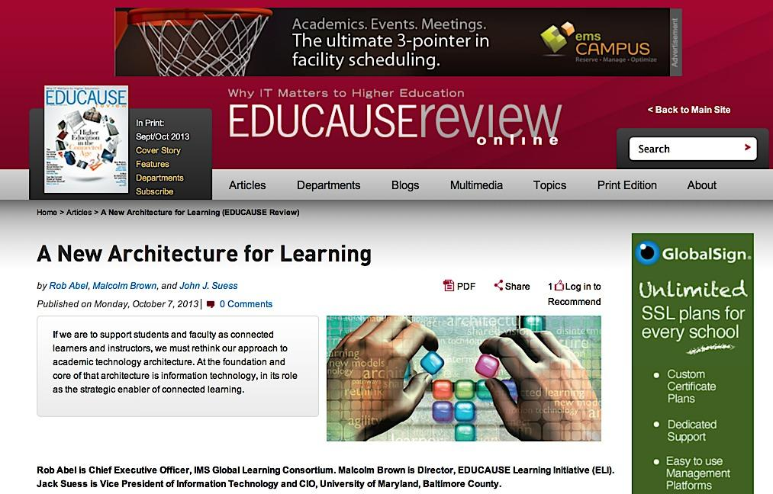
Notes:
In October 2013, Rob Abel, Malcolm Brown, and I co-wrote an article for EDUCAUSE Review titled, “A New Architecture for Learning.” This piece focused on rethinking teaching and learning from being a walled garden that is dominated by the Learning Management System to being an ecosystem that broadly supported innovation. We used the model of the “App Store” and what that did for mobile technology – it changed the way people think about software. The “App Store” relied upon an ecosystem where 3rd parties could fairly compete and was easy for end-users to manage.
We did not call this new environment the NGDLE but we saw the essential elements of easy end-user application integration, analytics, and user experience being essential in the future.

Slide 4
https://net.educause.edu/ir/library/pdf/eli3035.pdf
Notes:
The ELI paper, The Next Generation Digital Learning Environment, https://net.educause.edu/ir/library/pdf/eli3035.pdf, was an important paper in defining what the NGDLE is and isn’t.

Slide 5
Dimensions of the NGDLE
Interoperability and Integration
Personalization
Analytics, Advising, and Learning Assessment
Collaboration
Accessibility and Universal Design
https://library.educause.edu/~/media/files/library/2015/4/eli3035-pdf.pdf
Notes:
Interoperability – All components must be able to accept and exchange curricular content in common formats. This would ensure that content can be exchanged, transferred, and utilized. Second, on the tool side, integration must be easy enough for end users to quickly and easily add tools to the environment, without help from central IT. Third, the learning environment will continue to be the key source of learning data. The unimpeded exchange of data is imperative to be able to aggregate, integrate, and analyze learning data. Fourth, the NGDLE must enable the creation of new interoperability standards in ways that are compatible with its other standards so that overall coherence is maintained.
-- For IMS we see LTI Advantage and Caliper Analytics as key standards we need to build on.
Personalization - Personalization encompasses two aspects. The first is the outfitting and configuration of the learning environment, which is then used to construct pathways to accomplish learning tasks and attain learning goals. The second aspect is adaptive learning, in which an automated system provides learners with coaching and suggestions specific to each learner’s needs.
For IMS Microcredentials and Access for All as key standards we need to build on
Analytics, Advising, Learning Assessment - Learning analytics, defined as “the measurement, collection, analysis, and reporting of data about learners and their contexts, for purposes of understanding and optimising learning and the environments in which it occurs.” Integrated planning and advising systems (IPAS), defined as “an institutional capability to create shared ownership for educational progress by providing students, faculty, and staff with holistic information and services that contribute to the completion of a degree or other credential.”
-- For IMS Caliper Analytics is key.
Collaboration - The NGDLE must provide learners with individual spaces that persist across entire academic careers (and possibly into professional lives), serving as a base for all learning operations. Tools such as portfolios and tools for content creation must also be fully integrated into the environment.
-- For IMS micro-credentials will be important and future advances in LTI.
Accessibility and Universal Design - “Universal design is the design of products and environments to be usable by all people, to the greatest extent possible, without the need for adaptation or specialized design.”13 In the context of the NGDLE, universal design means, most simply, having the goal of a learning environment that works for all learners and instructors
--For IMS, Access for All is a key standard and improvements in the LTI profile are necessary.

Slide 6
Four Recent IMSglobal Efforts
IMS launched in mid-90’s.
IMS-Europe launched 18 months ago, 2nd conference is October 10-11 in Barcelona.
IMS works across K-12, higher-ed, suppliers, and governments to create standards

Slide 7
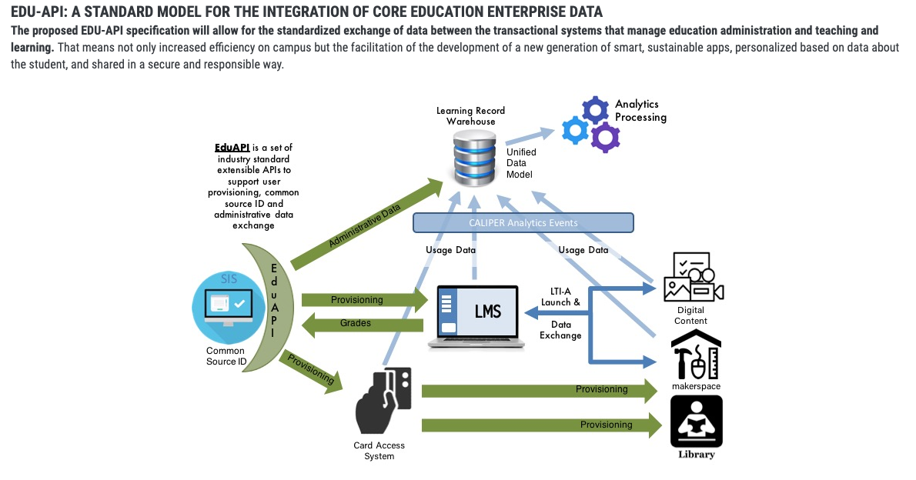
EduAPI

Slide 8
Evolution of thought for Person data model and Higher Ed enterprise models
LDAP
1993
IETF-RFC 2798 inetOrgPerson
2000
Internet2
eduPerson
2001
Internet2
Grouper
2003
SAKAI
Course management service
2006
Metadata for Learning Opportunities (MLO)
2008
Schac
2011
IMS
LIS
2013
AARC Blueprint Architecture
GEANT (Europe)
2017
IMS
OneRoster 1.1
2017
IMS
Edu-API
2018
Compiled by Keith Hazelton
Notes:
<main presenter: Matthew>
Time estimate: 2-3 min
On the shoulders of giants
Building on the past

Slide 9
Timelines and Next Steps for V1.0
Completion of concept and information model (Summer 2019)
Hackathon at August Technology Congress (Long Beach)
Candidate Final presentation at Educause (October 2019) V 1.0
Notes:
<main presenter: Michael>
Time estimate: 5 min

Slide 10
Learning Record Store
Student Analytics Hub

Slide 11
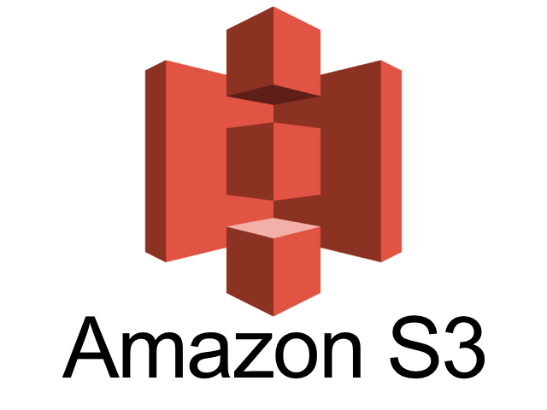
Ingesting Streaming Campus Activity Data
“Student 123 declared major X”
JMS messages, web services, transaction logs, etc
Event data enriched and converted to standardized, semi-structured profiles
Event payloads streamed to AWS S3 data lake
Data securely stored in 5MB line- delimited text files
Organized by profile type (source)
SNS initiates data load into Snowflake in-memory analytics warehouse
PeopleSoft SIS
JMS
“WiFi client ABC dwelled 17 minutes in building 1, floor 2, room X”
REST API
Cisco CMX WiFi
Apache NiFi
AWS S3 Data Lake

Slide 12
Ingesting Streaming Vendor Event Data
Contextual Relational Data (SIS, Student portal, Analytics for Learn, etc)
Contextual Flat Data (VitalSource books, users, etc)
Caliper Event Stream
Amazon Redshift
Clients
Amazon CloudFront
AWS
Lambda
Kinesis Firehose
AWS Glue
Amazon API Gateway
Amazon S3

Slide 13
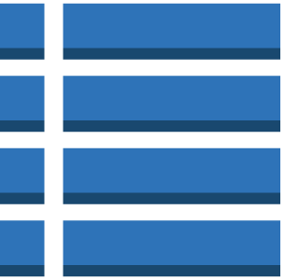
Today: Learning Record Store
Streaming Event Data
AWS Data Warehouse
Blackboard Caliper Events
VitalSource Caliper Events
Bulk-loaded Table Data
Courses
LMS
eTextbook
Students
Student Portal
SIS
Peoplesoft/SIS
Student Portal
Vendor Dimensional Data
Ingest and Extract
Ingest streaming Caliper events
Extract bulk tabular dimensional data
Transform
AWS Glue, Lambda, etc
Complex and inflexible data transformations
Subject to failure on source data changes
Load
Required schema decision prior to understanding business requirements
Lack of analytics flexibility
Far-removed from source

Slide 14
Tomorrow: Student Analytics Hub
Streaming Event Data
AWS S3 Data Lake
Snowflake Warehouse
Semi-structured data
Blackboard Caliper Events
SIS Events
Blackboard Caliper Events
SIS Events
VitalSource Caliper Events
Student Portal Events
Curated Views
VitalSource Caliper Events
Student Portal Events
WiFi Location Events
Student Activity Events
WiFi Localtion Events
Student Activity Events
Ingest Event Streams
Ingest streaming vendor Caliper events
Ingest streaming contextual events (grades, enrollment, bio/demo, etc)
Enrichen and Load
Store events in AWS S3 data lake
Lossless, transaction data remains very close to source
Transform in Memory
Curated data sets (views) matched to consumer need
Optimized for analytics discovery

Slide 15
LTI Advantage
Blackboard, SAKAI, Moodle, D2L, and Canvas all support LTI Advantage
Enables 3rd parties to write once and integrate with all LMS
This standard is a key element of the NGDLE

Slide 16
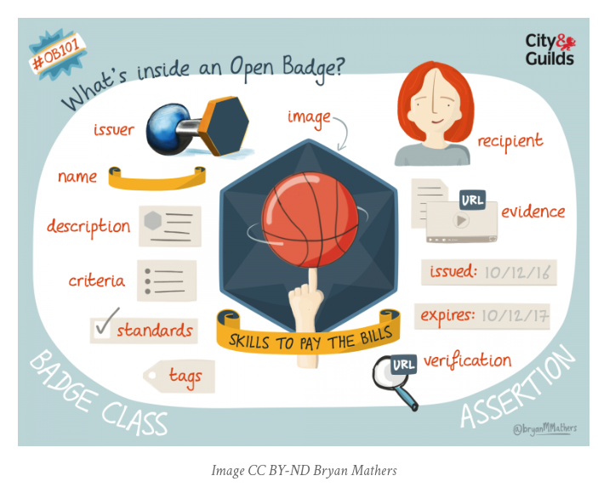
Open Badges V2.0 & CLR

Slide 17
Open textbooks and the opportunities they present
Klara Jelinkova
Rice University
klaraj@rice.edu

Slide 18
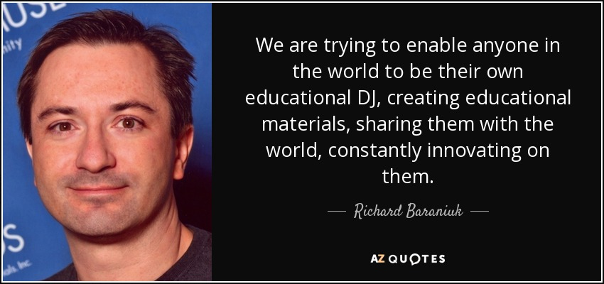
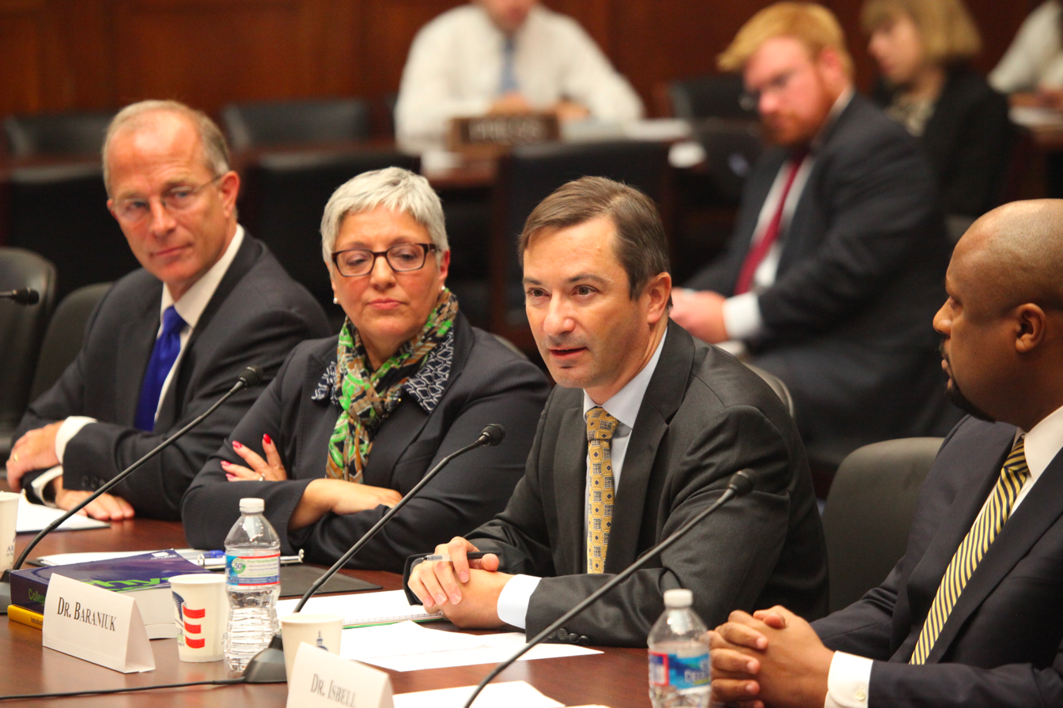
OpenStax and OpenStax tutor

Slide 19
OpenStax@Rice University

Slide 20
OpenStax@Rice University

Slide 21
OpenStax@Rice University

Slide 22
OpenStax@Rice University

Slide 23
OpenStax@Rice University

Slide 24
OpenStax@Rice University

Slide 25
Problems yet to be solved
For learning science to break out of its lab-based, small-sample-size past, it needs a research infrastructure that places scientists as close as possible to large numbers of students in their normal learning workflow.
Learning scientists need to be able to manipulate standard student experiences as well as introduce research-specific interactions.
User accounts, coordinating content, enrolling students in studies, assigning work, collecting consent, manipulating experiences based on data, protecting privacy -- these are immense barriers for learning scientists who want to study real-world learning at scale.

