Slide 2
Agenda
Project overview
Technology choice
Complementary perspective
Distribution
Networking capabilities
Sustainability
Support
Trainings and documentation
Further deployments
Take-aways

Slide 3
Inspiration For the Project
User survey results - inexpensive measurement device but with known capabilities
Low cost deployment target
Low entry work (preinstalled setup)
Get first hand experience
Increase awareness and usage in the GÉANT community
For an NREN with an outdated perception of perfSONAR or end-user organization
Useful for custom and numerous deployments
More deployments, more useful perfSONAR is

Slide 4
Performance Measurement Platform (PMP project)
Consists of set of low-cost hardware nodes with preinstalled perfSONAR software
Natural evolution of successful Small Nodes project (2016)
The central components that manage the platform elements, gather, store and represent the performance data, are operated and maintained by the GÉANT project
Coupled with GÉANT MPs to create a partial mesh for NRENs
Small nodes users can shape the predefined setup and configure additional measurements to their needs and get more familiar with the platform
Can become example measurement experimentation and training platform about network measurement, network management, network performance
Can provide an easy way to setup a new perfSONAR small nodes on new small devices (not tied to the hardware) through providing ways for image creation and guidelines

Slide 5
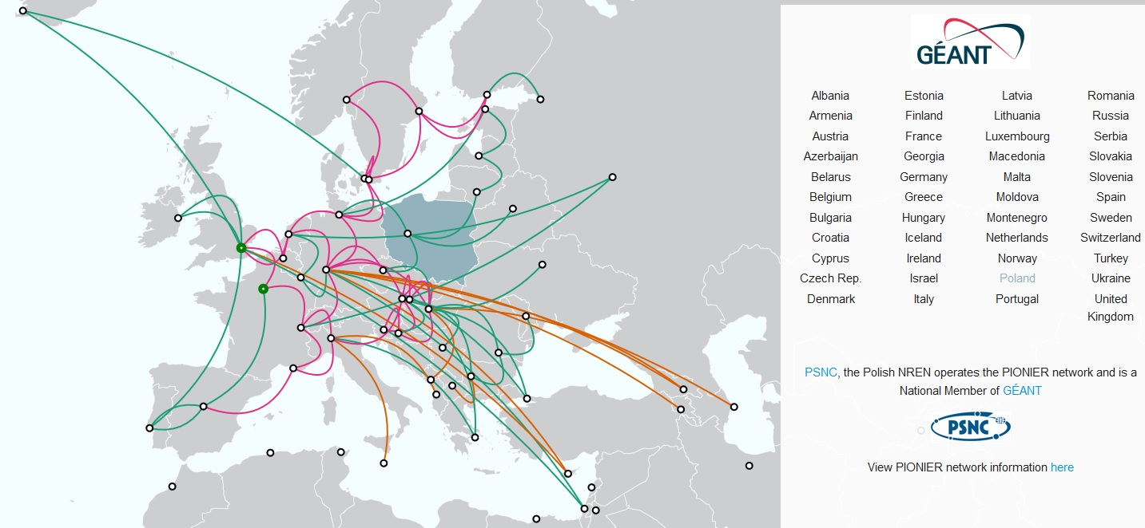
A Production GÉANT Service
Operations team
Central infrastructure
Automation
Monitoring
Processes and documentation

Slide 6
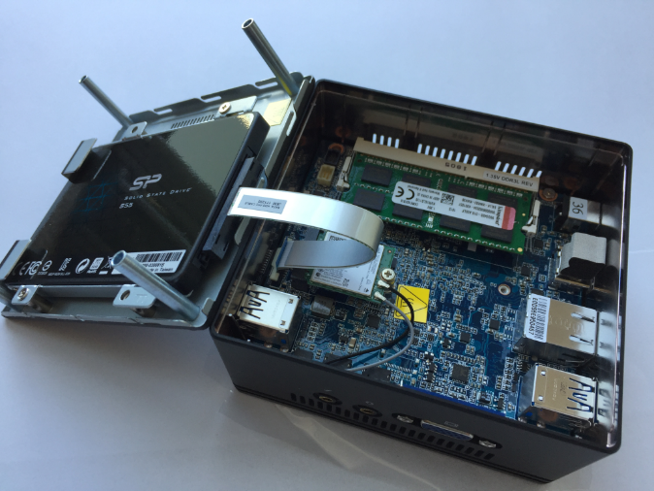
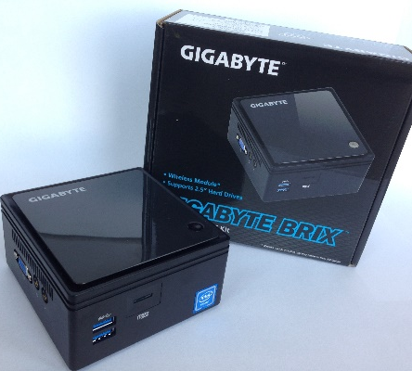
Technology Choice
Small size
Targeting ~200 Euros/box
Multiple considerations but price factor mattered
Final choice GIGABYTE BRIX (GB-BACE-3150/3160) with 8GB RAM and 1Gb/s RJ45 LAN
Doesn't mean to replace proper servers
1G limits large scale users but also can be a challenge for smaller NRENs
Other hardware may be more powerful but is more pricey

Slide 7
Complementary Perspective
perfSONAR-based platform that adds a new perspective to existing deployments
Low cost
Preinstalled and preconfigured
A basis for new research work to cover new use-cases
On-demand measurements
Campus deployment
New ways of visualization
NRENs are primary targets but outcomes useful not only to a limited population of users
Global integration of features is challenging

Slide 8
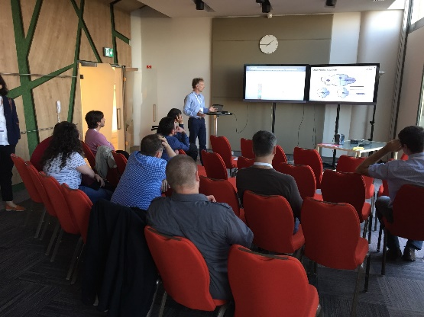
Distribution
Recognizes the diversity of various communities
NRENs (GN4 project partners)
Individual organizations
GÉANT partners
Free of charge model
Distribution of nodes mainly at various events
We benefit from direct interaction
Direct distribution important but the pace seems not sufficient
Not easy to reach all project partners through direct channel
Free distribution model is not a guarantee of quick success

Slide 9
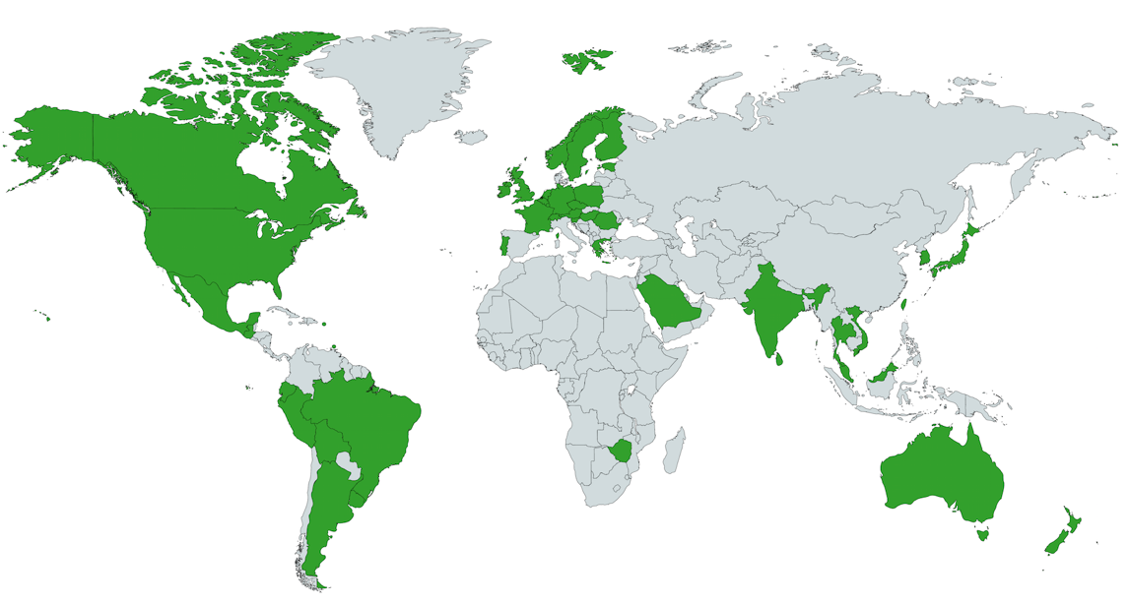
Networking Capabilities (1/2)
perfSONAR is capable running both IPv4 and IPv6 measurements
Dual stack recommended
PMP has ~66% of IPv6 interfaces coverage
~30% of interfaces in the whole perfSONAR world
Countries with IPv6 deployment greater than 5%, „State of IPv6 Deployment 2018”, https://www.internetsociety.org/
In 2018 38% of RIPE Atlas had IPv6
(Source, RIPE Atlas: https://labs.ripe.net/Members/stephen_strowes/ipv6-launchiversary-a-review-from-ripe-atlas-and-k-root)
Providing IPv6 connectivity service still an issue
IPv6 coverage data matches other statistics
Performance monitoring should implement both types of measurements to follow user traffic patterns

Slide 10
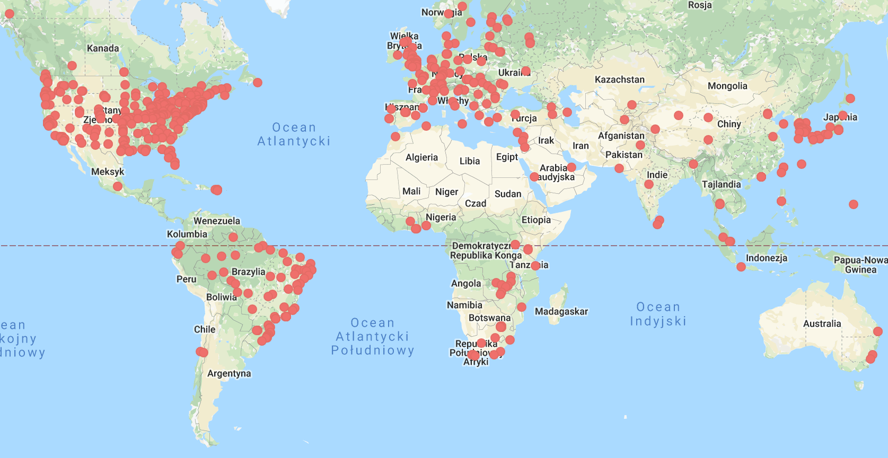
Networking Capabilities (2/2)
perfSONAR is about sharing data
Contributes to a global view of network performance
Organizations have different network and host security policies
Limited remote access to the node for ops team
Who can run what
perfSONAR therefore implements ways to adapt to those
pScheduler limits offers the ability to control what tasks may be run, by whom and with what parameters
We should create a community of trust to build common measurement infrastructure
Consider private deployment when no other choice
Organizations should have access to own node
Node behind firewall may observe performance impact

Slide 11
People Sustainability
We need an individual who has responsibility with regard to the deployment and maintenance of service instance
Fluctuation of members may lead to lost credentials or even equipment lost
Changes are natural but can make PMP service troubleshooting process longer
Danger of abandoned nodes
„… left a couple of years ago and whilst he handed over the perfSSONAR node to me the credentials for it have been lost during the transition.”
Don’t falsely assume there won’t be staff changes
General contacts works well in most cases but named individuals are helpful
Works better when service embedded into organisations’ internal structures

Slide 12
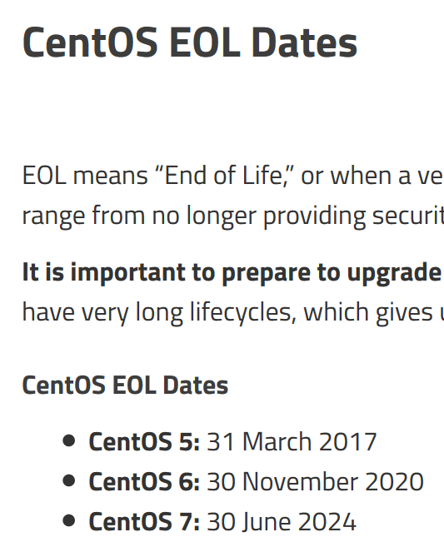
Technical Sustainability
perfSONAR regular releases adopt to OS changes
But OS change requires manual intervention in the node
PMP relies on GÉANT perfSONAR servers infrastructure to operate network monitoring platform
PMP relies on NRENs’ engagement
Evolving networks may require PMP extensions
Manual interventions are cumbersome but required
Physical access to the node may be an issue
GÉANT should make sure it supports cooperating services

Slide 13
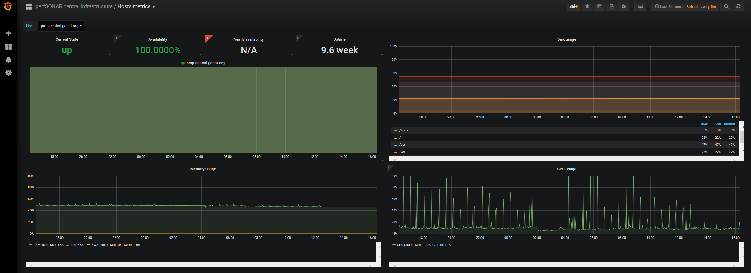
Support
Operations team
Distributed
Runs central infrastructure
Reacts on monitoring alerts and user reports
Provides consultancy and support
Can improve the service ownership experience for users
Affected by project personnel changes
Processes and how-to knowledgebase important parts of operations team sustainability
Big world-wide user community is helpful
Identified service gaps should be addressed

Slide 14
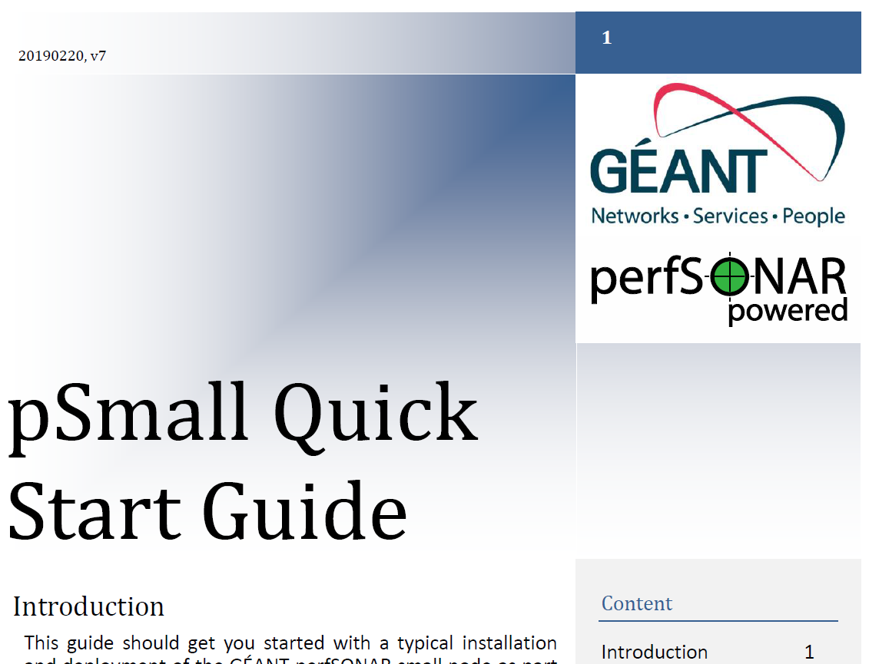
Trainings and documentation
Regular updates at various events
Tailored user trainings
General and specific documentation
Helps in effective service adoption
Allows to strengthen users’ skills
Allows to take full charge of their own monitoring infrastructure
Helps reduce any weak links that may exist in the community for deploying monitoring platforms and solving end-to-end performance problems
Information flow can circulate around the same user communities
Don’t assume people have foundational skills
Accessing project documentation may be an issue

Slide 15
Leveraging Project Suport to Extend perfSONAR Footprint
PRACE project, http://www.prace-ri.eu/
STFC, https://stfc.ukri.org/
LoLa project, https://lola.conts.it/
EaP Connect, https://www.eapconnect.eu/
Notes:
The PMP platform inspired the scientific community into further extensions and deployments of monitoring infrastructures. Over time we have seen an increasing engagement to use perfSONAR, and users becoming motivated to deploy perfSONAR within their own domains, in addition to any currently existing PMP platform. perfSONAR enables communities or organisations to deploy, configure and manage large-scale measurement capabilities which interoperate with the rest of any multi-institution infrastructure.
perfSONAR implements capabilities that are vital to diverse user groups and it constantly evaluates the changing requirements and addresses them to ensure the product is applicable to a wide range of different communities.

Slide 16
Take-aways (1/2)
Our findings may be applicable to other GANT services or similar deployment projects
perfSONAR can serve many use-cases. PMP is one of them
Networking capabilities significantly vary in NRENs and organizations
Secure but common access to data and infrastructure is important factor
Wide adoption of services requires people and technical sustainability

Slide 17
Take-aways (2/)
GÉANT is an important player
Users (NRENs, institutions) play a significant role in production service deployment
Good service and excelent support experience can improve service reputation
Trainings move users from a novice level to an enhanced capability level and may allow creating new use-cases
Listen and learn from your users

Slide 18
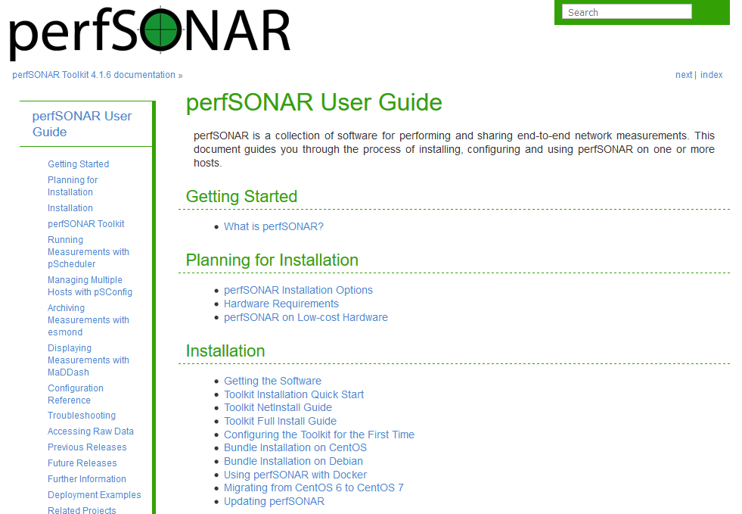
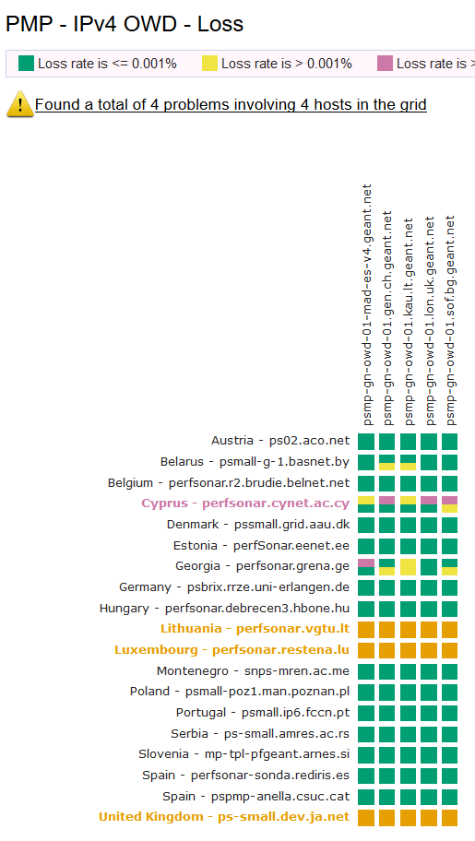
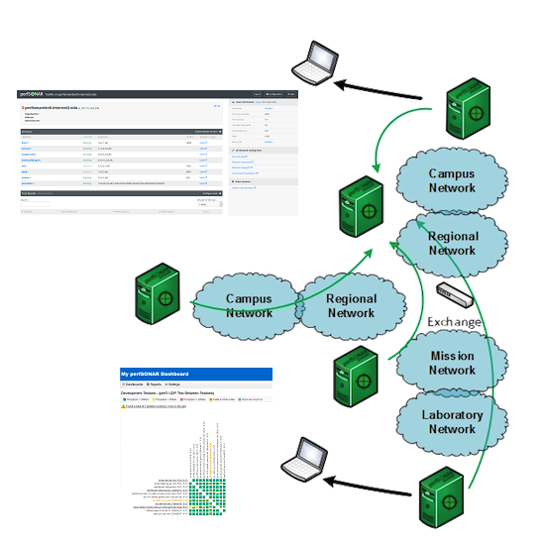
Get Involved!
www.perfsonar.net
http://pmp-central.geant.org/maddash-webui/

Slide 20
The scientific/academic work is financed from financial resources for science in the years 2019 - 2022 granted for the realization of the international project co-financed by Polish Ministry of Science and Higher Education.

