Slide 1
Open, Honest & Wonderful!
Brian Nisbet
HEAnet
@natural20
Notes:
- Good people of TNC, my name is Brian Nisbet and I am, as was mentioned, the Service Operations Manager in HEAnet, I also have opinions, many of them, so thank you for listening to one of them today...

Slide 2

Notes:
- I've spoken at events now and again, sometimes even at this one, and sometimes HEAnet even know what I'm going to say in advance...
- When we stand up to present, we generally want to make ourselves and our company look good, because who doesn't like to look good?
- Equally we want to show progress, we want to have finished products and fully configured monitoring and all of that jazz
- These are what I call the Facebook version of our projects, NRENs & lives. Everything is good, nothing is wrong, and unfortunately it reinforces the belief some people have that their work isn't good enough
- (There's a joke in here about being recorded and broadcast live is probably still more private than putting something on Facebook, but I'm not quite sure it works...)

Slide 3
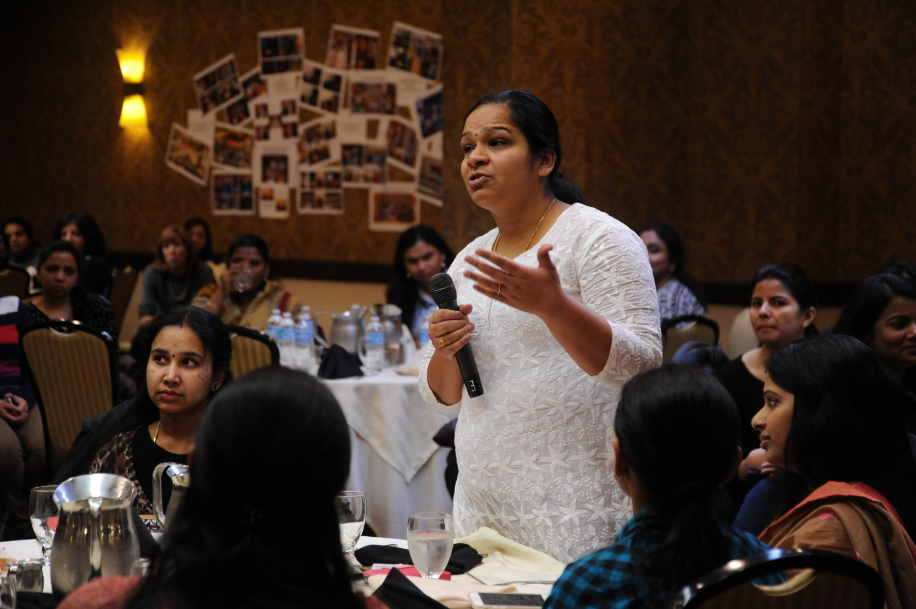
Notes:
- On top of all of that sometimes people look at practiced speakers and think "I could never do that, like that" or, even worse, "I could never represent my company well!"
- Would never force anyone to present in public, but like anything, training and practice makes it better. All of us had our first time, all of us are hopefully better now than we were then.
- But this isn't a talk about public speaking...

Slide 4

Notes:
- Also, we all want to represent our companies well, if only for the fame and power and money that presenting on behalf of an NREN gets you...

Slide 5

Notes:
- So I want to tell you that you shouldn't fall into that trap, that we should all be Open, Honest & Wonderful...

Slide 6

Notes:
- A brief example... Ubuntu upgrades are important, every 2 years there's a release that has 5 years of security updates, so every 2 years a bunch of servers will stop getting security updates. Planning your Ubuntu upgrades is important!
- In March we were upgrading our Anycast DNS resolvers, carefully.
- We had resilience, it was all going to be fine! 2 DCs, 2 servers in each DC
- We upgraded one server, it rebooted, it came back up and decided it was the king, but it's config was broken and it wasn't resolving queries
- It was not good, but we dealt with the immediate issue, or so we thought
- We upgraded another box 5 days later and guess what!
- So we've learned a lot about our DNS setup and Anycast, revised our setup and now we're a *lot* happier the resilience.
- We're also going to take any such servers *out* of the Anycast pool before upgrading them in future, the pop them back in when they're working!
- And this incident also gave us a great opportunity to revise our MI and RFO procedures, including the blame free post mortem and communication to the wider company

Slide 7

Notes:
- So perfect is boring. The best talks I've experience are the ones where the hurdles overcome and the lessons learned are the focus.
- What didn't work? Why did it take so long? Why did that server have to be shot into the heart of the sun to ensure nobody ever sees the code again?
- Like my example above!
- Absolutely everyone has issues and delays, makes mistakes, has to re-scope and redefine, that's normal!

Slide 8

Notes:
- I'm not suggesting that anyone stands up on stage and presents themselves and/or their NREN as bumbling fools, but neither should they have to try to say they are all perfect paragons of engineering
- If your company doesn't want you to talk about the things that went wrong, then I would really like to know why.
- Equally, if you're a manager who doesn't want your staff to speak honestly, I'd love to know why!
- Come find me and tell me, I promise I'll suitably anonymise in a future talk!

Slide 9
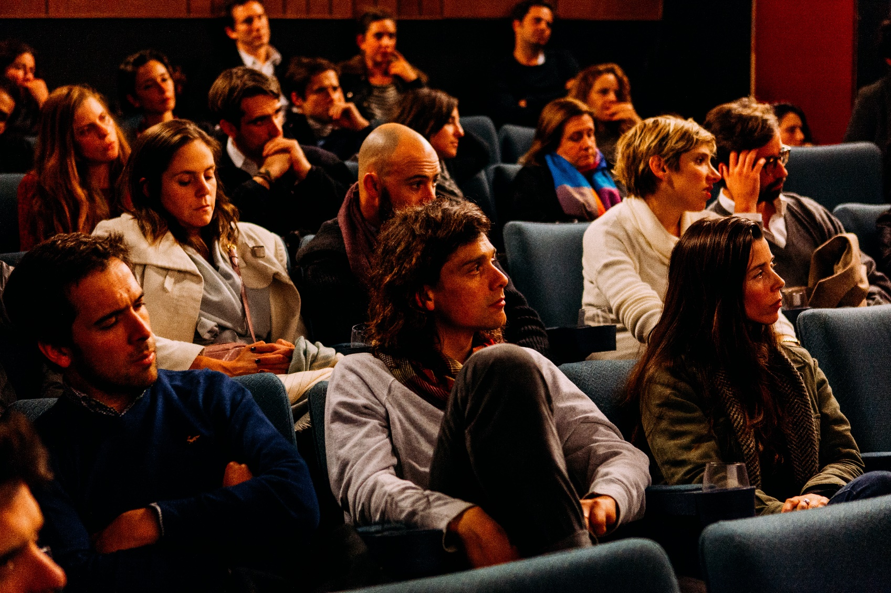
Notes:
- Importantly if we don't talk about what's wrong we're never going to fix the issues. If we always say something is going really well, then you get, at least, two major problems.
- First is that those who have the authority and/or budget to help will think there's nothing they need to do (and likely expect more)
- Secondly those who are affected (staff working on the project etc.) will get really annoyed. Really, really annoyed.
- What you definitely don't want is to have your manager sitting in the audience saying "Oh, it's all going great, yay, the team can do more" at the same time as your colleague is going "Have they not being paying attention, it's all on fire!"

Slide 10

Notes:
- So, if you wait to be perfect or near perfect a limited number of talks, of people striving to cover up the bad, and the community not getting the information and lessons it needs to improve and grown

Slide 11

Notes:
- If you don't, or rather if you don't try to present only the Facebook version of your talks, you have awesomeness, people sharing, encouraging others to not only get involved in things but to show that their projects are just as valid and interesting as everyone else's and the community getting to enjoy really valuable presentations!

