Slide 1
Is there a way to explain networking to ordinary people and still look clever?
Maja Vreča, ARNES

Slide 2
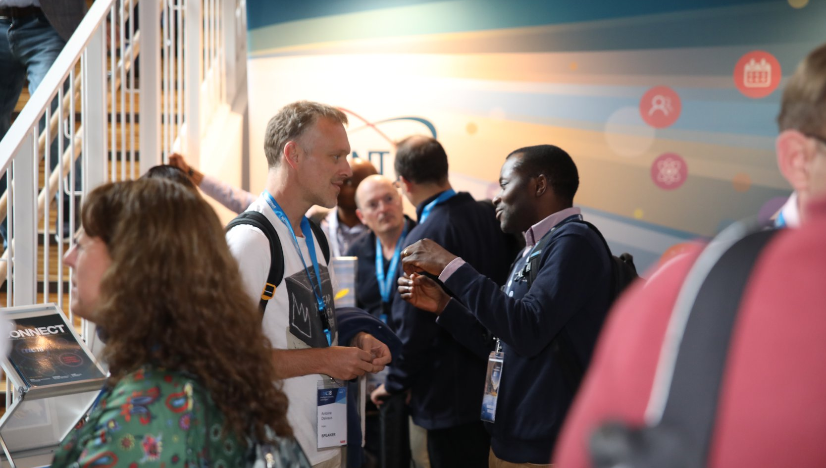
(CC) GÉANT
Notes:
Here at TNC you can see how happy everyone is because you can finally talk to people that actually understand what are you talking about. But why is it so?
Why do many technicians feel that they can be understood only by other technicians and why do they feel perplexed when asked to explain technical stuff to the “muggles”?
Is there a way one can feel better about that?

Slide 3
Why am I doing this ?
I want the other person to understand what I am doing.
I want to impress the listener with my technical expertise and make him or her believe that my work is something so techy no one can understand (but me and maybe a couple of other people like me).
Notes:
But first ask yourself: Why I am doing this?
If the answer is B, don’t bother to listen to this presentation. You can turn back to you laptop.
But, if the answer is A, you’ll maybe even hear something, that might be useful.

Slide 4
(CC) Flickr/Jonas Lonborg
Notes:
Kid and fibre optics anecdote.
We, the muggles are like that kid – we are so happy if we understand something that we see as highly technical, even if we understand it just partially.

Slide 5
How?

Slide 6
(CC)Flickr/CarolRossFlorida
Notes:
If I start to talk about the ants ...

Slide 7
(CC)Flickr/Brenda Dobbs
Notes:
... about fungi and mushrooms ...

Slide 8
(CC) Flickr/Brian Boucheron
Notes:
...about the soil...

Slide 9
(CC) Flickr/Simply Viola
Notes:
... the animals...

Slide 10
(CC) Flickr/Hunter Desportes
Notes:
... the microorganisms...

Slide 11
(CC) Flickr/Henry Burrows
Notes:
... the birds ...

Slide 12
(CC) Flickr/Matt
Notes:
...about the bumblebees...

Slide 13
(CC) Flickr/Kevin Krebs
Notes:
...the seeds...

Slide 14
(CC) Flick/Kent McFarjland
Notes:
...and about the dead leaves...

Slide 15
(CC) Flickr/Barbara Bober
Notes:
... you would probably struggle to find out that I‘m actually talking about this immensely complicated ecosystem we simply call „the forest“.
Each tree is important and the undergrowth is important, the soil is important. Fungi and microorganisms are crucial for the existence of the forest.
Details are very important, but without the big picture one gets lost.

Slide 16
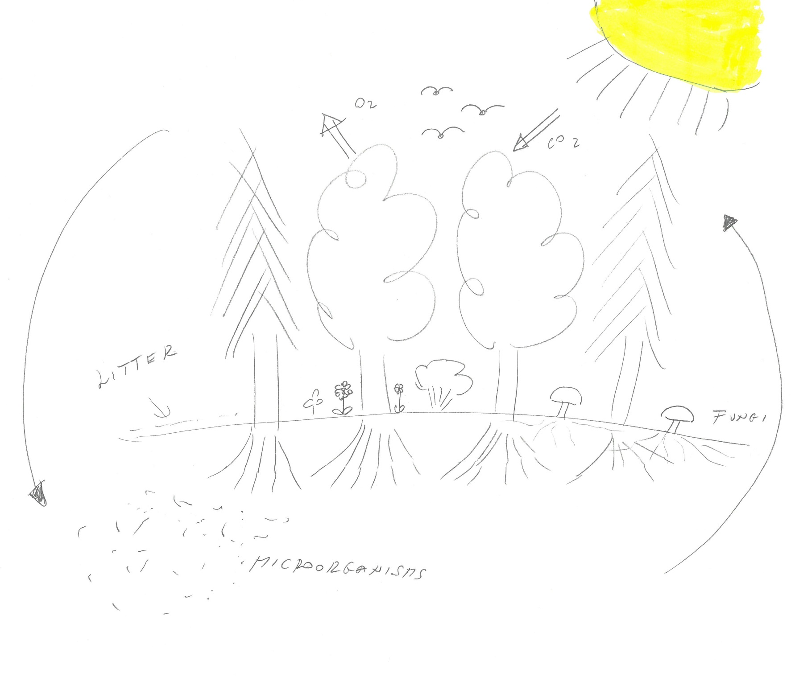
Make it simple
Make it visual if possible
Notes:
Make it simple. Don t go into to many details, even if you think they are very important. Use just the ones that are really crucial for understanding what you are talking about.
And of course use simple words when possible.
Make it graphical and visual if possible.
You don t need to be good at drawings – almost anything will do. Like this, or this.

Slide 17
(CC) Flickr/Hunter Desportes
Notes:
Try to move to the different scale gradually.

Slide 18
(CC) Flickr/Barbara Bober
Notes:
Don’t jump from “microorganisms” to the whole forest ...

Slide 19
(CC) Flickr/Matt
Notes:
... to the pollinators ...

Slide 20
(CC) Flickr/Hunter Desportes
Notes:
... and the back again.

Slide 21
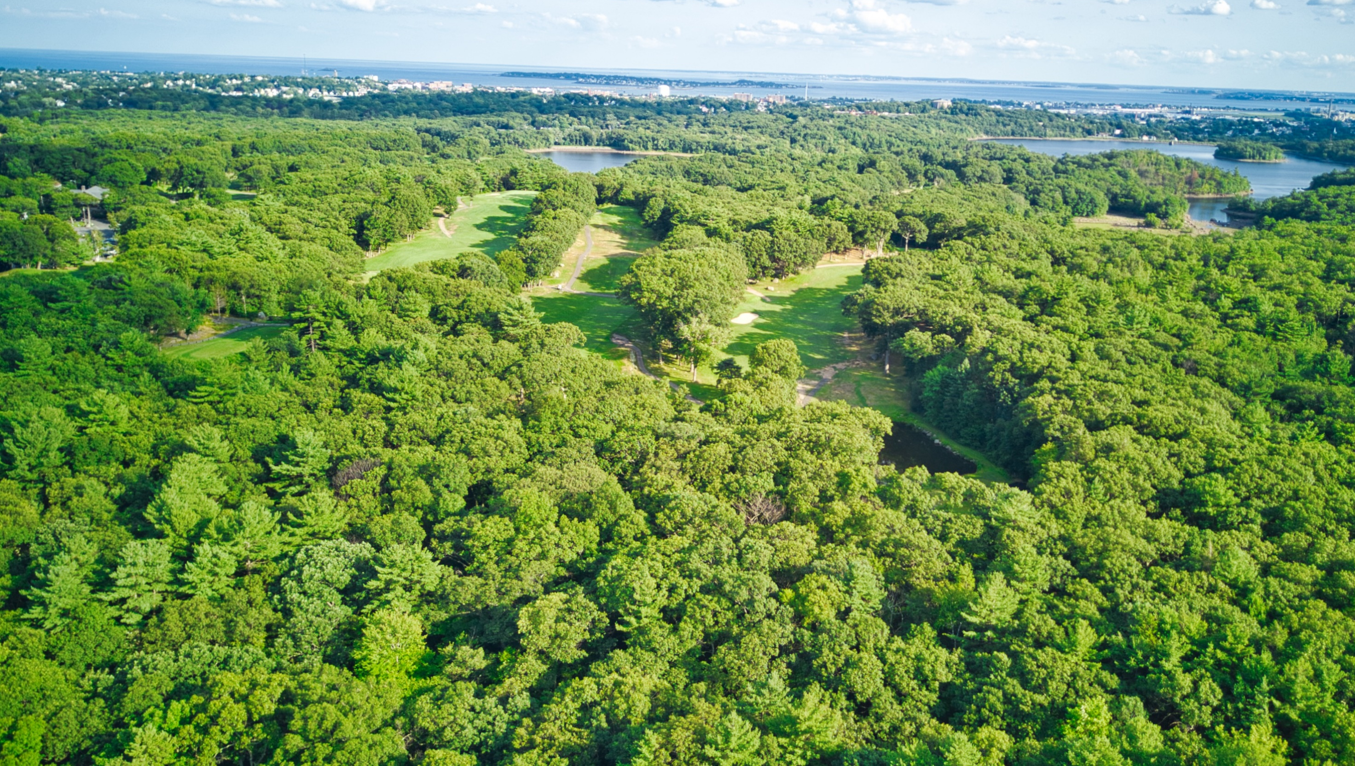
(CC) Flickr/Nick McMahon
Notes:
Use analogies – like „the green lungs of the planet“ ...

Slide 22
(CC) Flickr/Randolf Rautenberg
Notes:
... or „the information highway“ - even if you hate it. It makes it much easier for the listener to understand a new concept.

Slide 23
?
Notes:
Ask questions in between your explanations to check whether your listener is still with you.

Slide 24
„Any intelligent fool can make things bigger and more complex… It takes a touch of genius – and a lot of courage to move in the opposite direction.“
Albert Einstein
Notes:
And yes – in the eyes of the muggle you will look clever, maybe even a proper genius, like Albert Einstein said.

Slide 25
Fill in the geekiest word you can find in your field of work.
Well, this is all of course way to simplified. If you want to understand the issue better, I can explain you more about ...
Notes:
But if you want to stay on the safe side, at the end you can always add ....

Slide 26
Don’t be afraid of us – the muggles.
We are mostly harmless.
Notes:
Non-geeks are curious about the geeky stuff, but often don’t dare to ask because of the fear of not understanding of the answer - so by being able to explain things, you do look very clever in our eyes.
And don’t be afraid of us - the muggles- we are mostly harmless.

