Slide 1
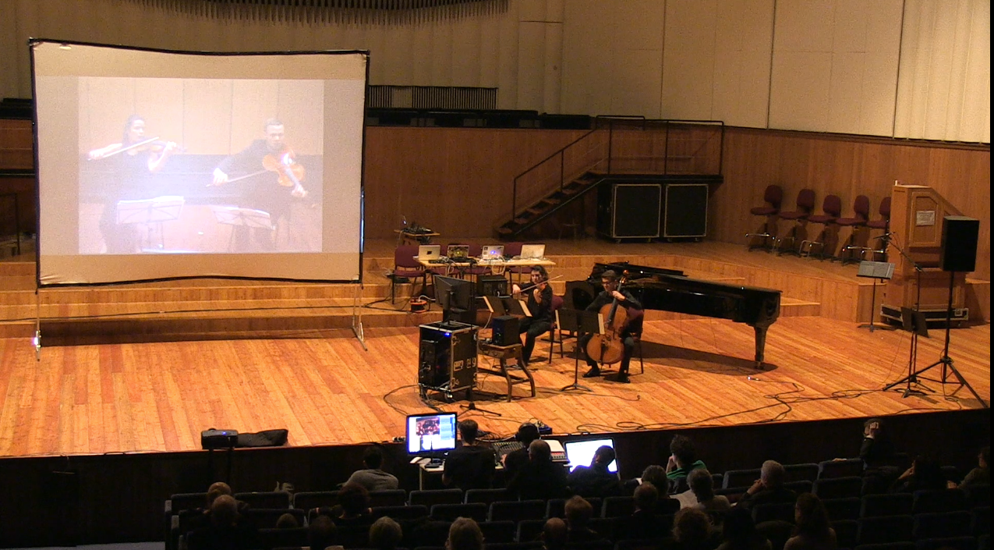
Content interaction powered distance learning
Enrico Pietrocola TNC19
Notes:
Think about being in the audience of this concert, you see two musicians on the stage and two other musicians projected on a screen. They play together some pieces from Beethoven and Shostakovic and everything sounds almost as the quartet were right there, even though you know that the two projected on the screen, are actually more than 1000 km away from the hall you’re sitting in.
ADD LOGO from consmi and garr

Slide 2
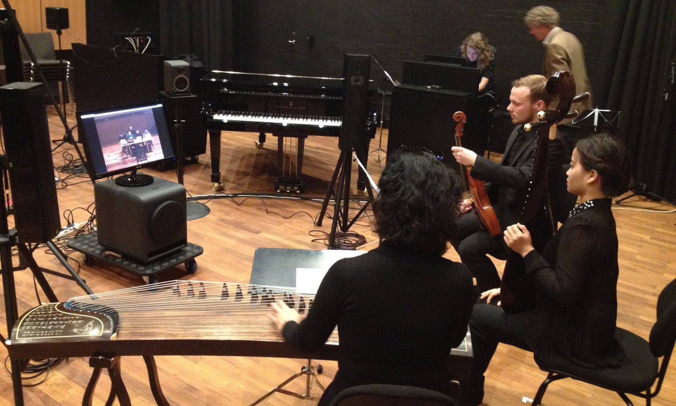
Notes:
This is a Networked Music Performance, featuring two couples of musicians forming a string quartet and playing music realtime.
Networked music performance is something that has been growing in the last years. Technology allows us to adopt highly performing hardware and software in our homes and institutions enabling us to play music almost seamlessly with people far away from us.
Of course, this is only the tip of the iceberg, these systems are used to learn as well, we have something called Distance Learning, in particular Music Distance Learning.
In music distance learning we try to recreate the environment of a traditional music lesson, we have a teacher in front of us, and we can hear him/her play and talk to us about his/hers favourite Beatles song.

Slide 3
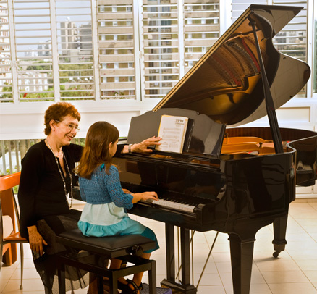
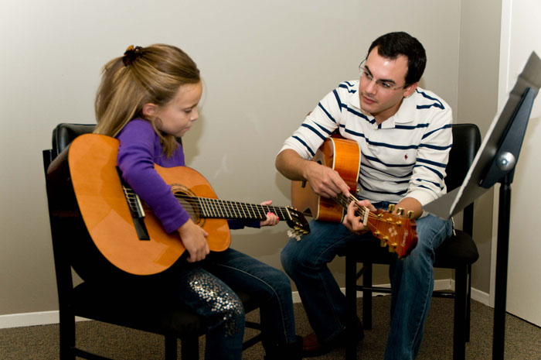
Traditional music lesson
Notes:
There is in fact a difference between traditional music lessons and the distance learning ones: you know, usually a system for videoconference is basically made by a camera focusing on the performer’s body and instrument, and a monitor, showing the other performer’s body and instrument.
You probably already figured out from the image on my back that a musician pointing on a score in front him in a videoconference environment will virtually point to nothing on the other side. In fact, there is no score sharing (slowly) usually.

Slide 4
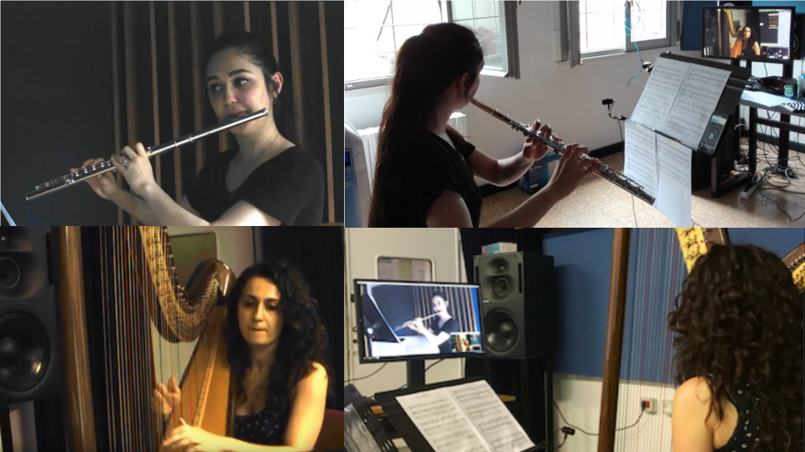
Notes:
Let’s take another example, this flute player is Summer

Slide 5
Notes:
she had to tape her sheet music on the stand during this tests in distance learning in order to visualize properly her part while playing on a distance. From these kind of experiences I had the idea to digitally support the score, connecting the PDF document and the interactions between users through a realtime cooperative interaction application.

Slide 6
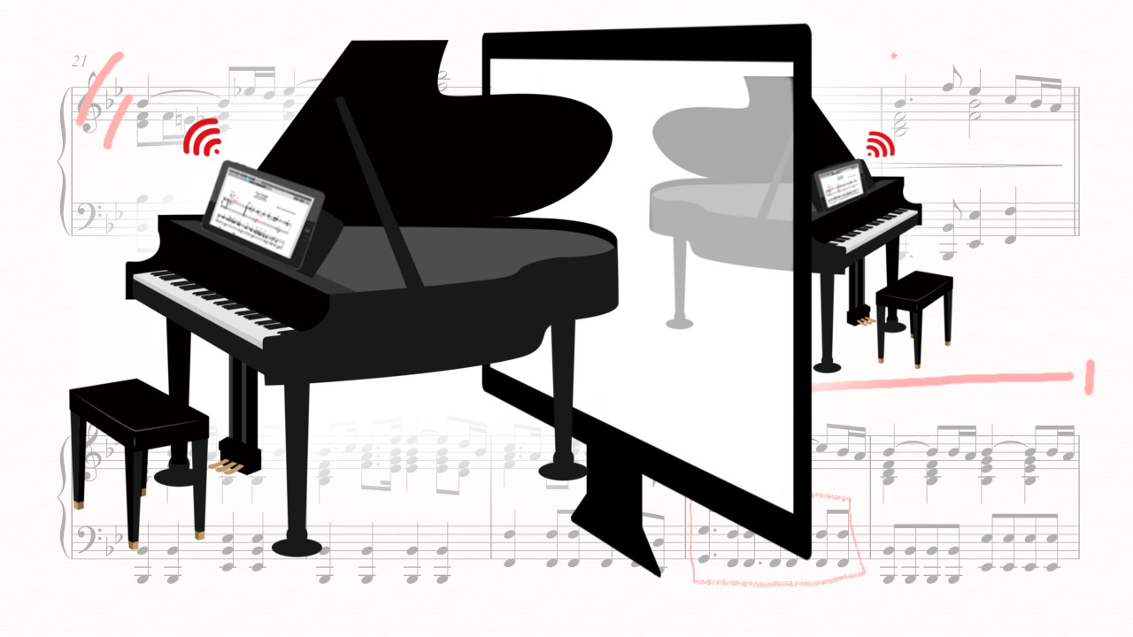
Notes:
The tablet placed in front of you during the distance learning experience represents the document you are reading together with the other user or performer on the other side.
You can write and exchange notes, I can turn page to show you how the piece proceeds, you can “ping”, point with something similar to a laser pointer to show your teacher that bar that is so difficult to play.

Slide 7
Notes:
The name for this application is Cid Reader, the first version will be for Android, but other versions are planned, it will be free and open source. Everything is developed with performance and ease of use in mind.

Slide 8
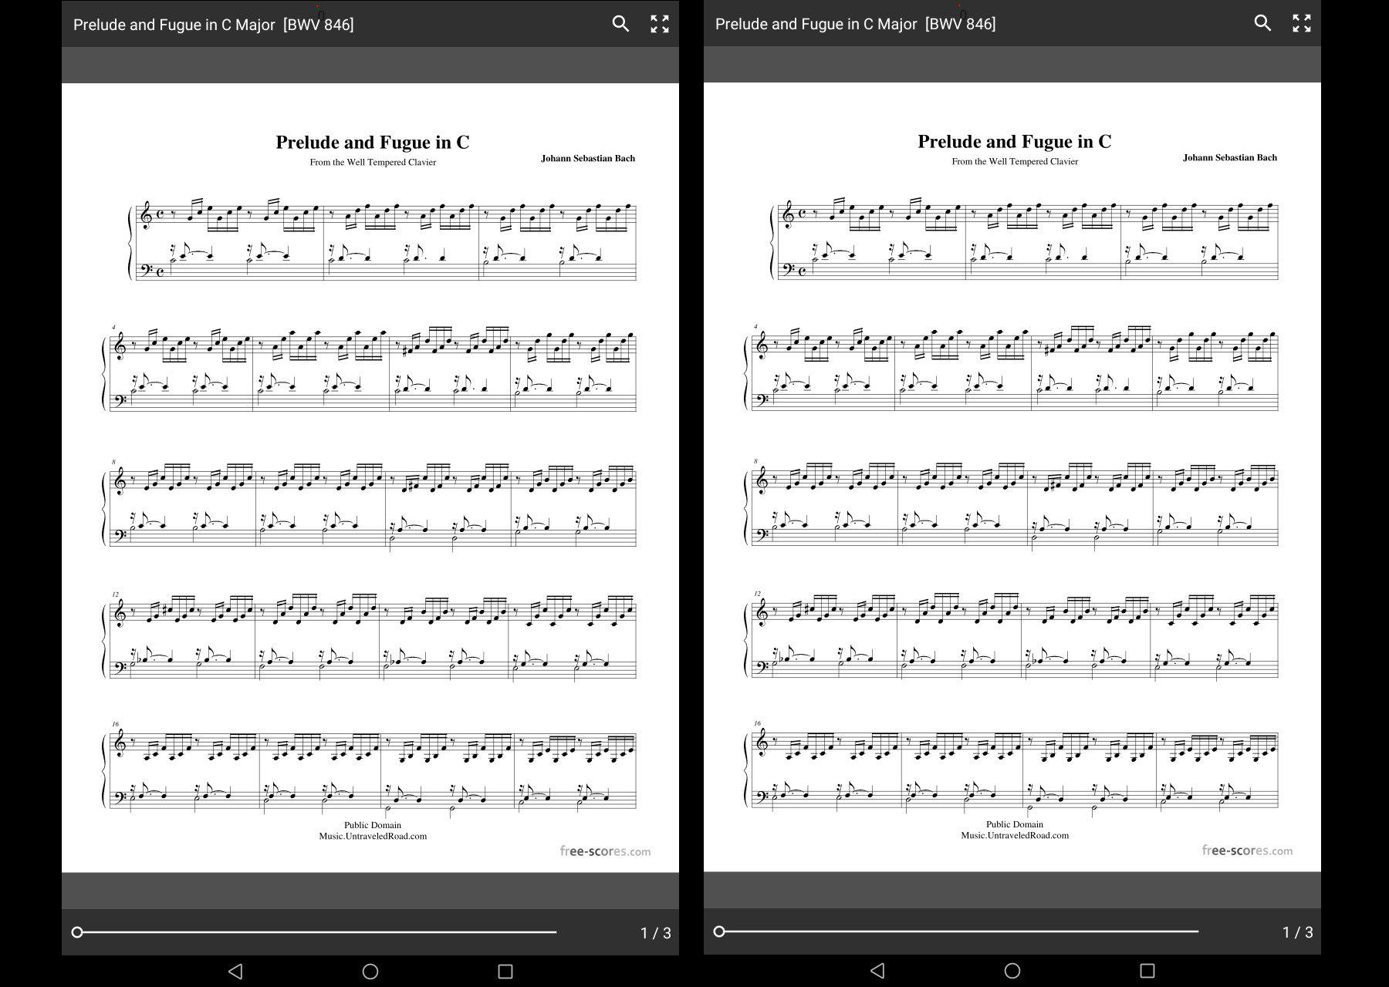

Slide 9
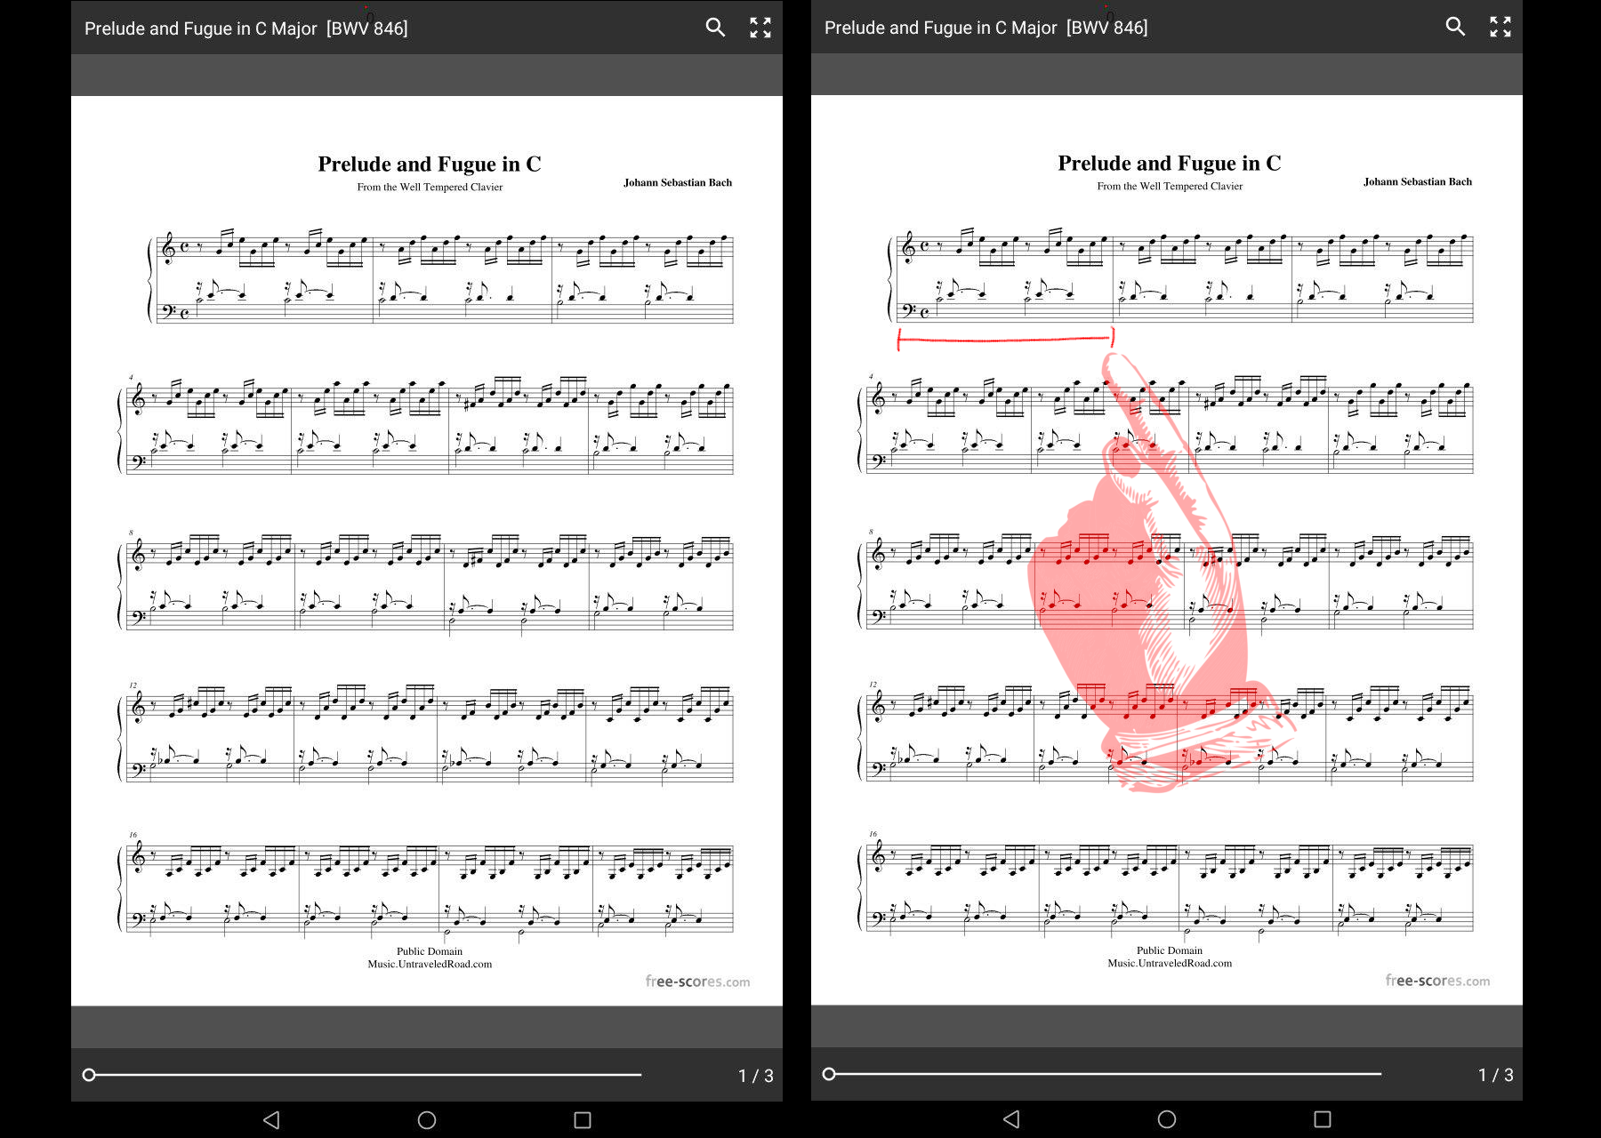

Slide 11
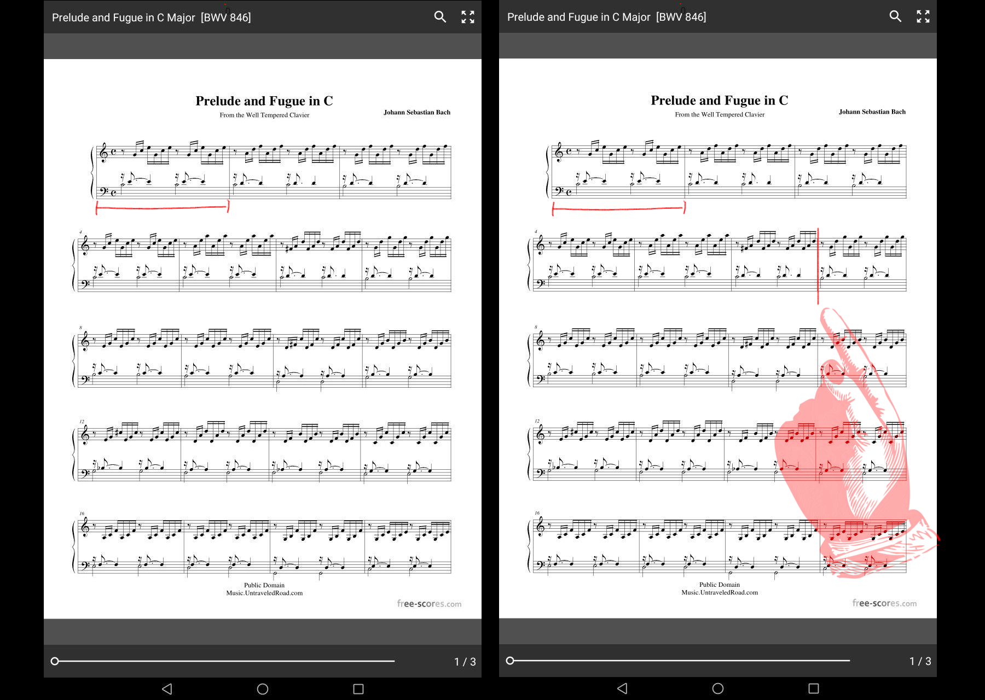

Slide 13
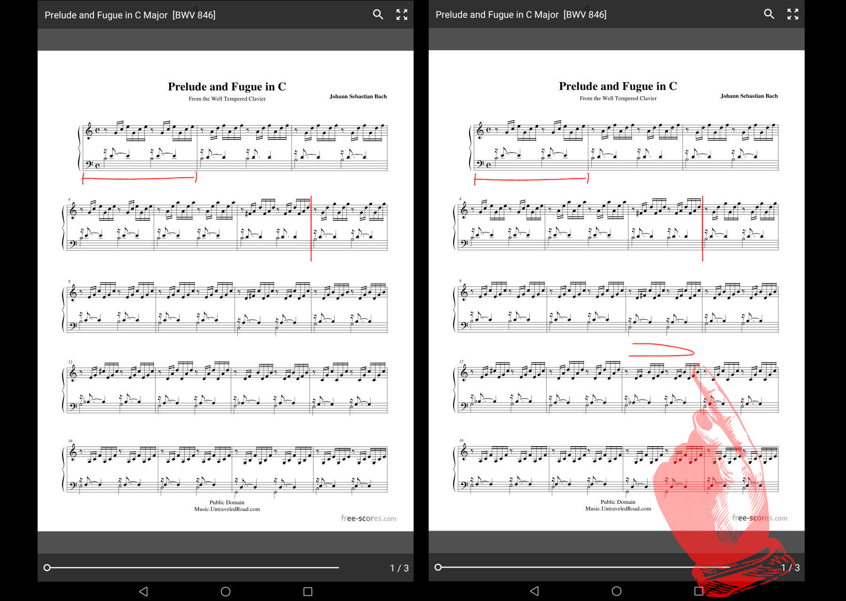

Slide 14
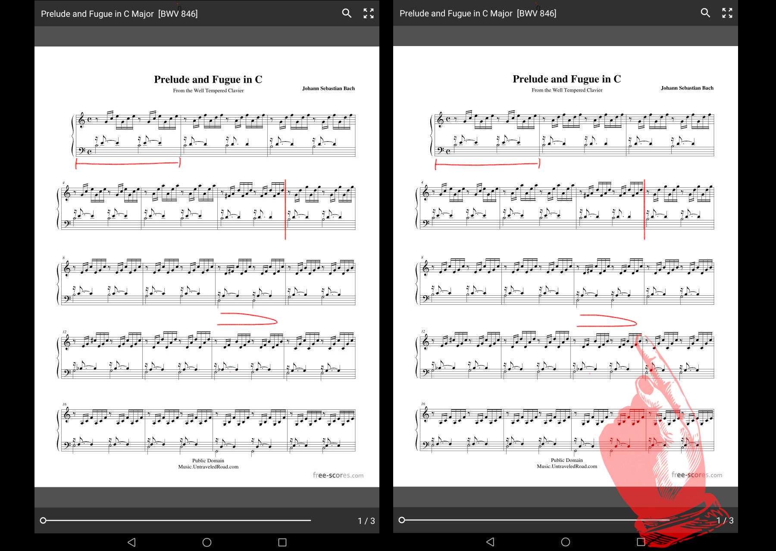

Slide 15
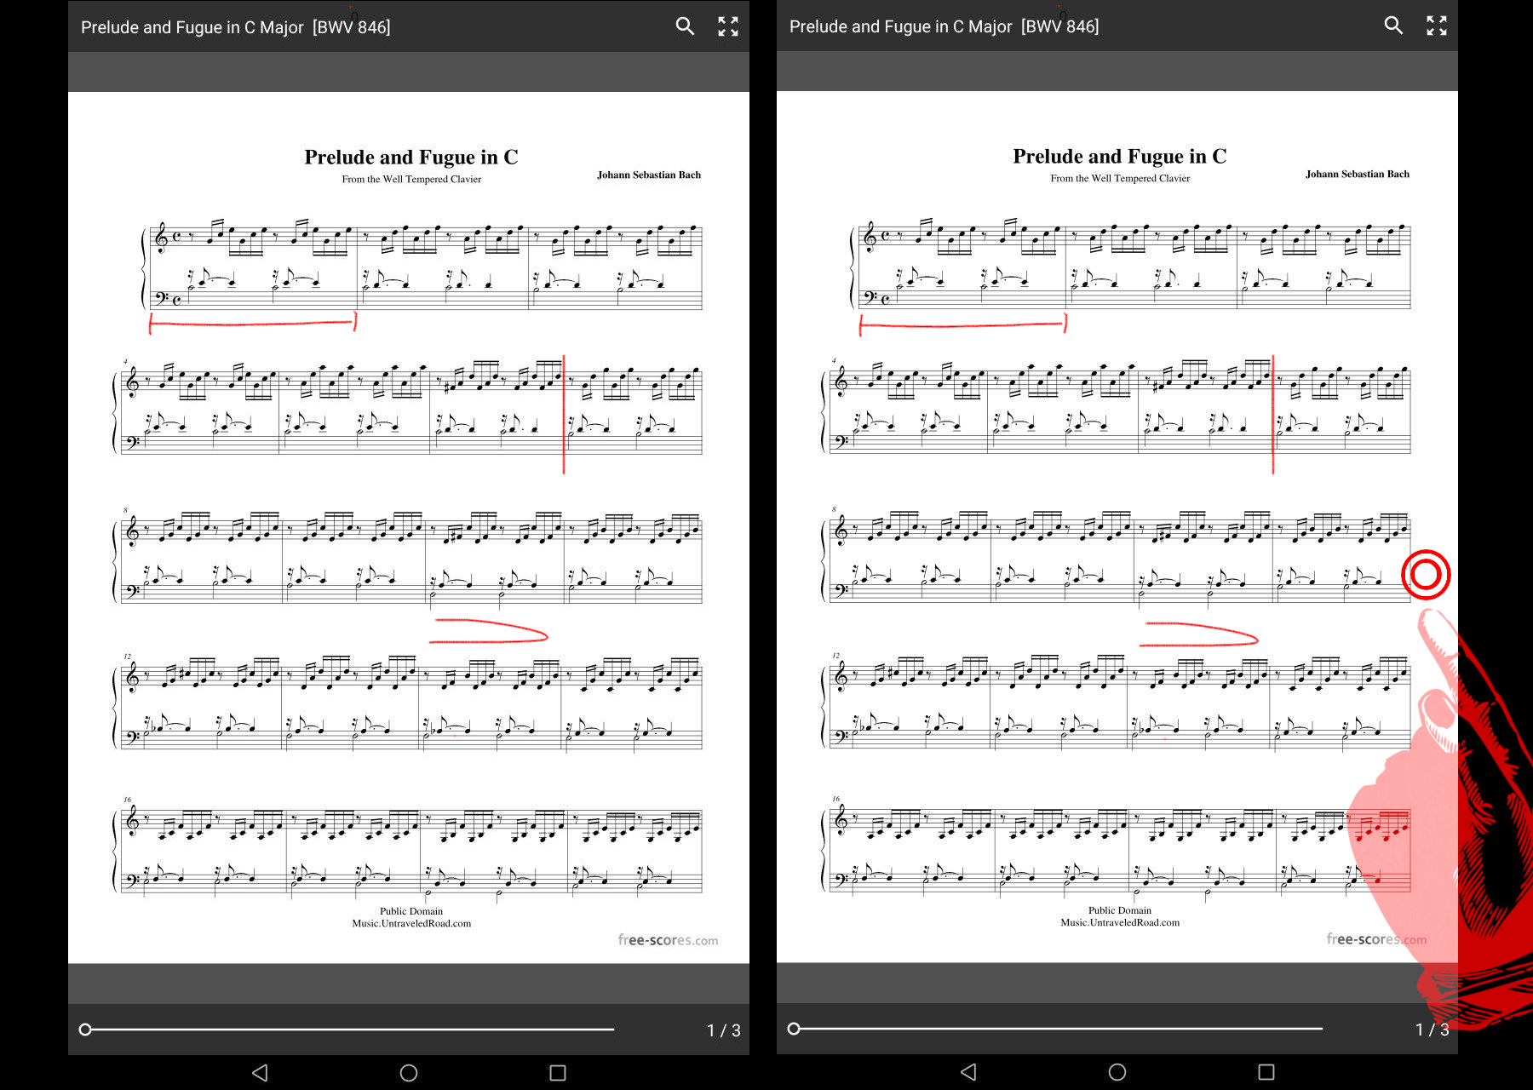

Slide 16
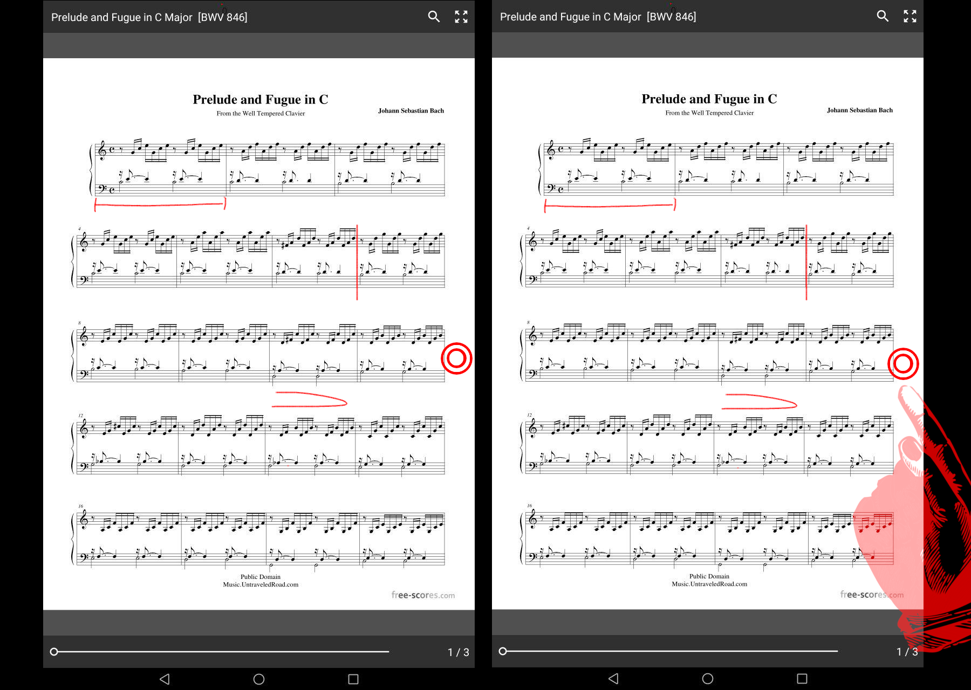

Slide 17
enricopietrocola@gmail.com
enricopietrocola.com/cidreader
Notes:
These are my contacts, might you be interested in the project or in involving your institution with this project please don’t hesitate to contact me, a page with everything about Cid Reader is available on my website and I am always looking for feedback and possible collaborations.
Thanks for the attention

